Slide 1
When matter waves become visible from superfluidity to supersolidity
Sébastien Balibar
Laboratoire de Physique Statistique de l ’ENS (Paris)
see: « The discovery of superfluidity » J. Low Temp. Phys. 146, 441 (2007)
« The enigma of supersolidity » Nature 464, 176 (2010)
“Giant Plasticity of a Quantum Crystal” Phys. Rev. Lett. 110, 035301 (2013).
Umezawa Public Lecture,
Edmonton, 12 Feb. 2013

Slide 2
Outline
- Some liquids flow more easily than others
- They are called « superfluids »
- Video sequences show their astonishing properties
- the discovery of superfluidity - history – Great scientists compete at the beginning of World War II
- quantum mechanics at the macroscopic scale of the visible world
- superfluidity, superconductivity …
- … and perhaps supersolidity? probably not yet discovered

Slide 3
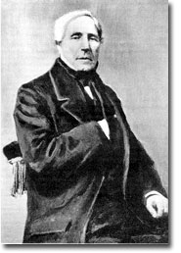
the flow of an ordinary liquid
reservoir
height
difference
h
Jean-Louis Marie Poiseuille
French engineer born in 1797,
became a medical doctor,
studied the flow of blood and
established the classical laws for
“laminar flow”
tube
flow
velocity
V
the flow velocity V is proportional to
the height difference h, that is the pressure applied to the liquid
the cross section of the tube
the inverse of the viscosity

Slide 4
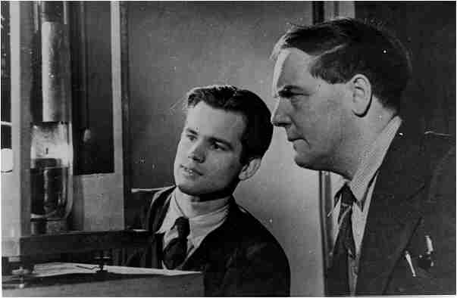
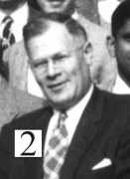
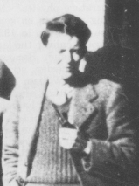
Décember 1937: 2 simultaneous discoveries
below 2.2 Kelvin (2.2K = -271 °C), that is near the absolute zero (0 Kelvin = -273.15 °C) where the thermal agitation stops in matter,
2 different research groups study the flow of liquid helium
Piotr Kapitza (Moscow): below 2.2 K
very fast flow through a slit only
0.5 micrometers thick, between 2 polished disks
he calls liquid helium « superfluid » below 2.2 K
Jack Allen et Don Misener (Cambridge, UK) : along thin capillaries and below 2.2K,
the flow is independent of the applied pressure, even of the diameter of the capillary
(from 10 μm to 1 mm)

Slide 5
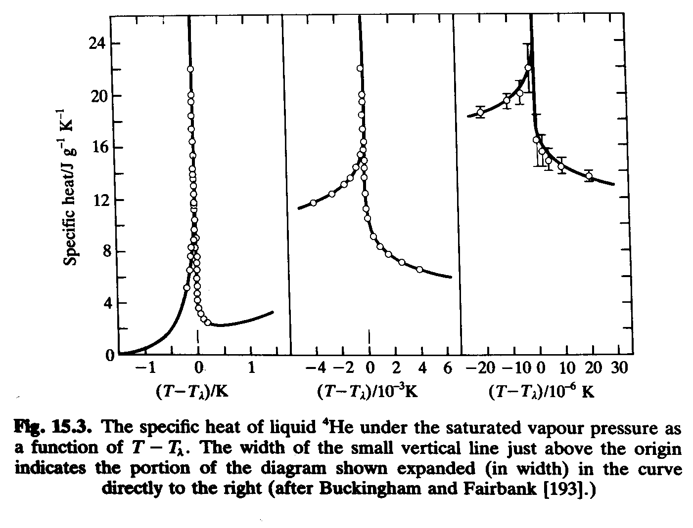
prehistory of the discovery of superfluidity
1927 – 1937
Several steps :
1927-32: W.H. Keesom, M. Wolfke and K. Clusius (Leiden):
liquid He has two different states which they call « helium I » above 2.2K and « helium II » below 2.2K. A singularity in the specific heat at 2.2 K (the « lambda point »)
1930: W.H. Keesom and J.N. van der Ende (Leiden): liquid He II flows very easily through narrow slits (superleaks)
1932: McLennan et al. (Toronto): liquid He stops boiling below 2.2K
B.V. Rollin (Oxford, 1935), W.H. Keesom and A. Keesom (Leiden, 1936)
J.F. Allen R. Peierls and M.Z. Uddin (Cambridge, 1937) :
helium II is a very good thermal conductor

Slide 6
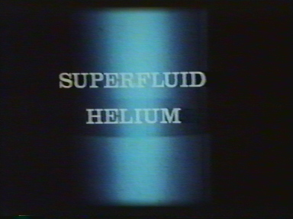
the film by J.F. Allen and J. Armitage
(St Andrews, Scotland, 1972 - 82)

Slide 7
a very fluid liquid
Wilhelm, Misener, et Clark (Toronto 1935): helium II is much less viscous than helium I (using a “torsional oscillator”).
Rollin (Oxford 1936): in a beaker, liquid helium II goes up along the sides, around the top rim and escapes spontaneously !
Near the end of 1937 in Moscow as in Cambridge: could the large thermal conductivity be due to some kind of convection because the viscosity is small ?
It was known that helium II flows easily through tiny pores

Slide 8
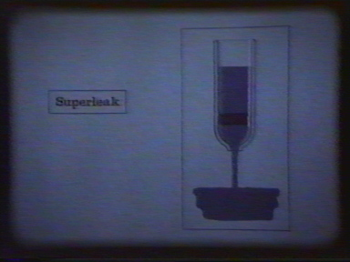
the flow of a superfluid

Slide 9
two articles side by side
Nature n°141 (January 1938), page 74 (received December 3, 1937) :
P. Kapitza, « viscosity of liquid helium below the lambda point »
and page 75 (received December 22. 1937) :
JF Allen et A.D. Misener: « Flow of liquid helium II »
But who found first ? Piotr Kapitza ?
Allen et Misener cite their competitor Kapitza:
« A survey of the various properties of liquid helium II has prompted us to investigate its viscosity more carefully. One of us had previously deduced au upper limit of 10⁻⁵ cgs units for the viscosity of helium II by measuring the damping of an oscillating cyclinder. We had reached the same conclusion as Kapitza in the letter above ; namely that, due to the high Reynolds number involved, the measurements probably represent non-laminar flow ».
19 days later: did they simply reproduce the work of Kapitza ?
Kapitza received the Nobel prize in 1978 (not Allen nor Misener)
Kapitza invented the word « superfluid » to qualify heliumII, this strange liquid:
« by analogy with superconductors, the helium below the lambda-point enters a special state which might be called superfluid »

Slide 10
Piotr Kapitza, an outstanding physicist
born in 1894
1918: doctorate in electrical engineering St Petersburg
1921: joins Rutherford in Cambridge (UK), father of
nuclear physics Nobel prize 1908.
1929: Fellow of the Royal Society
1934: builds a helium liquefier which produces its first drops of liquid on April 19th. But retained in USSR by Stalin on Sept. 24th during Mendeleiev’s 100th anniversary
1934-37: obtains from Stalin that an Institute is built for his research, from Rutherford that buys his equipment (except the liquefier…) . He builds a new liquefier which starts producing liquid helium on February 22nd, 1937.
December 5th, 1937: letter to Nature: “I am sending herewith a short note…, which I hope you will kindly publish... I think this is an important note and I should be glad if you could arrange it to be published as soon as possible, and with the day of dispatch. Please …send the proofs either to Prof. P.A.M. Dirac, Dr. J.D. Cockcroft, or to Dr. W.L. Webster ... I hope you will kindly help me in publishing this note very soon ... »
1946: refuses to work on the Soviet atomic bomb under the authority of Beria
1953 : Stalin dies and Beria is executed
1978: Nobel prize in Physics (40 years after the discovery)

Slide 11
Allen and Misener: two Canadian immigrants in Cambridge
Jack Allen, born in 1908 in Winnipeg, doctorate in 1933 in Toronto,
- 1935: hired by Rutherford in Cambridge to replace Kapitza,
- worked there thanks to the liquefier built by Kapitza
- had attracted a young Canadian student, Don Misener in 1937
the work by Allen et Misener was independent of the work by Kapitza
(except for the liquid helium supply):
- they had been working on this subject since 6 months at least
- series of measuremnts using several capillaries with different sizes
- a proof in their notebook (November 1937 )
John Cockcroft, Director of their laboratory, had asked them to write down their article, and asked Nature to publish the 2 letters side by side.
Was Kapitza’s work also independent ?

Slide 12
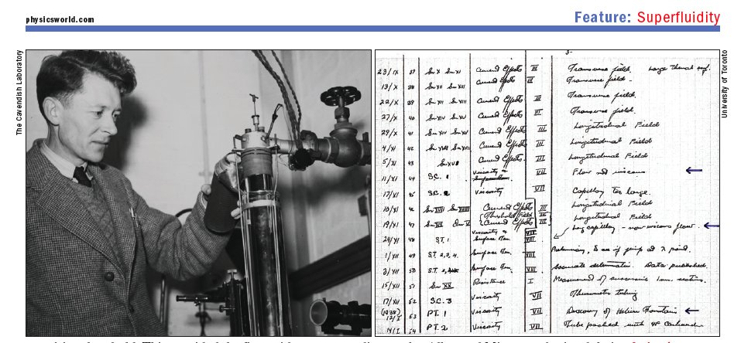
J.F. Allen

Slide 13
Any contacts between Moscow and Cambridge ?
David Schoenberg 22 Jan 2001: no contacts
  at that time it would have been too dangerous to communicate
But letters from Kapitza show the opposite: regular contacts
Rutherford to Kapitza on October 9th 1937: mentions the « interesting work on helium in Cambridge » and dies on October 21st
Kapitza to Cockcroft on Nov. 1st : « It is difficult to believe that there is no more Rutherford…Things in the lab are not going badly at all. We just started the new liquefier and the first time it gave four liters per hour… »
Webster had visited Moscow in September
On Dec. 10th, Kapitza writes to Niels Bohr: « I had your letter about the death of Rutherford…May be you remember what I was telling you during your visit here [ in June 1937]… the results are quite interesting…I am sending herewith a copy of my preliminary note to Nature… »

Slide 14
Indépendent, but not equivalent
Kapitza:
From the measurements we can conclude that the viscosity of helium II is at least 1500 times smaller than that of helium I at normal pressure… The flow must have been turbulent… »
Allen-Misener:
« the observed type of flow in which the velocity becomes almost independent of pressure, most certainly cannot be treated as laminar or even as ordinary turbulent flow. Consequently any known formula cannot, from our data, give a value of the viscosity which would have much meaning »
At that particular time, the most remarkable work was done by the Canadians in Cambridge.
Why is it that Kapitza received his Nobel prize only 40 years later?
How came the idea that superfluidity is ananologous to superconductivity? From discussions with Lev Landau, the genius of Soviet Physics at that time?

Slide 15
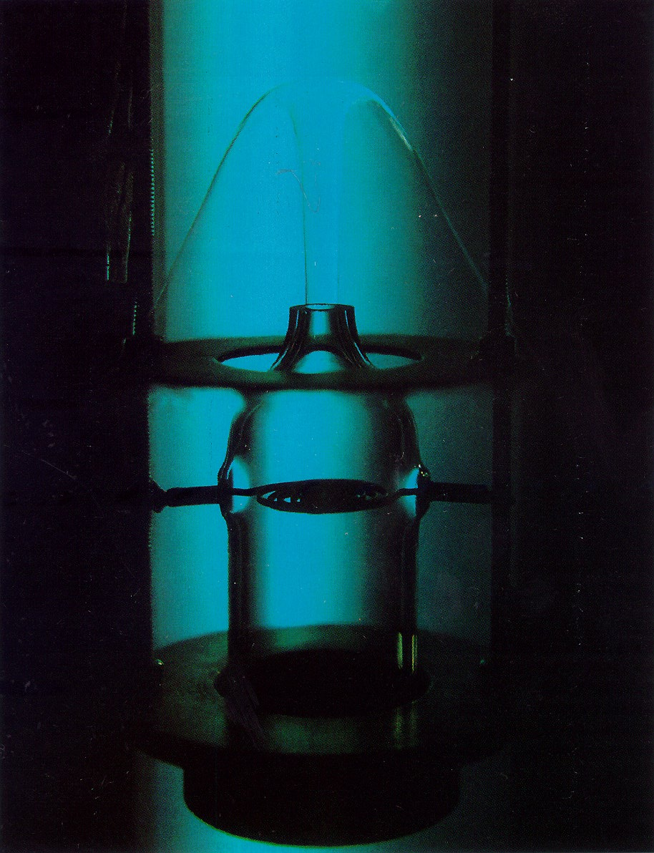
February 5th, 1938 : the fountain effect
J.F. Allen and H. Jones, discover
non-classical thermal properties
which they publish in Nature 141, 243, 1938
When heat is supplied on one side of a porous plug, the pressure of superfluid He increases so much that it produces a liquid jet
In a classical fluid, the liquid level should decrease

Slide 16
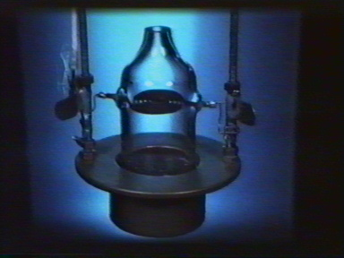
the fountain effect

Slide 17
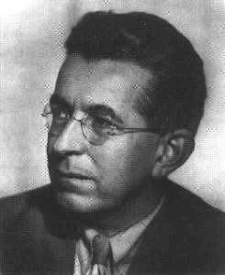
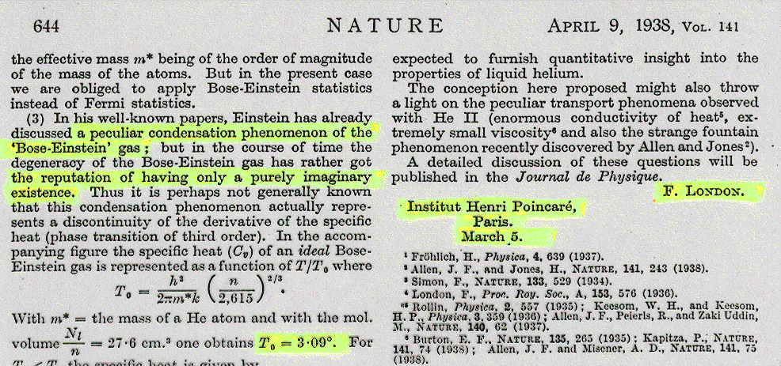
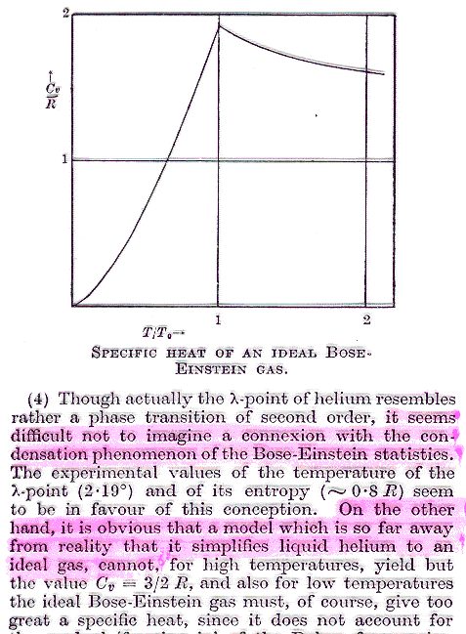
Fritz London, 5 March 1938, Institut Henri Poincaré :
London’s historical breakthrough
« it seems difficult not to imagine a connexion with the condensation phenomenon of the Bose-Einstein statistics... On the other hand, it is obvious that a model which is so far away from reality that it simplifies liquid helium to an ideal gas cannot... » was a rough approximation which could not give quantitative agreement with experimental measurements.

Slide 18
The « Bose-Einstein condensation »
In 1924, Einstein extends work by a young Bengali physicist, Satyendra Nath Bose:
The accumulation of indistinguishable atoms in the same quantum state leads to the formation of a macroscopic matter wave
unrealistic? « the theory is pretty but is there anything true in it? »
early days of the theory of phase transitions
1937 : 100th anniversary of van der Waals
Ehrenfest, Einstein and Kramers discuss the « Bose-Einstein condensation » in front of London

Slide 19
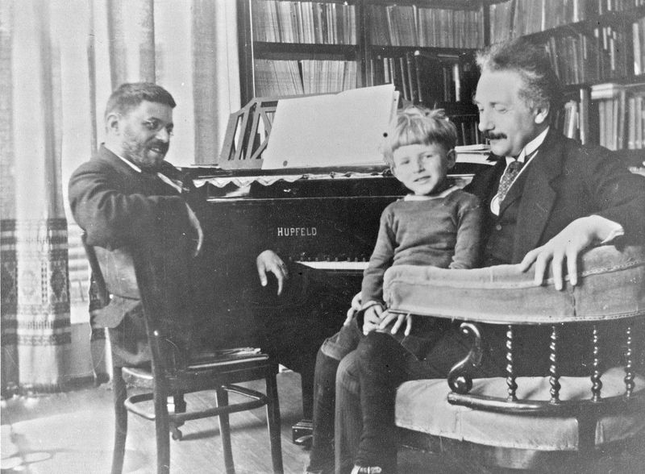
Einstein
Ehrenfest

Slide 20
Fritz London
1900 : birth in Breslau (today Wroclaw in Poland)
1921: Doctorate in Munich
1927: understands the binding of the H2 molecule with Walter Heitler
1933: joins Schroedinger in Berlin
and soon escapes from the Nazi Germany towards England
1936: London and his wife Edith are attracted in Paris by Paul Langevin, Jean Perrin, Frédéric Joliot-Curie and Edmond Bauer, a group of lelft wing intellectuals linked to the « Front Populaire »,
London starts working at the Institut Henri Poincaré
March 1938: proposes that BEC could explain the superfluidity of liquid helium where quantum fluctuations are large.
1939 (september!): escapes from France to Duke University (USA)
1954: dies of a heart attack

Slide 21
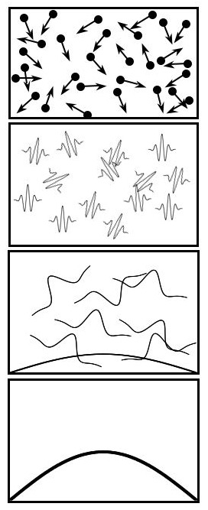
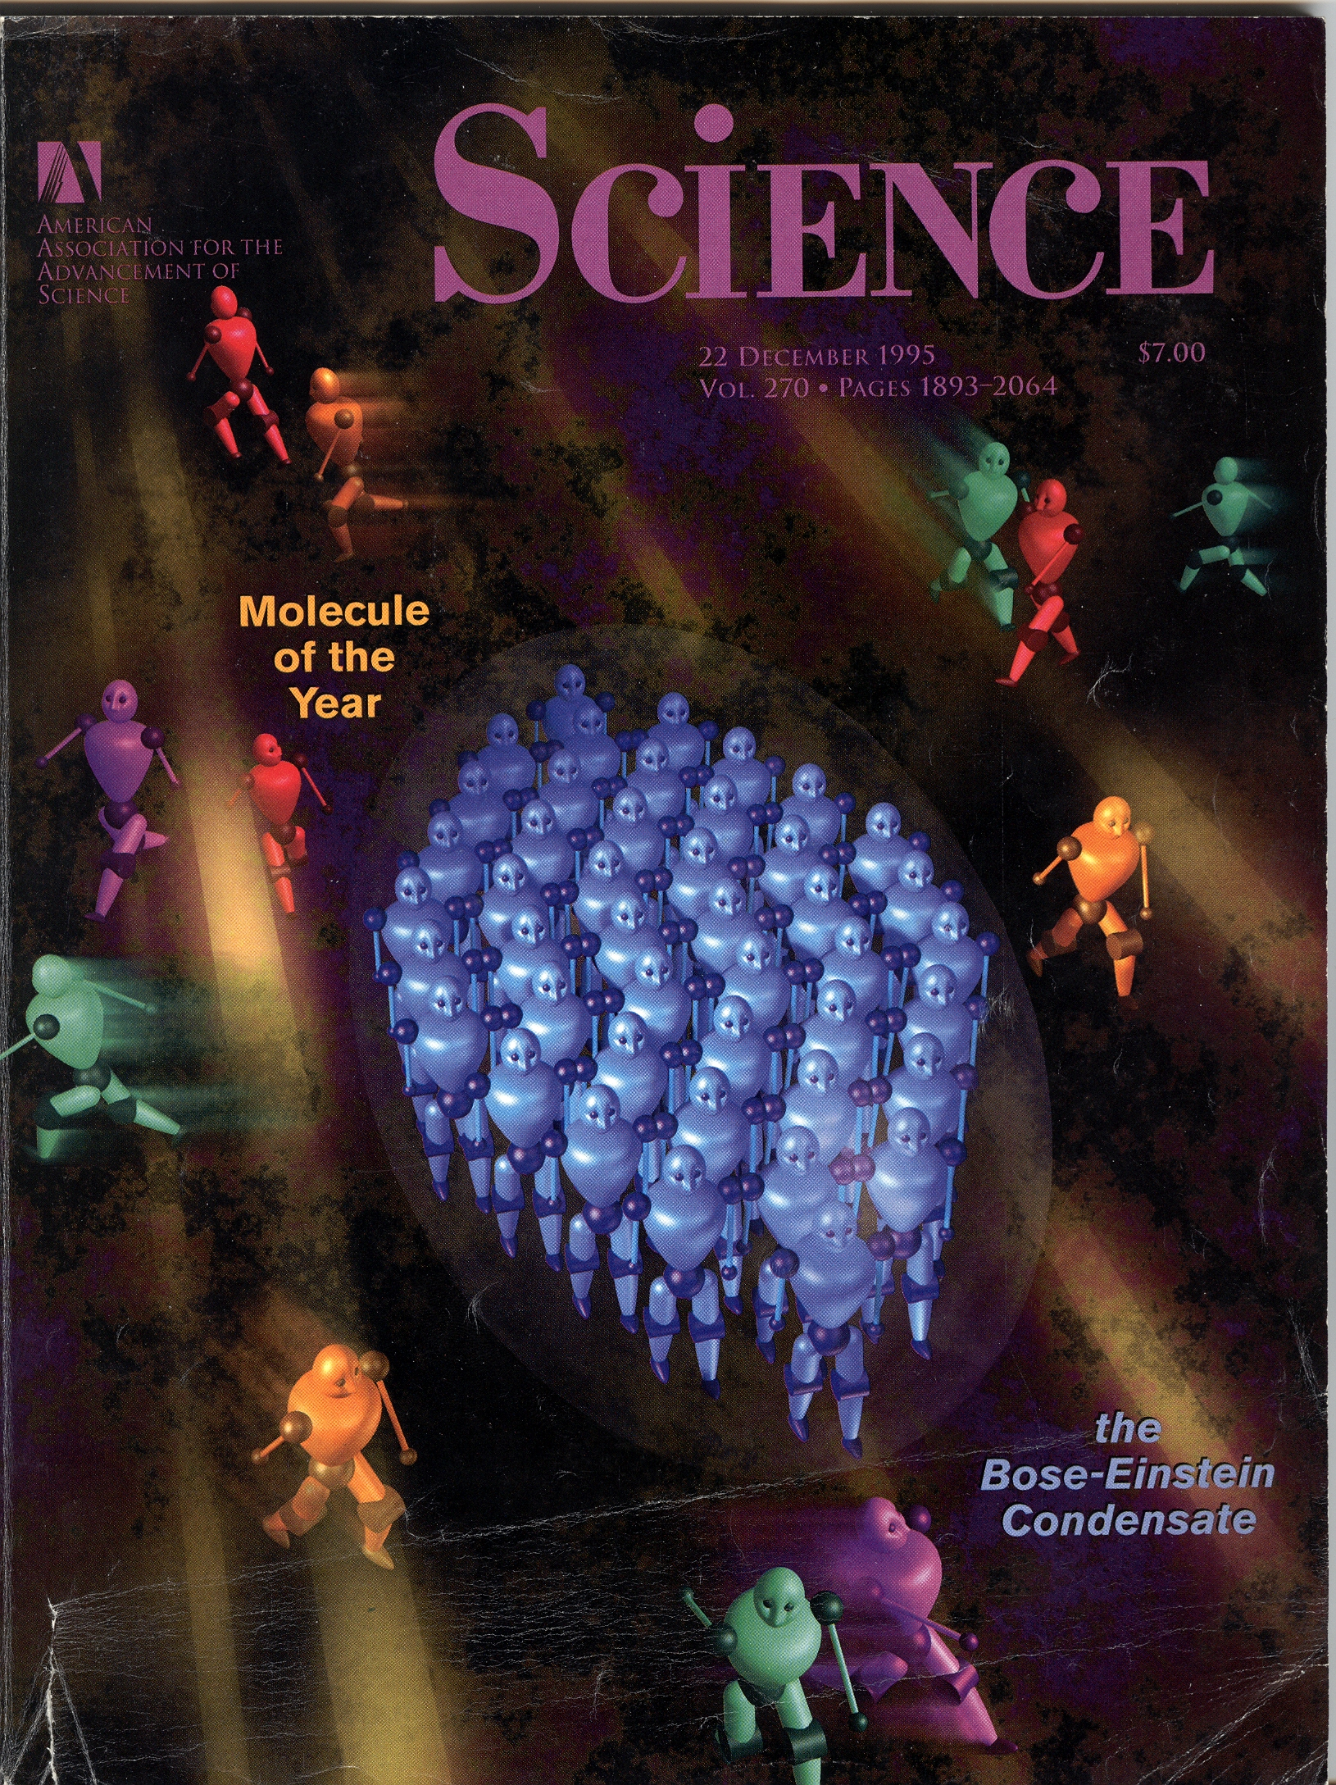
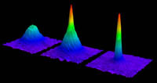
visible matter waves: Quantum mechanics jumps to the macroscopic scale
high temperature
In March 1938,
London proposed that
« Bose-Einstein condensation »
was actually at work in superfluid helium.
Experimental evidence in 1995 thanks to the work of Cornell, Wieman (Boulder) and Ketterle (MIT), Nobel prizes in 2001
superfluidity in cold atomic vapors
a laser is a coherent ensemble of photons
a Bose-Einstein condensate is a coherent ensemble of atoms
(or molecules)
low temperature

Slide 22
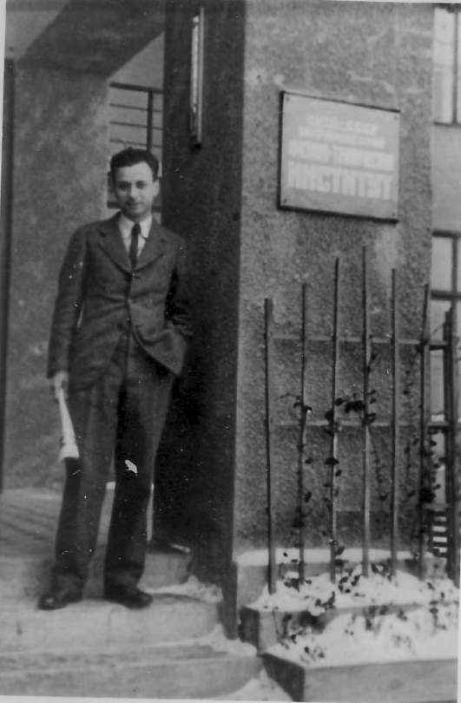
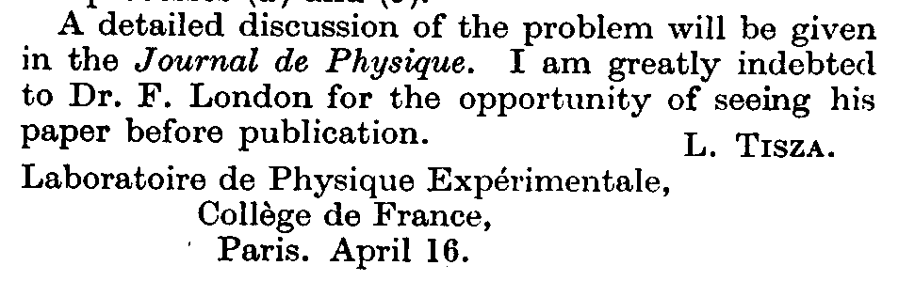
one month later (April 38):
Laszlo Tisza invents the « two-fluid model »
born in 1907, studies in Budapest , later with Max Born in Gottingen and with Heisenberg in Leipzig.
Accused of being a communist by the Hungarian nazi power: 1 year of prison in 1934
Teller recommends him for a post-doc position with Landau in Kharkov (1935-36)
Arrives in Paris in 1937, invited by Paul Langevin at the Collège de France where he meets London
Sends an article to Nature on April 16th 1938 on the « two fluid model »

Slide 23
the « 2-fluid model » by L. Tisza
liquid helium should be a mixture of two components:
condensed and non condensed atoms
there should be 2 independent velocity fields !
the fountain effect is a thermomechanical effect :
at constant chemical potential P increases with T.
There should be a reverse effect: some cooling associated with flow through a narrow channel, to be soon discovered in Oxford by Daunt and Mendelssohn Nature 143, 719 (1939)
In his next 2 articles (Comptes Rendus Ac. Sciences Paris, 207, 1035 and 1186 (1938) ) Tisza also predicted that, in addition to density waves (ordinary sound) there should be thermal waves (later called « second sound » by Landau) in a superfluid.
Together with F. London, Tisza explained all the properties of superfluid He which were known in 1938: λ-point, flow, thermal effects and also
the apparent contradiction between measurements of the viscosity in Toronto and in Cambridge.
the motion of helium liquid films (Rollin, Kurti and Simon 1936)

Slide 24
a crucial test
July 1938: at a small meeting in London, Tisza presented his predictions of « temperature waves » and « offered it to make or break his theory »
At that stage, Fritz London kept his opposition to the idea that two independent velocity fields could exist in liquid helium.

Slide 25
April 1939:
Landau escapes from Stalin’s jails
1908: Lev Davidovitch Landau born in Baku
1927: Doctorate in Leningrad at the age of 19!
Rockefeller fellowship , Landau travels to Germany, Switzerland, England and Copenhagen where he works with Niels Bohr
1932-37: Foundation of « Landau’s school » in Kharkov
Mars 1938: a leaflet against Stalin, Landau arrested by the NKVD (the KGB)
April 1939: Kapitza obtains that Landau is liberated to understand superfluidity by offering his own freedom as a guarantee to Beria. Landau starts working again near Kapitza in Moscow.
June 1941: Landau publishes a theory of superfluidity in the USA and in USSR

Slide 26
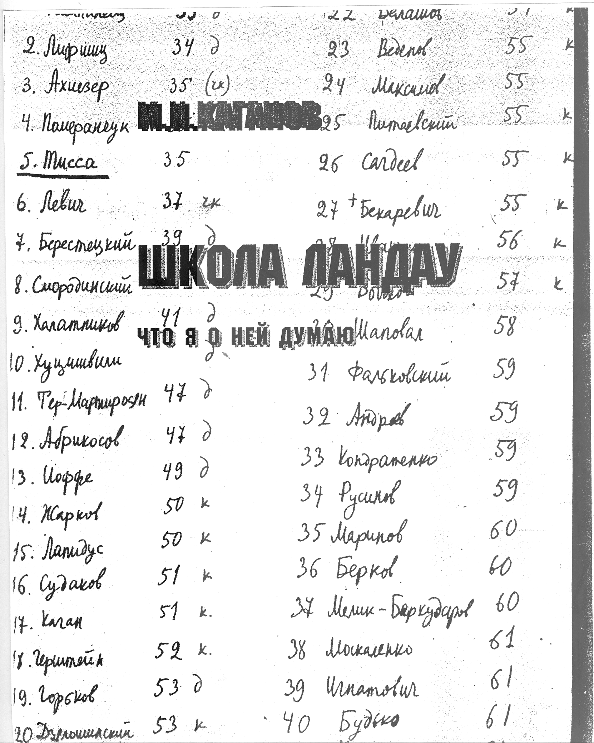
Landau’s school
Landau was born in 1908, one year after Tisza
but he graduated in 1927 (at the age of 19 !)
and founded his famous school in Kharkov with 5 students or postdocs who passed the «Teorminimum exam »
1: Kompaneez
2 : E. Lifshitz
3: Akhiezer
4: Pomeranchuk
5: L. Tisza
1937: Landau moves to Moscow
and Tisza moves to Paris

Slide 27
Landau’s article in 1941
It starts with the following statements:
« It is well known that liquid helium at temperatures below the λ-point possesses a number of peculiar properties, the most important of which is superfluidity discovered by P.L. Kapitza. »
According to Landau, the discovery was thus made in Moscow by the man who saved his life.
The paper continues with:
« L. Tisza suggested that helium II should be considered as a degenerate ideal Bose gas... This point of view, however, cannot be considered as satisfactory... nothing would prevent atoms in a normal state from colliding with excited atoms, ie when moving through the liquid they would experience a friction and there would be no superfluidity at all. In this way the explanation advanced by Tisza not only has no foundations in his suggestions but is in direct contradiction with them. »
Landau‘s astonishing agressivity ...

Slide 28
Two different theoretical approaches
Landau never cited Fritz London . Apparently, he considered him as a bad physicist
Landau never appreciated his former student Tisza
Fritz London had considered the ground state of superfluid helium at rest Landau considered the hydrodynamic properties for which and introduced a theory of excitations in quantum fluids, but he always rejected any connexion with Bose-Einstein’s condensation.
Each of them had found part of the truth, but they died before realizing it (London from a heart attack in 1954, Landau in 1968 after a car accident in 1960 and the Nobel prize in 1962).
The 2-fluid model had been introduced by Tisza with some mistakes
Landau corrected it and wanted all the glory
Landau received the London prize, in 1960 ! Proposed par Tisza !!

Slide 29
What happened after the war?
1946: Peshkov’s experiments show that Landau was right in his corrections of Tisza’s theory
1947: Bogoliubov predicts superfuidity in a Bose Einstein condensate as soon as the atoms interact with each other.
1949: Osborne, Weinstock and Abraham show that superfluidity does not exist in liquid helium 3 at temperatures comparable to helium 4 (Bosons and Fermions, the importance of quantum statistics which Landau totally ignored)
1950 : J. Bardeen develops the theory of superconductivity with R. Schrieffer and L. Cooper . Bose-Einstein condensation of pairs of Fermions. A letter to London:
“ Dear Prof. London,
You may be interested in the enclosed manuscript on superconductivity; they are both based on your approach…’’
1956: Penrose and Onsager generalize Bose-Einstein condensation to interacting system as “off diagonal long range order” in the density matrix.
1957: Superconductivity is understood by Bardeen Cooper and Schrieffer (BCS) who get the 1972 Nobel prize. Bardeen gives part of his prize money to support the “London memorial award”.

Slide 30
more recently
1972: Osheroff, Lee and Richardson discover at Cornell that liquid helium 3 ( a Fermi system) becomes superfluid also, but at 2 milliKelvin, a temperature
1000 times lower than for helium 4.
It is a consequence of the formation of 3He-3He pairs as in superconductors.
3 more Nobel prizes in 1996 + Leggett in 2003.
1995: E. Cornell, C. Wieman and W. Ketterle discover Bose Einstein condensation in gases of cold atoms (Rubidium, Sodium and many others later).
Evidence for superfluidity is soon found in these quantum gases.
The rotation of superfluids is anomalous, a phenomenon analogous to the behavior of superconductors in a magnetic field.
Another 3 Nobel prizes in 2001.
A large list of Nobel prizes for superconductivity:
H. Kammerlingh Onnes in 1913, J. Bardeen L. Cooper and R. Schrieffer (“BCS”) in 1972, I. Giaever and B. Josephson in 1973, J. Bednorz and A. Muller in 1987, A. Abrikosov, V.L. Ginzburg in 2003

Slide 31
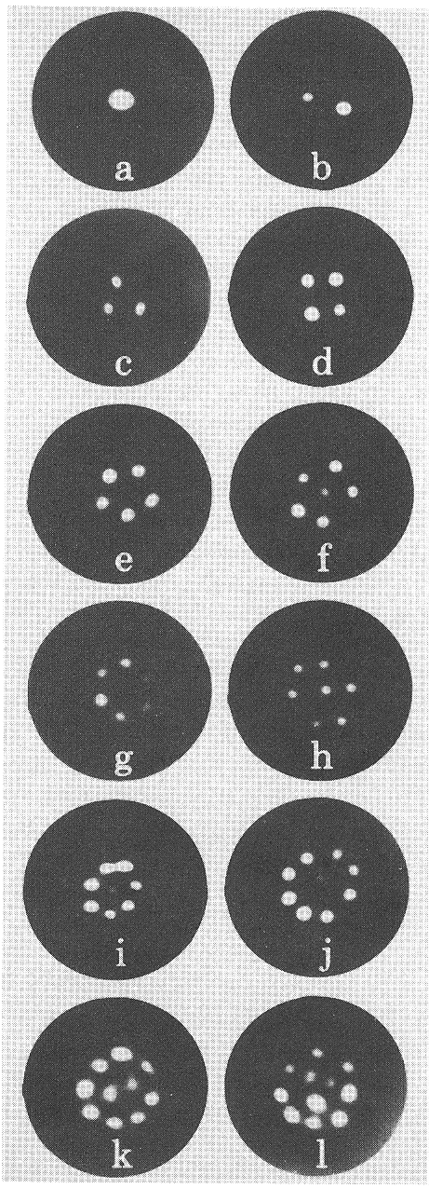
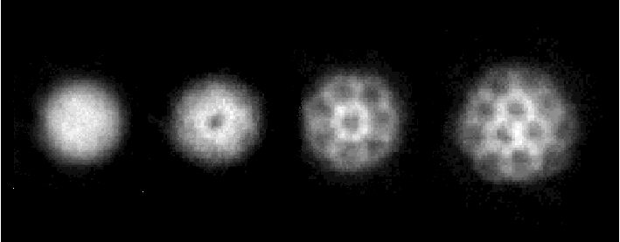
anomalous rotation of superfluids : quantized vortices
in liquid helium 4
(E.J. Yarmchuk, M.J.V. Gordon et R.E. Packard, 1979)
and in Rubidium gas
( KW Madison, F. Chevy, W. Wohlleben et J. Dalibard, 2000)
a consequence of macroscopic quantum coherence

Slide 32
Superfluidity and superconductivity today
Superconductivity has important applications:
mainly for building high field electromagnets
MRI medical imaging uses superconducting wires cooled down by liquid helium
The large particle accelerator LHC at CERN (Geneva) uses superconducting magnets in a 27 km long annulus filled with superfluid helium to understand the structure of elementary particles (The Higgs boson in 2012)

Slide 33
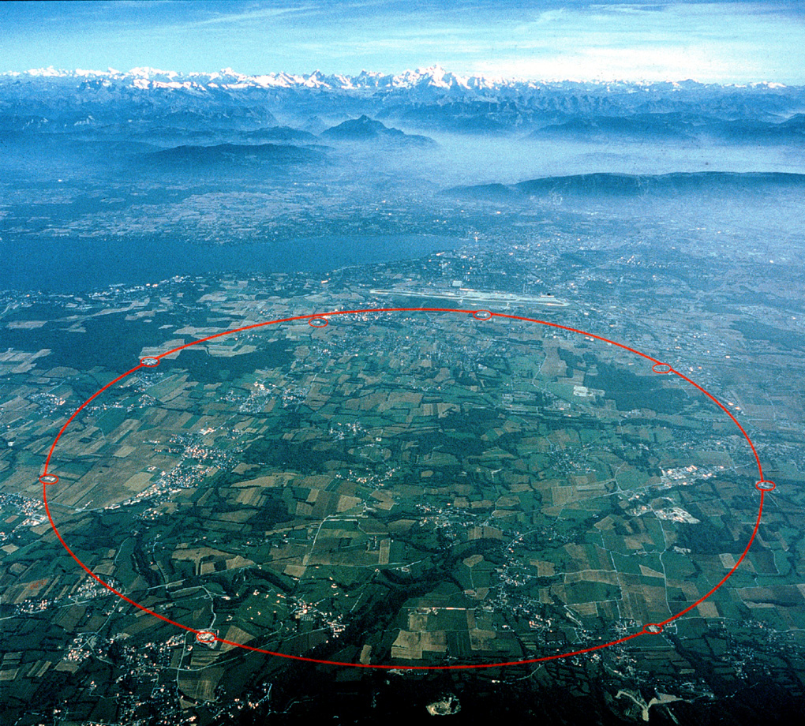
the CERN annulus near Geneva

Slide 34
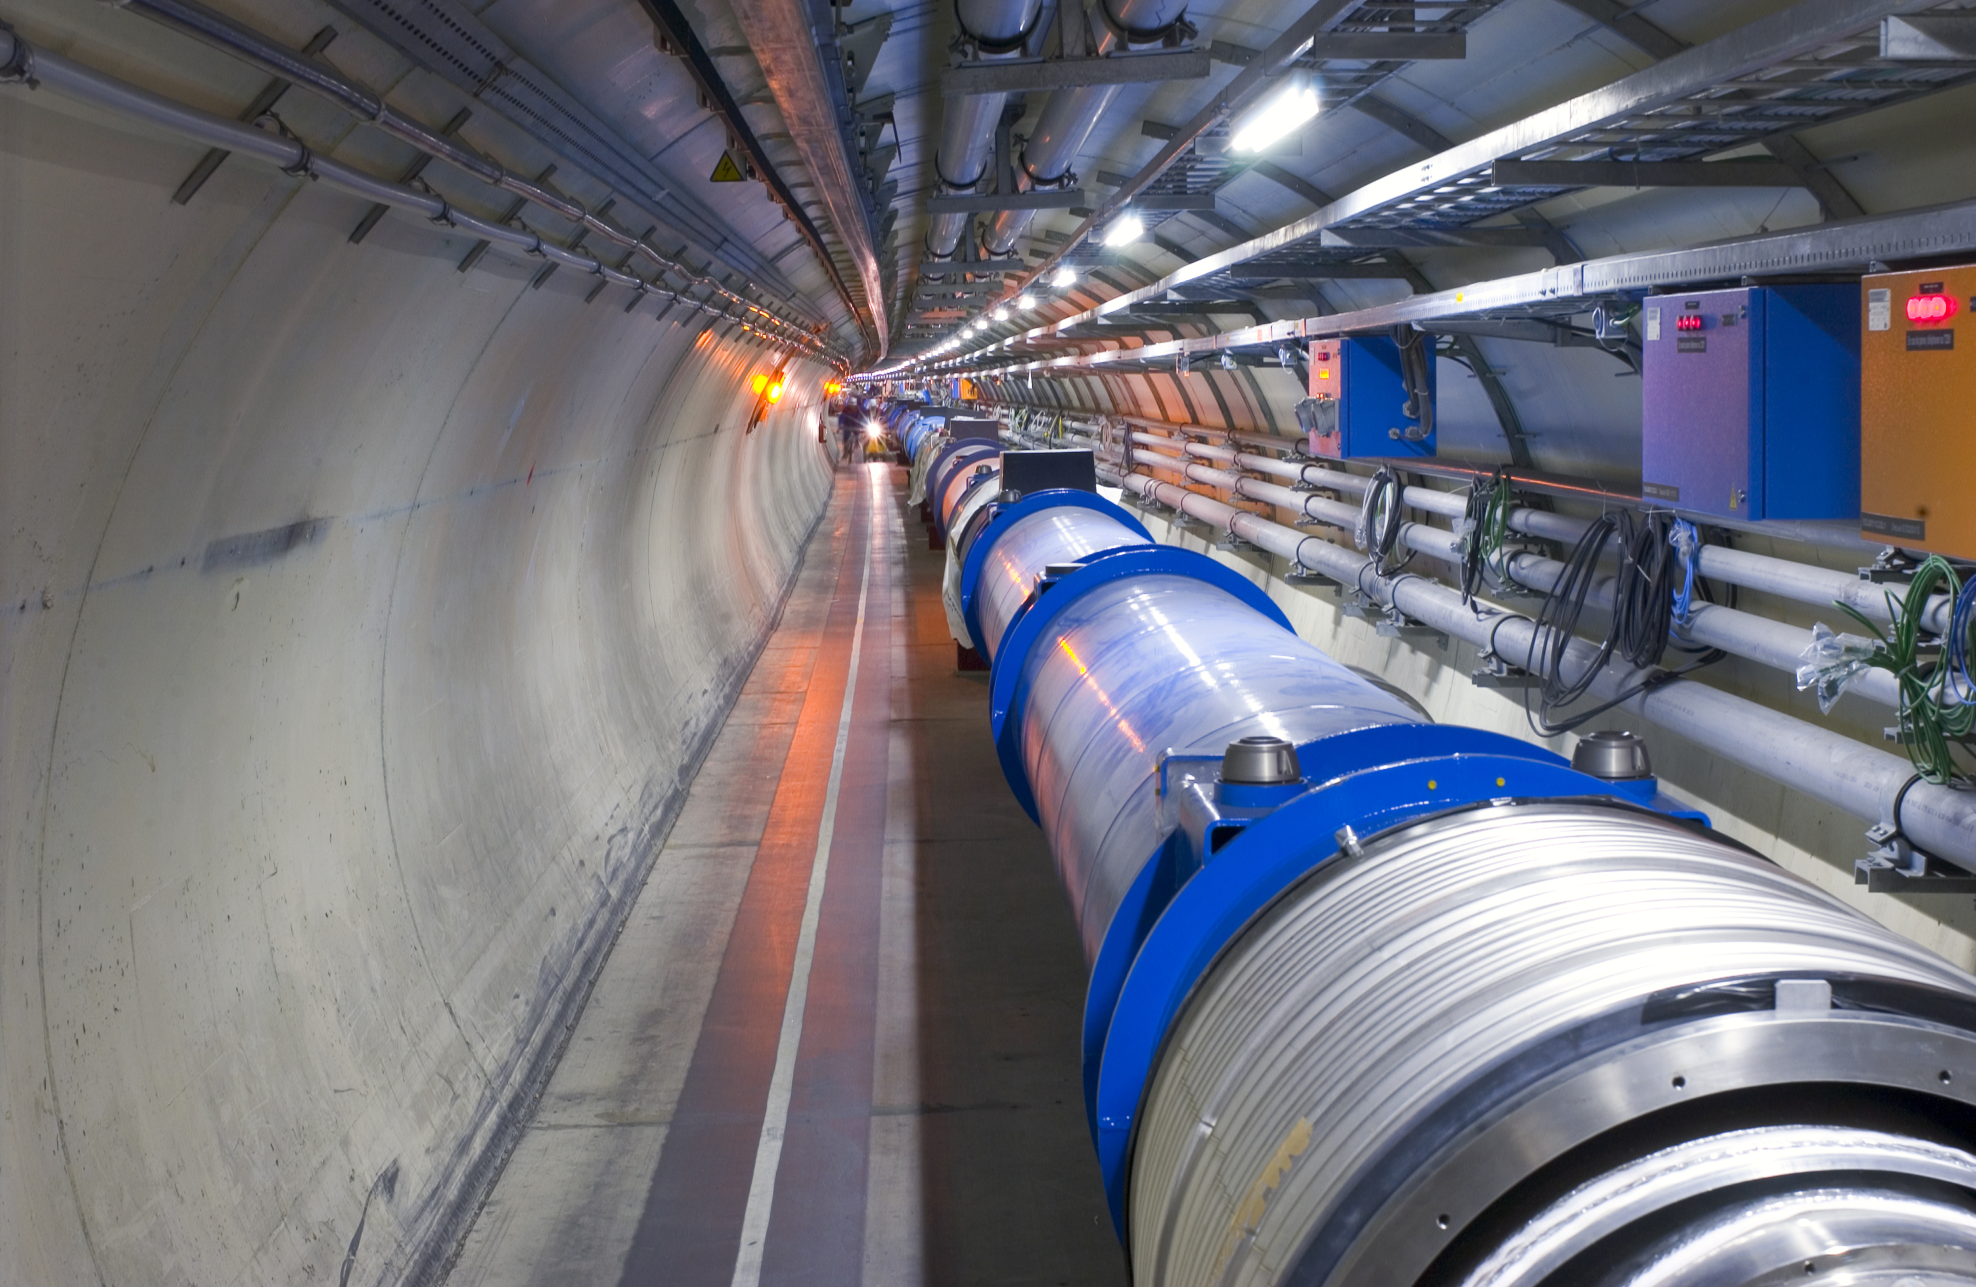
the magnets of the LHC are cooled down to 1.9K with superfluid helium
follow their temperature on
http://hcc.web.cern.ch/hcc/cryogenics/cryo_magnets.php

Slide 35
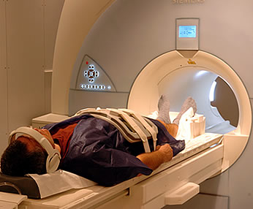
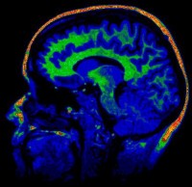
MRI medical imaging uses superconducting magnets cooled down in liquid helium

Slide 36
… and supersolidity ?
rigid axis
( Be-Cu)
In 2004 at Penn State University,
Eunseong Kim and Moses Chan
build a « torsional oscillator »
to measure superfluidity
liquid helium in the green box
at the superfluid transition, the liquid stops rotating with the box walls
the inertia momentum decreases
solid He
in a box
excitation
solid helium apparently behaves the same!
could solid helium be superfluid at T < 0.1K ??

Slide 37
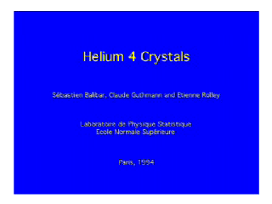
helium crystals @ENS Paris

Slide 38
supersolidity?
Is it really possible that a solid is superfluid ?
A quite astonishing property.
A supersolid would be elastic like a solid but a fraction of it would flow without
any resistance through the rest.

Slide 39
The 1969 historical model of superfluid vacancies in a quantum crystal
Thouless,
Andreev and Lifshitz :
delocalized vacancies at T = 0 ?
( the crystal would be « incommensurate »)
BEC => superfluid flow of mass
coexistence of non-zero shear modulus and mass superflow
A.J. Leggett (1970): non-classical rotation + bounds for the superfluid fraction
But creating vacancies cost an energy E ~ 13K (Clark and Ceperley 2008)
could supersolidity be allowed by disorder ? (Boninsegni, Pollet, Svistunov, Prokofev, 2006-2008)

Slide 40
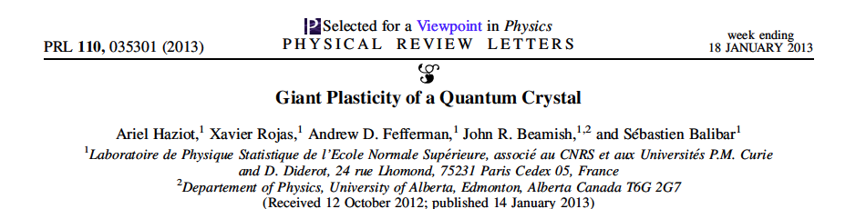
supersolidity or giant plasticity ?
Is it really possible that a solid is superfluid ?
A quite astonishing property.
A supersolid would be elastic like a solid but a fraction of it would flow without
any resistance through the rest.
Some more Nobel prizes to come ? probably not for « supersolidity », but…

Slide 41
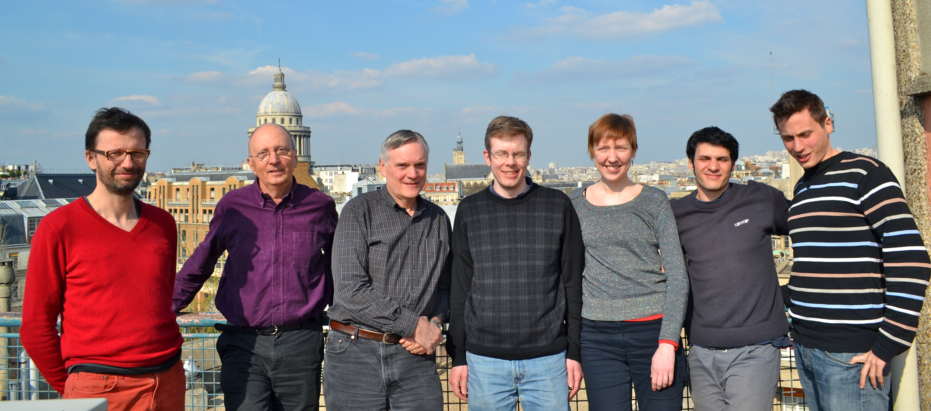
a fruitful collaboration with J. Beamish
(Paris 2012)
Kristina
Davitt
Xavier
Rojas
Etienne
Rolley
John
Beamish
Andrew
Fefferman
Ariel
Haziot
SB

Slide 42






I aknowledge support from

