Slide 1






The giant plasticity of a quantum crystal
S. Balibar, A. Fefferman, A. Haziot, X. Rojas, F. Souris
Laboratoire de Physique Statistique,
Ecole Normale Supérieure and CNRS,
associated to the Universities Paris 6 & 7, Paris (France),
and J. Beamish (Edmonton, Canada)
other collaborations: M.H.W. Chan and J. West (Penn State) ,
H.J. Maris (Brown University)
Konstanz Universität, October 2013

Slide 2
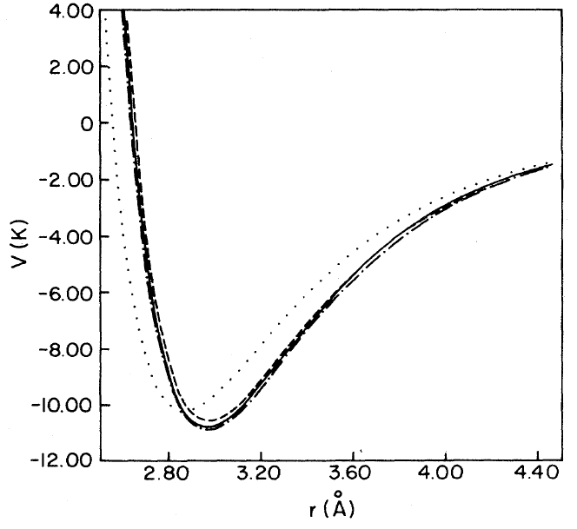
Quantum crystals: large quantum fluctuations
a particle (hard core diameter d, masse m)
localized in a box (size a)
Heisenberg principle => momentum p = ħ/(a-d)
a
d
"zero point" kinetic energy :
E_{c} = ħ²/2m(a-d)²
in the case of ⁴He crystals :
a = 0.37 nm ; d = 0.26 nm ; m = 4g/N
=> E_{k} ~ 15 K !
The interatomic potential is the sum of
a van der Waals attraction + a hard core repulsion
It has the same order of magnitude
large quantum fluctuations (Fritz London 1936)

Slide 3
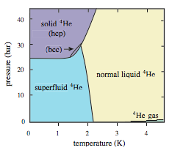
consequences at the macroscopic scale
F. Simon (1934) and F. London (1936):
a large molar volume
liquid ⁴He : 28 cm³/mole at P = 0
³He : 37 cm³/mole
⁴He
At P < 25 bar, the liquid phase is more stable
no triple point (liquid-gas-solid)
crystal growth from the liquid at low T
2 liquid states: superfluid at T < 2K ; normal viscous at T > 2K

Slide 4
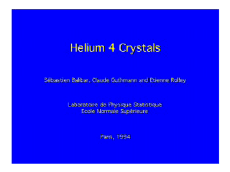
Helium 4 crystals: growth, facets

Slide 5
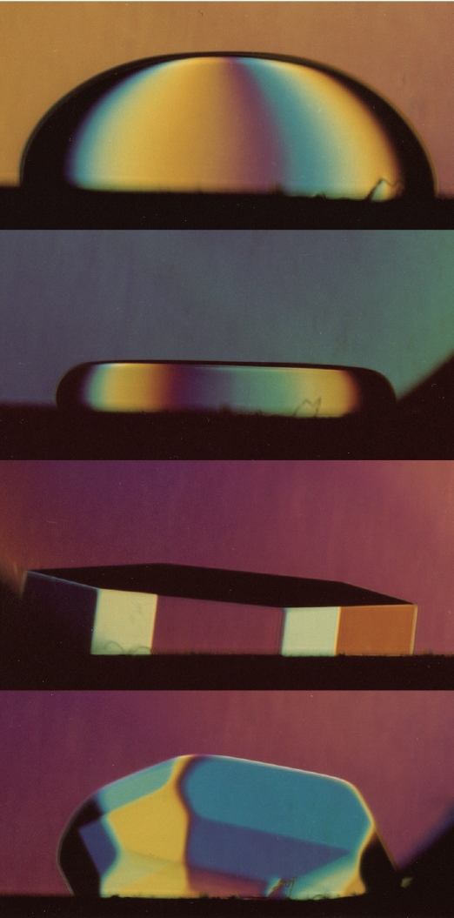
The Lindemann criterion + two questions
1.4 K
the Lindemann criterion:
at the liquid-solid equilibrium
(i.e. on the melting line)
classical systems:
the mean square displacement of atoms
R_{L} = (<u²>)^{1/2} ~ 0.10 a
(10% of the atomic spacing)
in helium 4: 26% (Burns and Isaac 1997)
atoms are weakly localized in their lattice
1 K
0.4 K
Question 1:
are facets destroyed by quantum fluctuations? NO
see Balibar, Parshin and Alles, Rev. Mod. Phys. 77, 317 (2005)
Question 2:
any anomaly in the elastic properties ? YES
could solid ⁴He be partially superfluid, i.e. « supersolid » ???
the two subjects of this talk
0.1 K

Slide 6
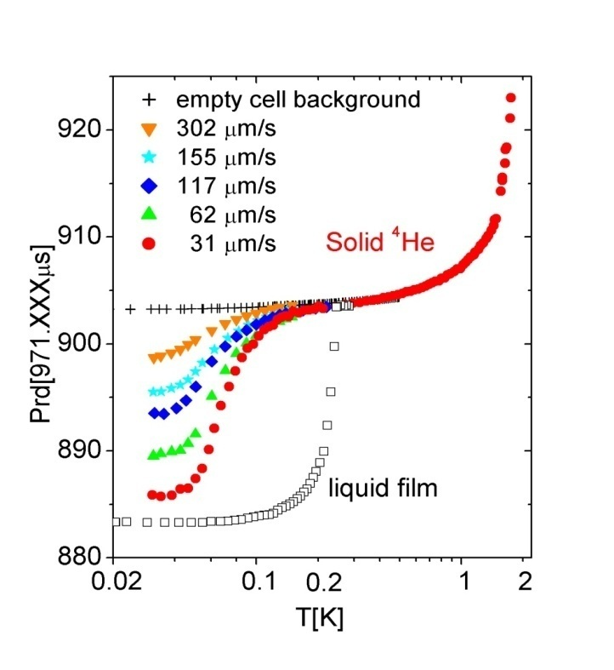
original motivation: the enigma of supersolidity
E. Kim and M. Chan (Penn. State U. 2004):
a « torsional oscillator » (~1 kHz)
a change in the resonance period below ~100 mK
a small critical velocity
1 % of the solid mass decouples : Leggett’s « NCRI »?
rigid axis
( Be-Cu)
solid He
in a box
excitation
detection
period (μs)
the resonance period
depends on the inertia momentum I and on the torsion constant K
supersolidity appears (I decreases) ?
or a change in stiffness (K increases) ?
temperature (K)

Slide 7
The 1969 historical model
Thouless 1969,
Andreev and Lifshitz 1969:
delocalized vacancies could exist at T = 0
E₀
zhν
( the crystal would be « incommensurate »)
BEC => superfluid flow of mass
coexistence of non-zero shear modulus and mass superflow
A.J. Leggett (1970): non-classical rotation + bounds for the superfluid fraction
But hν ~1.6 K and the bottom of the vacancy band is at + 13K (Clark and Ceperley 2008)
P.W. Anderson (2010-11): the ground state has to be supersolid
If commensurate … not supersolid ?

Slide 8
Shevchenko’s scenario for supersolidity
how to reconcile superflow and stiffening?
mass could flow along dislocation cores forming a connected 3D network (Shevchenko 1987, Pollet 2008), but perhaps only if they do not fluctuate (pinning by ³He, Balibar Nature 2010)
dislocation lines
³He
impurity
kinks
transverse fluctuations of the dislocation lines could induce local mass currents, consequently phase fluctuations which destroy the quantum coherence Inversely, if the line is superfluid, the phase is blocked and the line should be fixed
2 difficulties: a very large dislocation density (10¹² /cm² !) is needed to obtain 1% superfluid fraction and phase coherence at Tc ~100 mK

Slide 9
how dislocations move
Periodic lattice. «Peierls» energy barriers against kink motion
Classical crystals: thermal activation (high T, large stresses)
Quantum crystals: quantum tunneling, kink delocalization, motion under very small stress

Slide 10
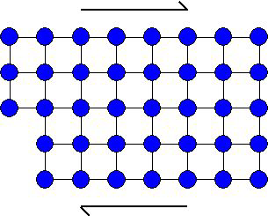
plasticity of a crystal: dislocation gliding
under small stresses: elastic deformation of the lattice determined by elastic coefficients
a shear stress
under larger stress σ
the strain ε is the sum of
ε_{lat} due to the deformation of the lattice and
ε_{dis} due to the displacement of dislocations
= μ_{eff} (ε_{lat} + ε_{dis})
an effective shear modulus μ_{eff}
If dislocations move, ε_{dis} is large
μ_{eff} is reduced

Slide 11

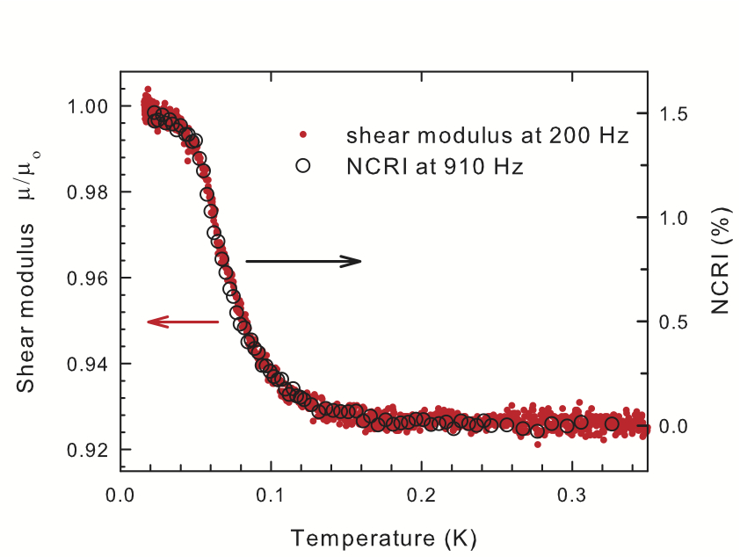
Direct shear modulus measurements: the method invented by Day and Beamish (2007):
piezoelectric shear transducers
an ac- voltage V
produces a deformation ε
and a shear stress σ
on the other transducer
inducing a current
I=ω d₁₅² μV/d
solid ⁴He
gap d ~1 mm
I
supersolid 4He would be stiffer than normal solid 4He ??
at ENS in 2012 we calibrated the measurement of μ=σ/ε on single crystals

Slide 12
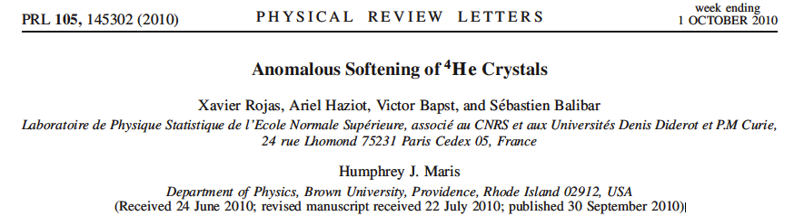
a model for the elastic anomaly:
pinning of dislocations by impurities
(Beamish et al. 2008 following Iwasa 1980 and Paalanen 1981)
dislocations are pinned by ³He impurities below a temperature which depends on
- the binding energy Ε_{B},
- the 3He concentration X₃
- the density of dislocations Λ
at high T
at low T
mobile dislocations => soft cystal
pinned dislocations => stiff crystal
large plasticity if dislocations move easily
network pinning
impurity pinning
→ crossover →
Syshchenko Day and Beamish (PRL 2010) : a distribution for E_{B} 0.73 ± 0.25 K
calculation by Corboz et al. 2008 : 0.8 ± 0.1 K (for screw dislocations)
ENS 2010: Compare high quality single crystals grown at ENS
with Beamish’s polycrystals
=> dislocations, not grain boundaries

Slide 13
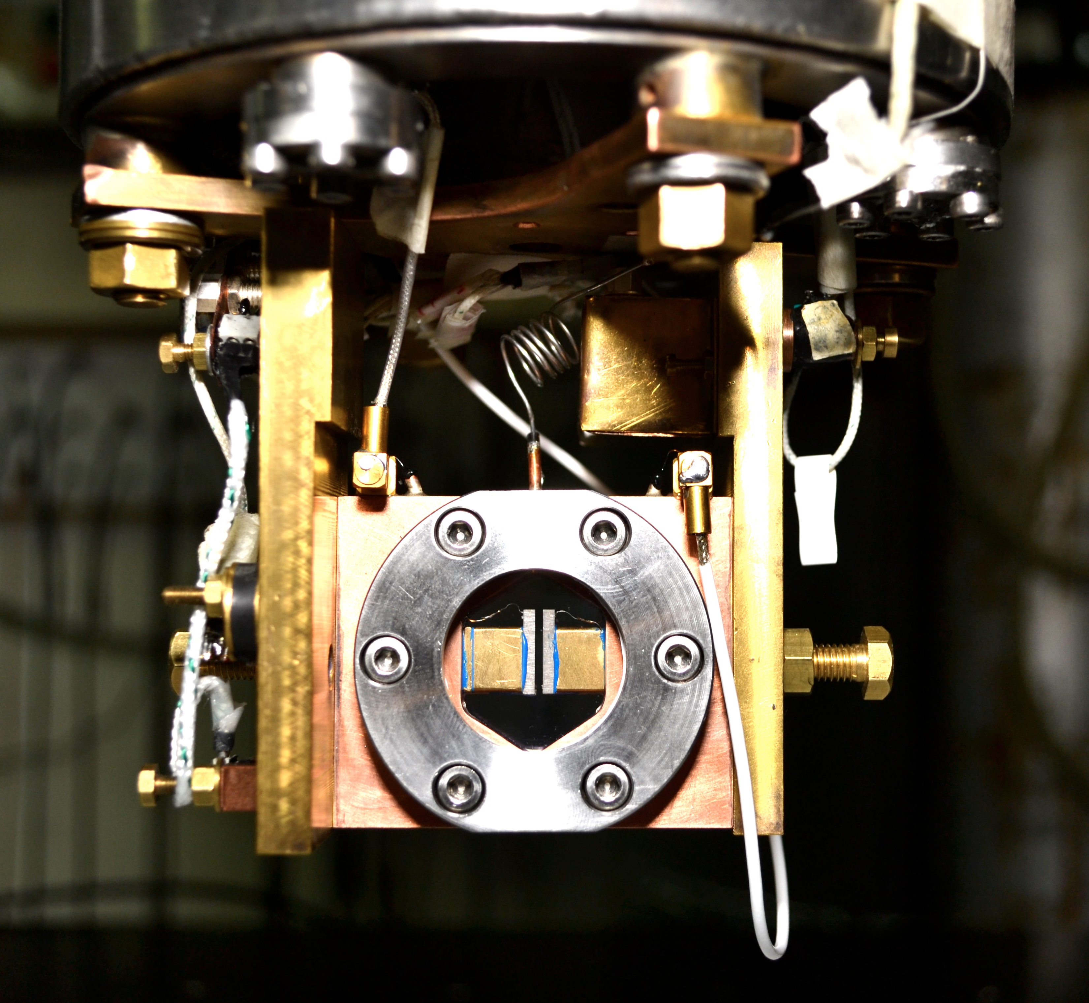
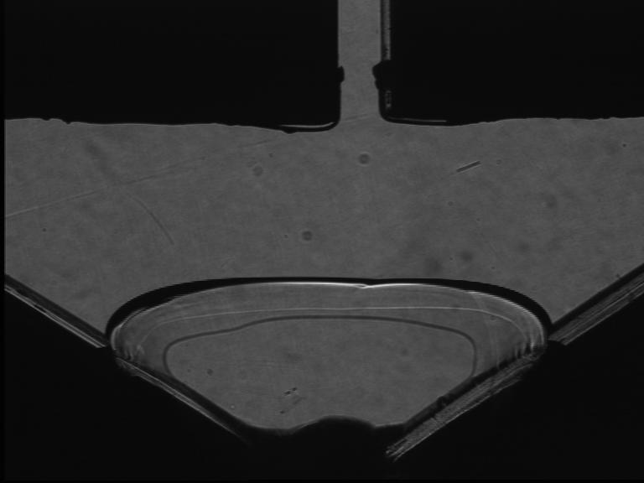
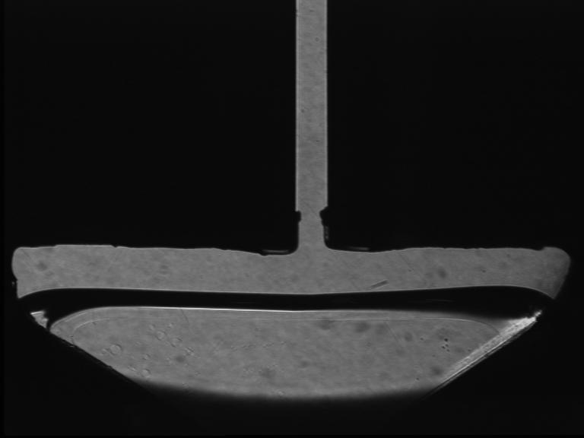
ENS 2012-2013: the shear modulus
of oriented ⁴He crystals
from 15 mK to 1K
orientation from growth shape of a seed
growth inside the 1.2 mm gap between 2 transducers
very small AC- vertical displacement (1Hz to 20 kHz)
down to 0.001 Angström ( strain ε down to 10⁻¹⁰)
vertical stress σ = με down to 10⁻⁹ bar
temperature: 15 mK to 1.5K
direct measurement of the shear modulus μ

Slide 14
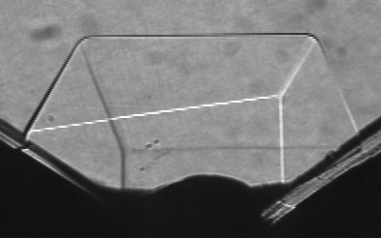
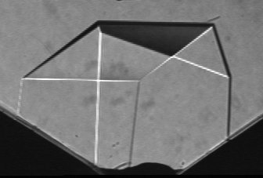
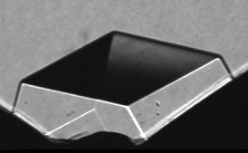
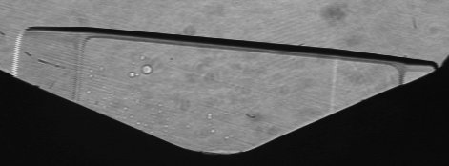
random nucleation on various sites:
many crystals with different orientations
X2
X6
X15
X3
X20
X5
X21

Slide 15
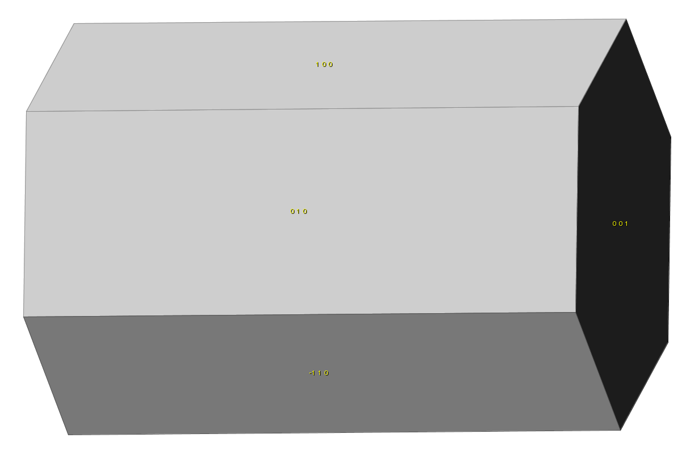
orientation X2
z
c
θ
y
x
φ
Orientation : θ=89.5° ; φ=75°
measured shear modulus:
μ = 0.0001(c₁₁-2c₁₃+c₃₃) + 0.933c₄₄ + 0.067c₆₆
depends mainly on c₄₄
prediction : μ = 122 bar
from measurements by Crepeau et al. at 1.32K and by Greywall at 1.2K where dislocations cannot move at 10 MHz
c

Slide 16
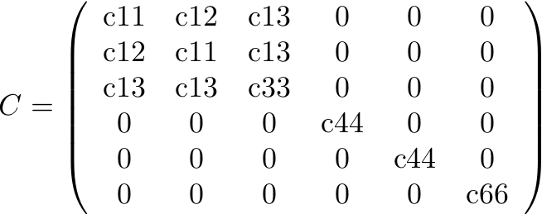
the elasticity tensor of hcp crystals
6 elastic coefficients cij
If z is parallel to the 6-fold symmetry axis c or [0001], the indices i,j from 1 to 6 mean respectively xx, yy, zz, yz, xz, and xy with
c₆₆ = (c₁₁ – c₁₂)/2
simple shear involve only c₄₄ or c₆₆:
the transverse sound velocity along c involves xz or yz shear and is given by
the transverse sound velocity inside the basal plane involves xy shear and is given by

Slide 17
orientation X2
z
c
θ
y
x
φ
Orientation : θ=89.5° ; φ=75°
measured shear modulus:
μ = 0.0001(c₁₁-2c₁₃+c₃₃) + 0.933c₄₄ + 0.067c₆₆
depends mainly on c₄₄
prediction from measurements by Crepeau at 1.32K and by Greywall at 1.2K where dislocations cannot move at 10 MHz:
σ_{stiff}= 122 bar
c

Slide 18
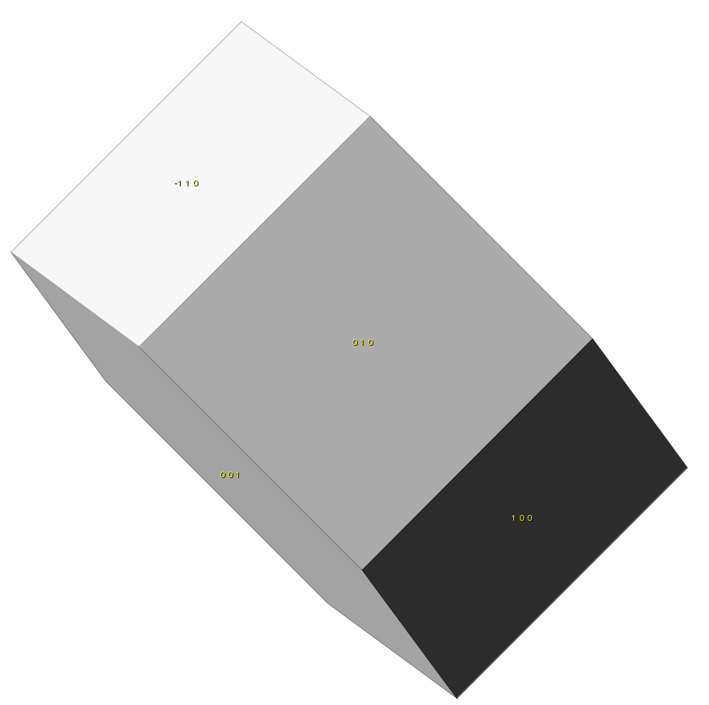
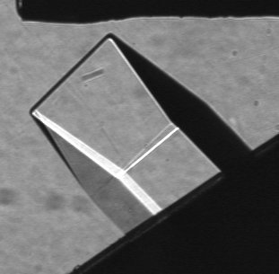
orientation X3
Orientation : θ=45° ; φ=85°
measured shear modulus: μ = 0.248 (c₁₁-2c₁₃+c₃₃) + 0.0038c₄₄ + 0.0038c₆₆
negligible dependence on c₄₄ and c₆₆
predicted stiff state: μ_{stiff} = 187 bar

Slide 19
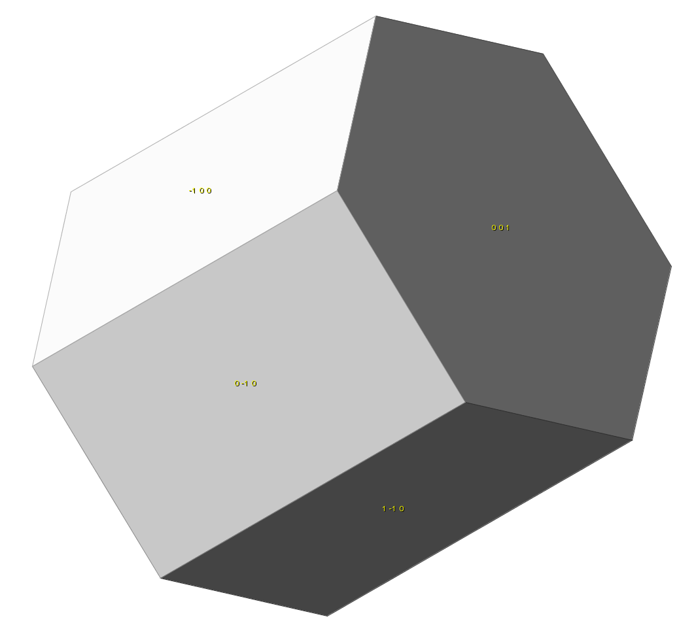
orientation X5
c
orientation : θ=60° ; φ=30°
measured shear modulus : μ = 0.047 (c₃₃ + c₁₂ – 2 c₁₃ ) + 0.25 c₄₄ + 0.56 c₆₆
large dependence on c₆₆
predicted stiff state: μ_{stiff} = 1.19 10⁷ Pa = 119 bar

Slide 20
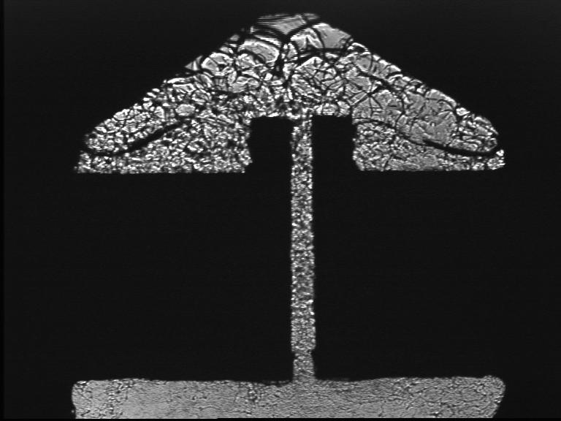
a polycrystal grown at constant V (“blocked capillary method”)
final growth pressure : 33.8 bar
predicted stiff state using HJ Maris’ averaging method: μ_{stiff} = 144 bar
melting shows grain boundaries. Small grains
ripening from the top in a few minutes

Slide 21
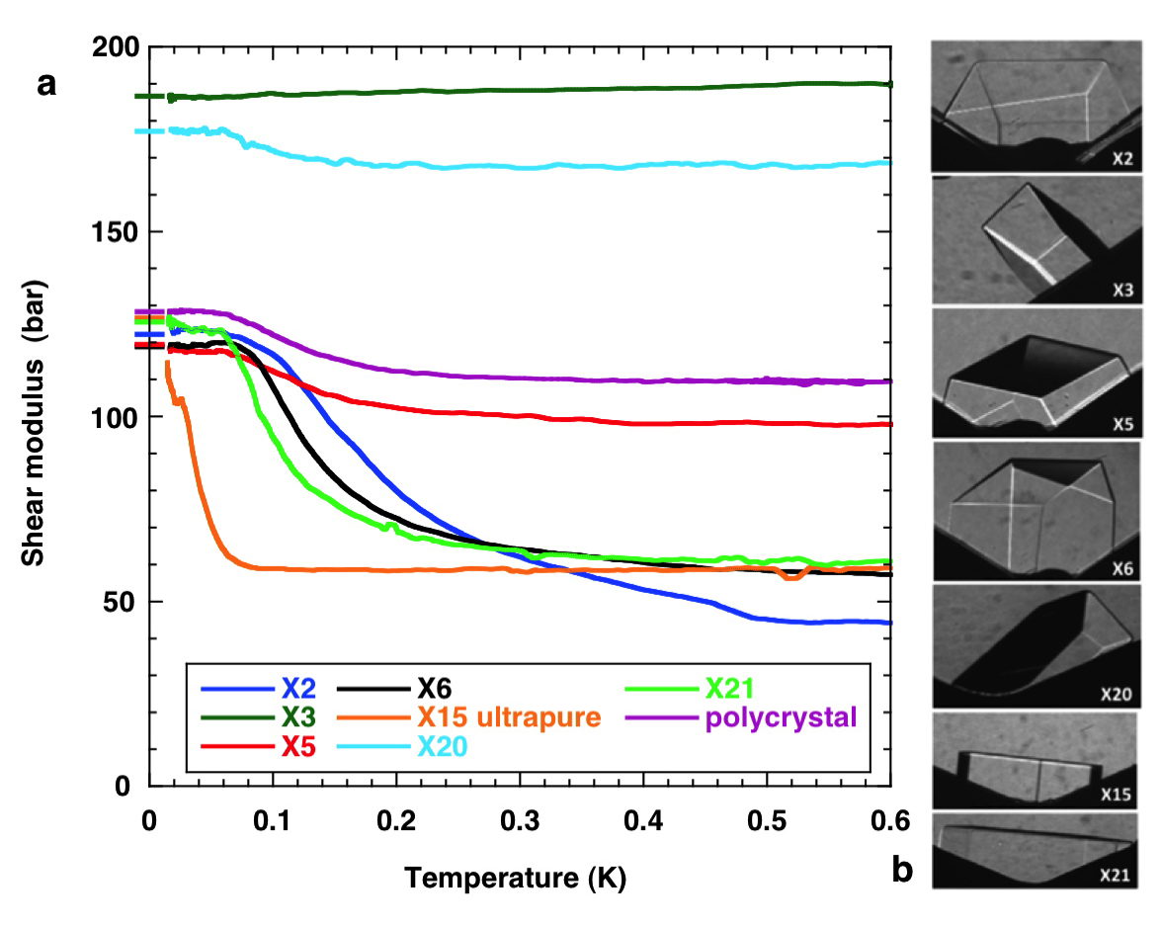
the elastic anomaly : giant and highly anisotropic
A. Haziot et al. Phys Rev Lett. 110, 935301 (2013)
X3 tilted by ~ 45°
indépendent of c₄₄ and c₆₆
no variation, μ = 187 bar
c11, c13 and c33 are constant
transducer calibration :
0.95 A/V in cell #2
(0.88 A/V in cell #1)
X3
at low T for all crystals,
agreement with measurements
at 10MHz and high T
by Crepeau (1.32K) and Greywall (1.2K),
the « supersolid » is not stiffer than the normal solid contrary to Anderson’s prediction.

Slide 22
What is the origin of the anisotropy ?
crystal X3 at 45° :
X3
X20
polycrystal BC2:
BC2
X21
X2
X5
X2 , X21 depend mostly on c₄₄
X5 depends more on c₆₆ than c₄₄
dislocations glide along high density planes
basal planes? reduction of c₄₄
prismatic planes ? c₆₆

Slide 23
dislocations glide along basal planes
X2, X5, X6 and X21 :
similar growth at 1.4K,
same purity (0.3 ppm of ³He)
=> same elastic constants?
if c66 = Cst and only c44 varies:
same reduction by 62±8% for all crystals
the opposite hypothesis (c44 constant, c66 variable ) would lead to absurd results:
for X6, c66 should vary by 300%
more than 1000% for X21 !
hexagonal metals:
gliding along basal planes in Be, Mg, Co, Zn,
along prismatic planes in Zr, Ti
Agreement with the criterion by B. Legrand (1984) : dislocation splitting due to the low energy of stacking faults

Slide 24
how to detach ³He impurities from dislocations at 20 mK
crystals grown at 1.4K,
no liquid in the cell
X6, X2 and X5:
the threshold stress
σ = 1 microbar
corresponds to the stress necessary for dislocations to break away from ³He impurities
hysteresis because the force depends on the distance between bound impurities
X4 cooled down at high drive
with liquid in the cell
X4 cooled down at high drive
with liquid in the cell
« resolved » = projected in the basal plane

Slide 25
with no impurities at all, dislocations move freely
crystals grown at 1.4K,
no liquid in the cell
X4 cooled down to 20 mK
under larger strain (10⁻⁶)
in the presence of liquid He
all ³He expelled into the liquid
stable soft state even when reducing the strain down to 10⁻¹⁰
80% reduction in c₄₄
a very large softening with no equivalent in classical crystals
X4 cooled down at high drive
with liquid in the cell
X4 cooled down at high drive
with liquid in the cell
« resolved » = projected in the basal plane

Slide 26
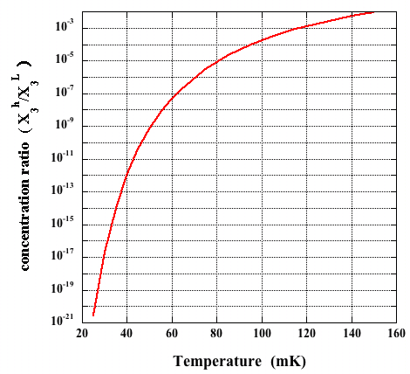
« zone melting » with ⁴He : from 0.3 ppm ³He to 0.4 ppb
… and down to zero
Slow growth proceeds very close to equilibrium at the solid-liquid interface.
The concentration ratio is
at 25 mK:
starting with X₃^{L} = 4 10⁻¹⁰
one obtains X₃^{h} = 4 10⁻³¹ !
even in the presence of dislocations,
no ³He in the crystals grown below 25 mK
concentrations equilibrate quickly
³He impurities are ballistic quasiparticles
(C.Pantalei , X. Rojas and S. Balibar, JLTP 2010
using
D.O. Edwards and S.Balibar Phys. Rev. B 1989
shaking the dislocations in the presence of some liquid expels all ³He in the liquid
=> the crystal is stable in a soft state at low T,
dislocations move like little violin strings (no measurable dissipation)

Slide 27
⁴He single crystals with only 4 10⁻¹⁰ ³He do not resist to shear around 0.2K
Haziot et al. submitted to Phys. Rev. Lett. (2012)
a hexagonal ⁴He crystal.
a direct measurement of its shear modulus
strong softening around 0.2K
dislocations are highly mobile in a T-domain between
- ³He impurity pinning at low T
- damping from collisions with thermal phonons at higher T
a giant plasticity with no equivalent in classical crystals:
dislocations move like free strings

Slide 28
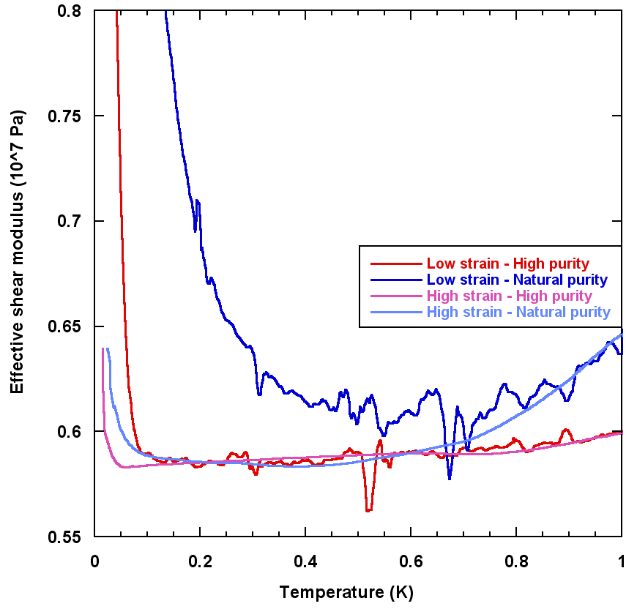
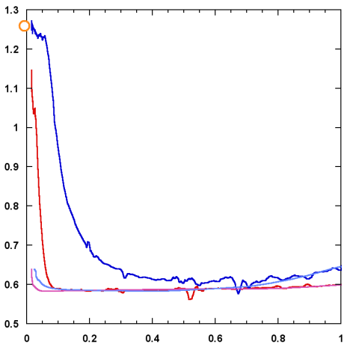
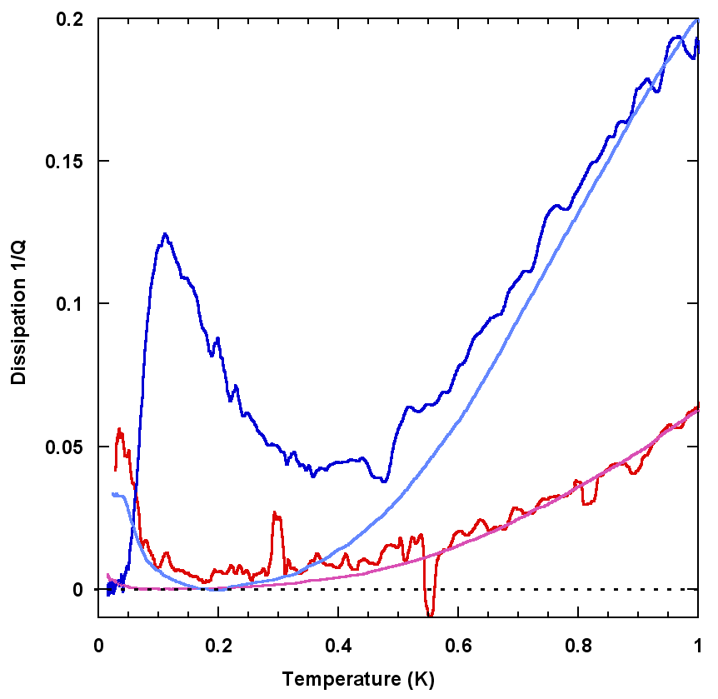
ωT³ dissipation for collisions with thermal phonons
high purity
low purity
we measure the dissipation from the phase shift of the response
the ³He binding and the reduction in c₄₄ depend on amplitude and purity
Granato and Lücke 1956 + Ninomiya 1974 predict a shear modulus variation
and a dissipation for phonon damping
If true, the dislocation density Λ
and the length L between network nodes
can be determined independently
low drive
high
drive
low
purity
high
purity

Slide 29
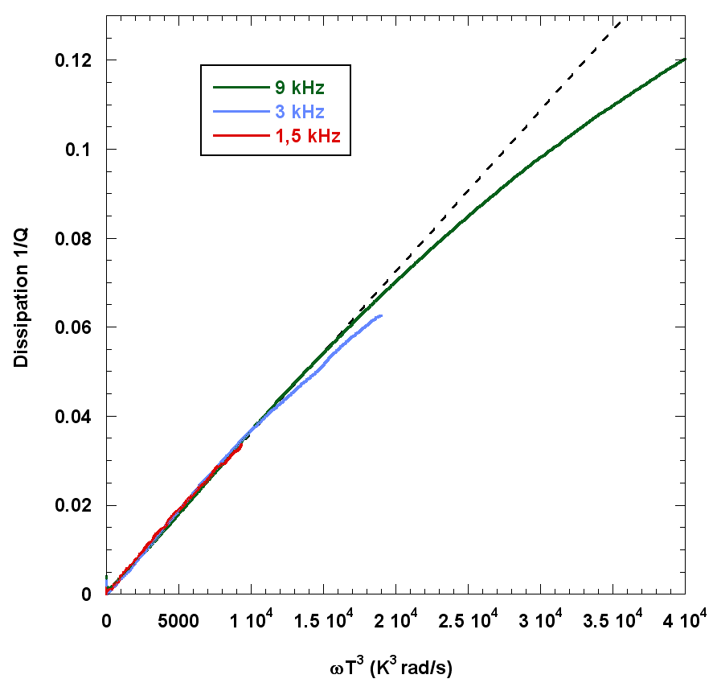
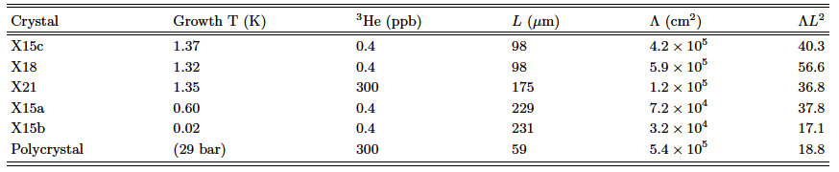
a measurement of dislocation density and pinning length for various crystals (Haziot et al. Phys. Rev. B87, 060509(R) 2013)
excellent agreement with 1/Q ~ ωT³
collisions with thermal phonons
densities from 3 10⁴ to 6 10⁵ cm⁻²
network lengths from 60 to 230 μm
ΛL² from 17 to 57
instead of 3 for a simple 3D lattice
=> dislocations are grouped in sub-boundaries
dislocations cannot move at 10MHz and 1.2K
the Shevchenko theory of a network of
superfluid dislocation cores
would require 10¹² disloc/cm² for a 1% NCRI

Slide 30
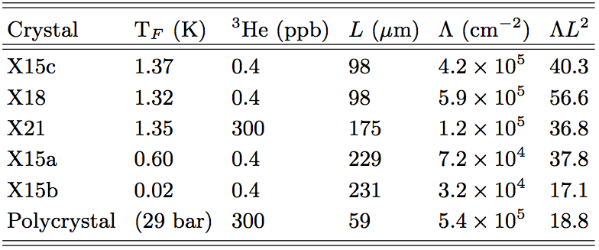
crystals of variable quality
ε = 10⁻⁷
X15a
X15b
- density : between 3x10⁴ and 5x10⁵ cm⁻²
- free length : between 60 and 230 μm
- velocity: up to 1 m/s at 10 kHz
The best crystals are grown at the lowest temperature.
ΛL² from 17 to 60 instead of 3 for a cubic network of dislocations.
the dislocation are grouped into sub-boundaries.
compare to previous experment…
X15c
BC2
Notes:
On étudie donc la dissipation de plusieurs cristaux préparés dans des conditions différentes. Les différentes pentes indiquent bien que les caractéristiques du réseau de dislocations sont différentes pour ces cristaux.
Les cristaux de meilleure qualité ont une dissipation plus élevée car leur dislocations plus longues se bougent beaucoup.
À partir de notre modèle, Nous avons mesuré des densité entre…
On remarque que les cristaux de meilleure qualités sont ceux préparés à basse température.
On peut aussi calculer le facteur lambdaL2 qui caractérisent la connectivité du réseau de dislocations. Ce facteur vaut 3 dans un réseau cubique de dislocations.
Dans notre cas, nous trouvons de très grandes valeurs entre 17 et 60 ce qui indiquent que les dislocations sont très peu connectées et qu’elles s’evitent en se regroupant de façon parallèle les unes au dessus de autre dans en sous-joints cad des joints de grain de faible désorientation.
Cela avait déjà été supposé dans des études anterieure puisque comme l’explique M. Friedel dans son livre, seule cette organisation du réseau de dislocations est à même de produire de grandes variation du module de cisaillement comme celles que nous observons. Cette hypothèse est vérifiée ici par ces grandes valeurs de lambdal2
Nos mesures relativement peu élevée de densité de dislocation permettent aussi de réfuter un autre model de la supersolidité. En effet le scénario de Shevchenko considére un réseau de dislocations dont le cœur serait superfluide, mais cela nécessiterait une densité de 1012 disloc./cm2 pour 1% de !
Or nous mesurons des valeurs 6 ordre de grandeur en dessous.

Slide 31
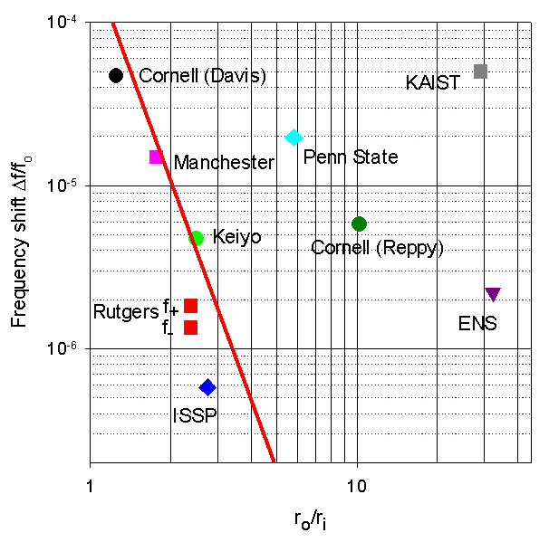
the torsion rod should not be a thin tube !
J. Beamish, A. Fefferman, A. Haziot, X. Rojas, and S. Balibar, Phys Rev B 2012
when the « torsion rod » is a torsion tube:
r₀ : outer radius of the tube
r₁: inner radius
solid line:
maximum possible effect of the He stiffness
In at least 4 cases the observed frequency could be a consequence of a 20 to 40% change in the He stiffness
the « critical velocity » would be the critical strain for unpinning of ³He (2 to 6 10⁻⁸ as measured by Day 2007 and by Rojas 2010)
the magnitude of the dissipation peak also agrees with the mechanical dissipation in stiffness measurements
other artifacts (Maris, Reppy, Chan…) need to be considered in most other experiments …
but some experiments (Kim, Kono, Shirahama…) resist to possible critics

Slide 32
a running controversy:
the frequency dependence of the softening
Crystal Y3 – ε = 2.7 10⁻⁹
Temperature (K)
Day and Beamish (2007): the response time of the moving dislocation τ ~ exp(E_{b}/T) is prop. to the concentration of ³He bound to it (binding energy E_{b})
transition where ωτ ~ 1 => frequency dependence
Iwasa (2010) and Kim (2013): a T-dependent pinning length, no frequency dependence
Notes:
We measured the stiffening transition in the same crystal Y3 for a wide range of frequencies and several different excitations.
As you can see the temperature of the transition is changing with these parameters.
For each run, we measured the temperature of the dissipation peak and we place it on an Arrhenius plot.

Slide 33
two dissipation regimes (A. Haziot et al. PRB 88, 014106, July 2013)
at high frequency or strain amplitude:
no frequency dependence
real pinning as predicted by Iwasa and Kim
at low frequency or small strain:
a thermally activated dissipation regime ~ exp(-E_{b}/T)
E_{b} = 0.67K
the transition temperature as a function of frequency and strain amplitude
Notes:
We have discovered two different regimes.
a regime where the stiffening temperature is dependent on the frequency as described by Day and Beamish with a Debye model.
a regime where the stiffening temperature is independent of the frequency as described by Iwasa with a pinning model.

Slide 34
a critical speed: ³He impurities move attached to dislocations below 45 μm/s (A. Haziot et al. PRB 88, 014106, July 2013)
From the dislocation density Λ = 7.6 10⁻⁵ cm⁻², and the dislocation length
L = 73 μm, we obtain the dislocation speed as a function of applied strain.
The transition occurs at
a critical speed v_{C} ≈ 45 μm/s
pinning
tentative interpretation:
a max tunneling frequency for ³He atoms on the dislocation?
in the bulk crystal ³He are quasi-particles moving by coherent quantum tunneling
bandwidth: 30 to 600 μK
average velocity:
<v>^{1/2} = 4.2 a J₃₄ ~ 0.6 to 12 mm/s
1 or 2 orders of magnitude faster
inelastic tunneling of ³He bound to dislocations up to 60 μm/s ?
tunneling along the dislocation ?
binding
Notes:
Then, we can plot the same data but instead of the frequency, we can plot the speed as a function of 1/T.
It appears that the transition between the two regimes occurs in the same speed region suggesting the existence of a critical speed.
We measured values for this critical speed between 40 and 100 micron/s.
In order to interpret these results let’s see quickly what is the model in the classical case.

Slide 35
the length distribution of dislocations (A. Fefferman et al. submitted to PRL, Oct. 2013)
when decreasing the driving strain,
³He bind to short dislocations before long ones.
With a single dislocation length, one should see a sharp transition to the stiff state where all dislocations are pinned by impurities.
we have measured the distribution of dislocation lengths between network nodes

Slide 36
the network length distribution is wide: from 30 to 300 μm
to each driving strain amplitude ε corresponds a max length L_{c} below which ³He binds
L_{C} = 2F_{C}/bεμ
with F_{C} = 6.8 10⁻¹⁵ N
b = 0.36 nm : Burgers vector

Slide 37
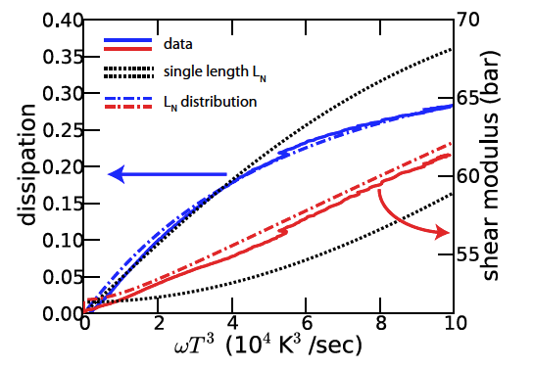
A good fit of the dissipation due to thermal phonons up to 1K, far above the asymptotic regime in ωT³

Slide 38
A very good fit of the stiffening due to ³He binding

Slide 39
... and the corresponding dissipation
... if one adds a narrow distribution of binding energies des ³He to dislocations whose character probably varies from edge to screw .
Here we chose a log-normal distribution with a width 0.1K around 0.67K (to be calculated; Syshchenko had neglected the length distribution and proposed 0.25K around 0.73K )

Slide 40
Conclusion: giant plasticity or supersolidity or both ?
the existence of a giant plasticity is now well established.
Once more, solid ⁴He proves to be « a probe in Materials Science » (P. Nozières 1994)
to be studied:
the nature of the critical velocity of dressed dislocations
larger strains and more defects
the limit of zero dislocation and zero impurity
the existence of supersolidity would need stronger evidence…
and support from a convincing theory

Slide 42
back to supersolidity:
elastic effects in torsional oscillator measurements
solid ⁴He
period decrease
=
frequency increase
k_{TO}
+ k_{He}
period (μs)
I_{TO}+ I_{He} (- I_{SS} ?)
temperature (K)
a decrease in inertia
due to supersolidity ?
or a stiffening
due to dislocation pinning?

Slide 43
dislocation motion:
comparison with a classical crystal
In helium :
80% reduction in c₄₄ => the plastic strain ε_{d} is 4 times larger than
the elastic strain ε_{l} even for stresses 10⁻¹¹ times the shear modulus
dislocations move like little violin strings
~ 10 μm under stresses σ ~ 1 μbar
=> typical velocities at 10 kHz up to 1 m/s
the plasticity exists at very low T,
it is giant at very low stress, reversible, linear,
fast, and anisotropic
δl
L_{n}
δl = π(1−ν)L_{n}²ε /16b
with b = 3.6 Angstrom and
the free length L_{n} ~ 200 μm
In Copper (Tinder and Washburn (1964) plasticity is very much smaller even at room T:
160 times smaller under stresses 10⁵ times larger (10⁻⁶ times the shear modulus)
irreversible and slow (minutes)
An interesting question:
do dislocations move by quantum tunneling through non-zero « Peierls » barriers or
classically with zero barriers ?

Slide 44

more possible artifacts in torsional oscillator measurements
Torsion rod hole
Elastic overshoot
Floppy mass, “glue”
Thin “lid” and/or gap

Slide 45
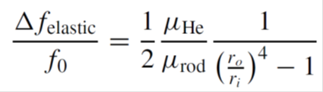
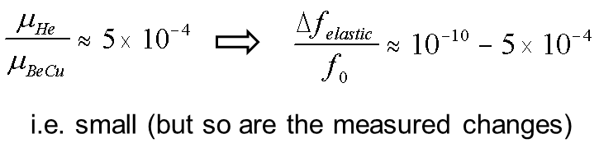
Torsion rod hole
Elastic overshoot
Floppy mass, “glue”
Thin “lid” and/or gap
independent of ω
mimics NCRI

