Slide 1




Supersolidity vs quantum plasticity in solid helium
S. Balibar, A. Fefferman, A. Haziot, X. Rojas
Laboratoire de Physique Statistique,
Ecole Normale Supérieure and CNRS,
associated to the Universities Paris 6 & 7, Paris (France)
Collaborations: H.J. Maris (Brown Univ. USA)
M.H.W. Chan and J.West (Penn. State Univ. USA)
LT26 – Beijing, Aug. 2011

Slide 2
Outline
A very short review on
the issue of supersolidity, 7 years after Kim and Chan’s first experiments (2004)
Measurements in our group at ENS-Paris:
1- elasticity (Rojas et al. PRL 2010 + poster LT26)
2- rotation (Fefferman et al. 2011, poster LT26 to be published)

Slide 3
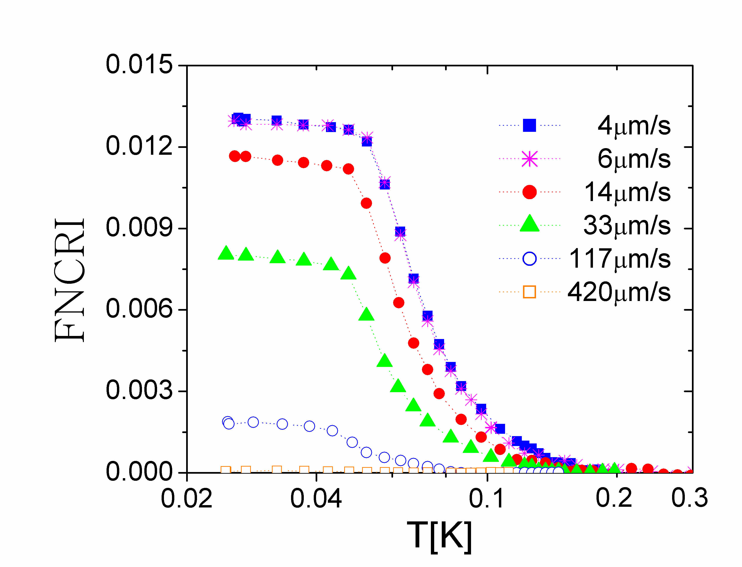
E. Kim and M. Chan (Penn. State U. 2004): could solid helium 4 flow like a superfluid ?
a « torsional oscillator » (~1 kHz)
a change in the resonance period below ~100 mK
1 % of the solid mass decouples from the oscillating walls ?
rigid axis
( Be-Cu)
solid He
in a box
superfluid fraction (NCRIF)
excitation
detection
I or K? supersolidity if I;
an elastic effect if K;
Temperature (K)

Slide 4
several anomalies exist
New torsional oscillator measurements in many groups :
Penn State, Cornell (2), Rutgers, Yokohama, KAIST, Tokyo, London, Kyoto, Manchester, Haifa, Paris...
the existence of rotation anomalies is confirmed
variable amplitude: from below 10⁻⁴ up to 20% apparent reduction in the rotational inertia
great sensitivity to ³He impurity content and disorder (rarely characterized)
hysteresis, relaxation times, frequency dependence…
Several other anomalies have been observed :
specific heat ( Lin, Chan et al. , Penn State): a peak at the transition temperature; some controversies about their interpretation
dc-mass superflow: Ray and Hallock (Amherst), not in Edmonton, Paris, Cornell; but the observed phenomena take place at different temperatures…
dielectric constant (Chan et al. 2010): to be confirmed
effect of a dc rotation (Kubota et al. followed by Kim, Kono et al.): see below
an elastic anomaly: Beamish, Day and Syshchenko (2007-2011)
after Iwasa and Suzuki (1980), and Paalanen (1981),
confirmed and extended by Mukharsky (2007-09) and by Rojas et al. (2010)
in the « supersolid » state, helium crystals are stiffer than in the « normal » state

Slide 5
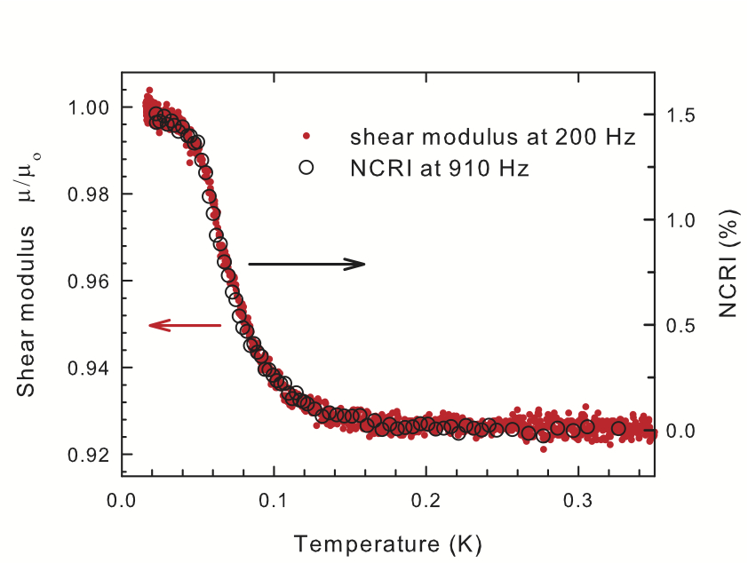
Day and Beamish (2007) : supersolid helium 4 is stiffer than normal solid helium 4
measurements on polycrystals with 0.3 ppm ³He
the shear modulus increases by ~ 10 % below ~ 150 mK
the temperature variation is the same as for the rotational inertia
Could all anomalies be consequences of a single phenomenon ?

Slide 6
a model for the elastic anomaly
Following previous work by Iwasa and Suzuki (1980) and by Paalanen (1981),
Day and Beamish propose in 2007:
³He bind to dislocations
below a temperature which depends on
the binding energy ε_{B},
the ³He concentration X₃
and the dislocation density Λ
after Beamish et al.
T > ε_{B}
T << ε_{B}
A crystal with mobile dislocations is softer than if they are pinned by impurities
Syshchenko Day and Beamish (Phys. Rev. Lett. 2010) :
measurements as a function of frequency and of the concentration X₃
precise agreement if ε_{B} = 0.73 ± 0.45 K

Slide 7
a possible model for supersolidity superfluid flow only if dislocations do not fluctuate (pinning)
dislocation lines
³He
impurity
kinks
supersolidity could exist inside defects (here dislocations)
(Pollet, Boninsegni, Svistunov, Prokofev, Kuklov, Troyer et al. 2007-2008)
transverse fluctuations of the dislocation lines could induce local mass currents, consequently phase fluctuations which destroy the quantum coherence Inversely, if the line is superfluid, the phase is blocked and the line should be fixed
difficulties: a very large dislocation density is needed in order to obtain phase coherence at Tc ~100 mK and ~1% supersolid fraction

Slide 8
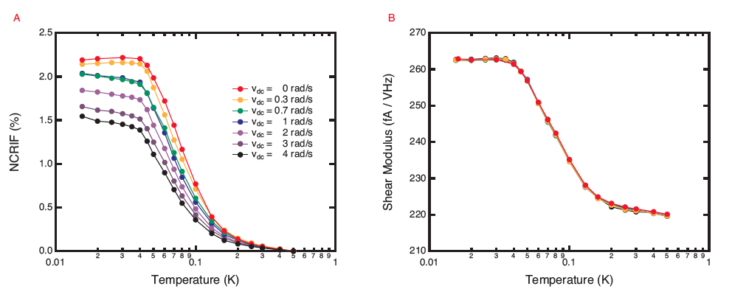
A purely mechanical effect ? according to several authors: NO
West, Chan, Day and Beamish, Nature Physics 5, 598 (2009):
in a very rigid cell where the contribution of solid helium to K is negligible,
hcp ⁴He shows stiffening and supersolidity
hcp ³He shows stiffening but no supersolidity
the period change of the oscillator is not due to an increase of the quantity K in τ = 2π √I/K, the period change must be the consequence of supersolidity in a Bose solid (helium 4)
Choi, Kim, Kono et al., Science 2010 + some more recent results:
influence of a dc-rotation reduction of the rotational inertia , no effect on the stiffness

Slide 9
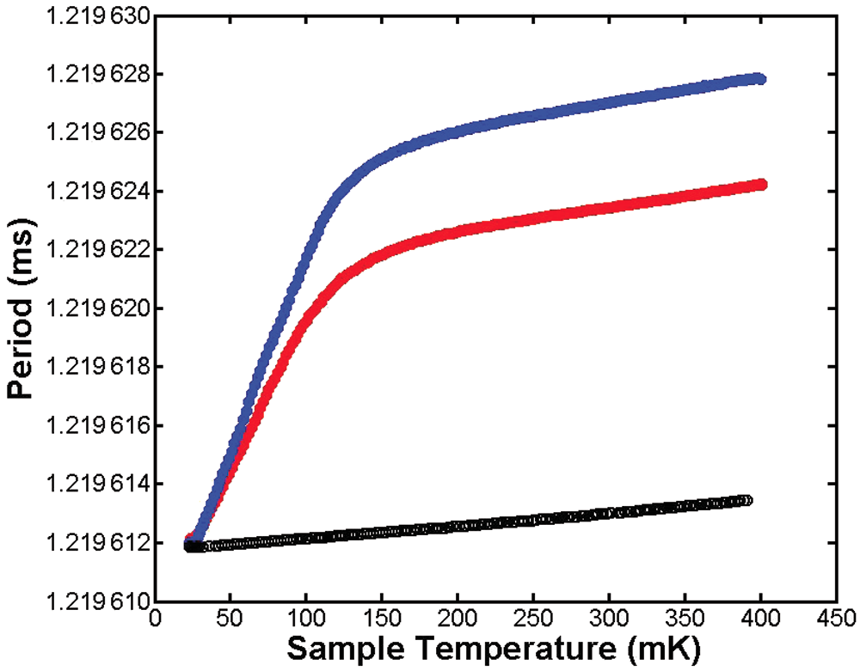
for some other authors: YES
J.D. Reppy (PRL 2010):
changing the disorder changes the crystal softening at high T, not the low T value as would be expected in the supersolidity scenario
Maris and Balibar JLTP 2010:
large freq. shifts expected in non-rigid cells due to the change in solid ⁴He stiffness
X. Mi, E. Mueller and J.D. Reppy (LT26):
the observed freq. shifts are due to the change in shear modulus of solid ⁴He, not to supersolidity
Pratt, Hunt, Gadagkar, Yamashita, Graf, Balatsky and Davis (Nature 2010):
Torsional oscillators show glassy dynamics.
Is this fundamentally different from the distribution of T-dependent relaxation times
of dislocations measured by Beamish et al. ?
Is this behavior universal or does it apply to some particular TOs only ?

Slide 10
our experiments at ENS-Paris
some control of the crystal quality thanks to optical access
compare high quality and low quality single crystals with polycrystals
1- elastic properties
Rojas, Haziot, Bapst, Balibar and Maris, PRL 105, 145302 (2010)
+ poster LT26 # 11P – A015
2- rotational properties in a sapphire minibottle (transparent and rigid)
Fefferman, Rojas, Haziot, Balibar, West and Chan (2011 to be published)
see poster LT26 # 11P – A029

Slide 11
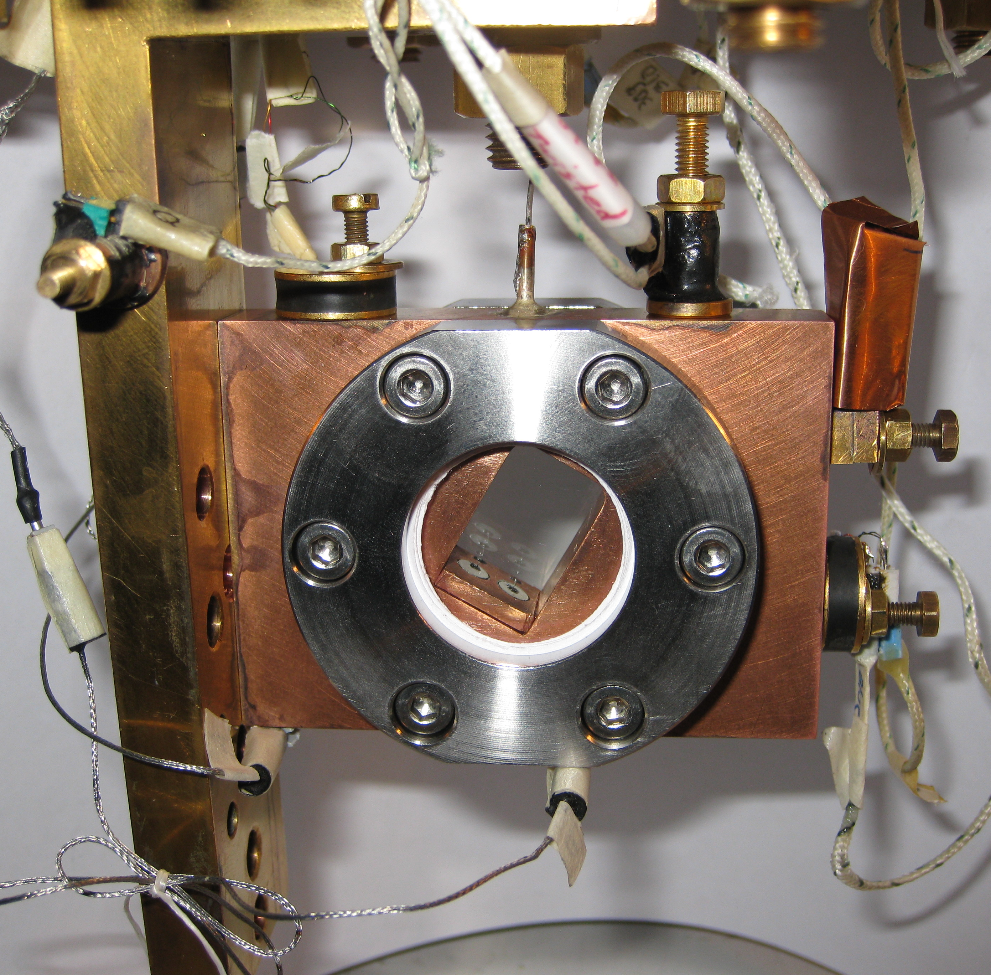
acoustic measurements in oriented single crystals
a retangular hole
18 x 12 x 11 mm³
in a copper plate
+ 2 sapphire windows,
In rings and
stainless steel clamps
fill line (0.1 mm ID) at the top
(the cell is tilted) most experiments done with ultrapure 4He (0.4 ppb 3He)
optical control of the crystal growth
2 piezo-electric transducers for the excitation and detection of acoustic resonances in the helium sample

Slide 12
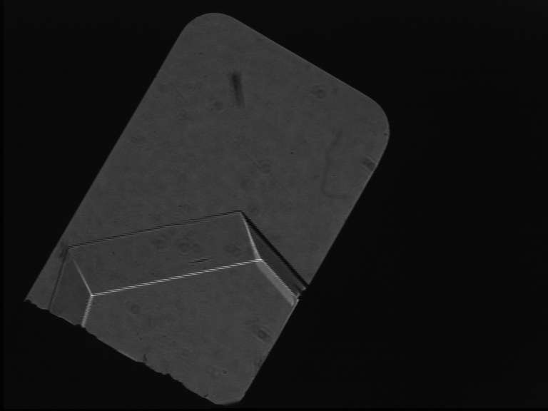
temperature dependence
liquid
a
c
crystal
X5
during growth
In agreement with Beamish’s results and model, the resonance frequency decreases (the crystal softens) as T increases from 24 to 100 mK
except if freshly grown

Slide 13
high quality single crystals
freshly grown X5a is soft because it contains NO impurity :
the potential energy of ³He in liquid ⁴He is 1.36 K lower than in solid ⁴He (see Pantalei et al. JLTP 2010 using Edwards and Balibar PRB 1989)
temperature cycles bring ³He impurities from the adjacent liquid into the solid . At low T, the resonance frequency tends to the value 19.2 +/- 0.2 kHz one calculates from measurements of the elastic coefficients by Greywall at 1.2K where the dislocation motion is damped by thermal fluctuations
crystal X5

Slide 14
a high quality crystal annealed at 950 mK : X5b
after annealing at 0.95K
the resonance freqency is now reduced to 15.9 kHz at high T
According to Maris'calculations,
this corresponds to an 86% reduction of c₄₄ .
a larger softening than for low quality crystals, much larger than for polycrystals (~ 10 %)
the « pinning length » is larger
The T-dependence varies as a function of
- cooling rate
- vibration level (1K pot)
for more details and ³He migration along dislocations, see PRL 105, 145302 (2010) and poster by Rojas et al. # 11P – A015

Slide 15
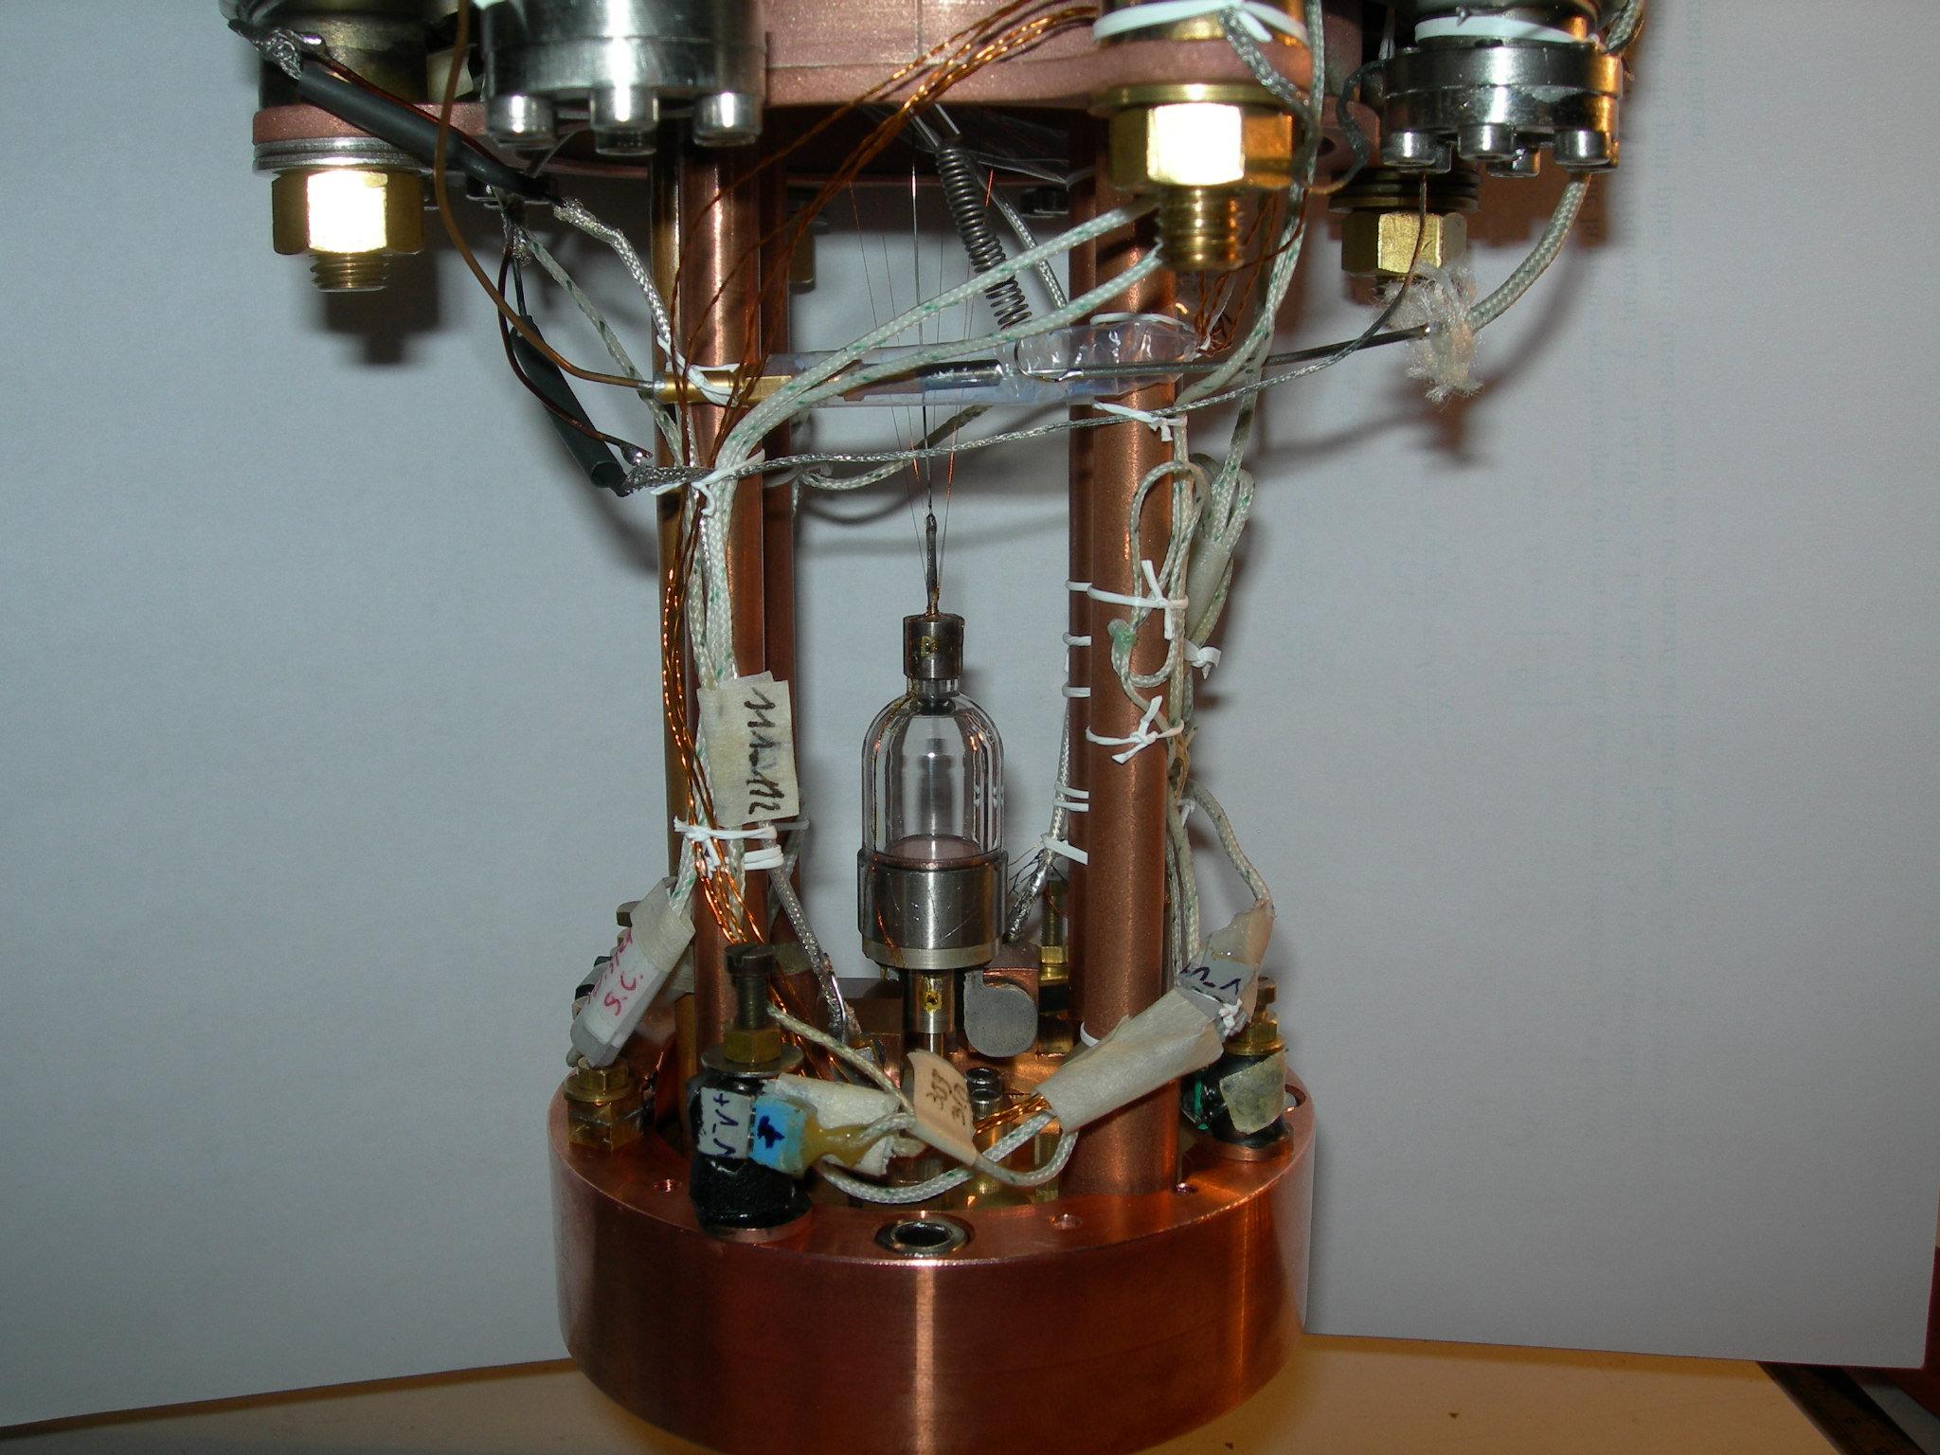
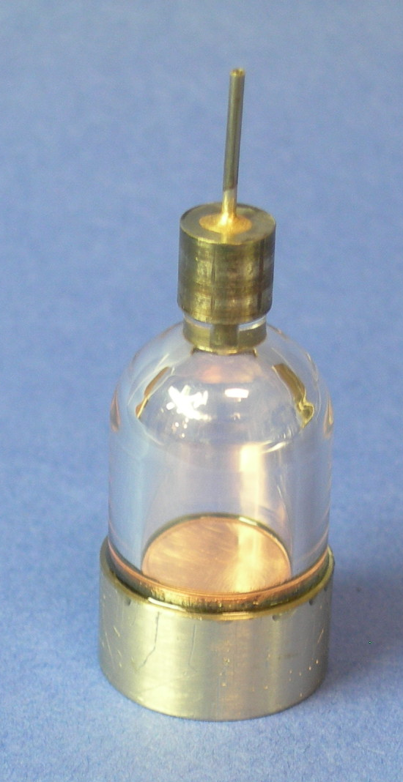
the rotation anomaly: single crystals compared to polycrystals
results to be published see poster by Fefferman et al.
A transparent torsional oscillator made by J. West and M.H.W. Chan (Penn State):
rigid sapphire body
AgCu torsion rod
resonance frequency f₀ ~ 900 Hz
Q up to 400 000 at low T
« mass loading » freq. shift ~ 1.8 Hz
T-cycles 10 mK–600 mK–10 mK in 24 hrs
We run it at constant amplitude and we measure the resonance frequency + the Q factor from the drive amplitude and the response phase.

Slide 16
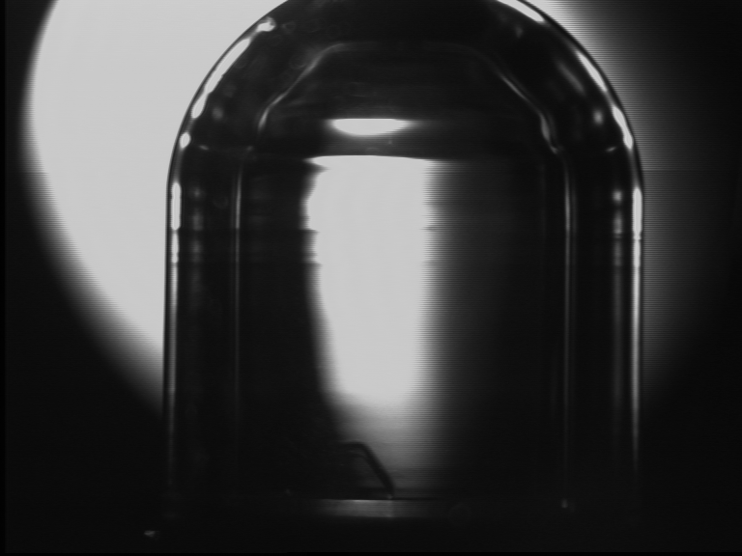
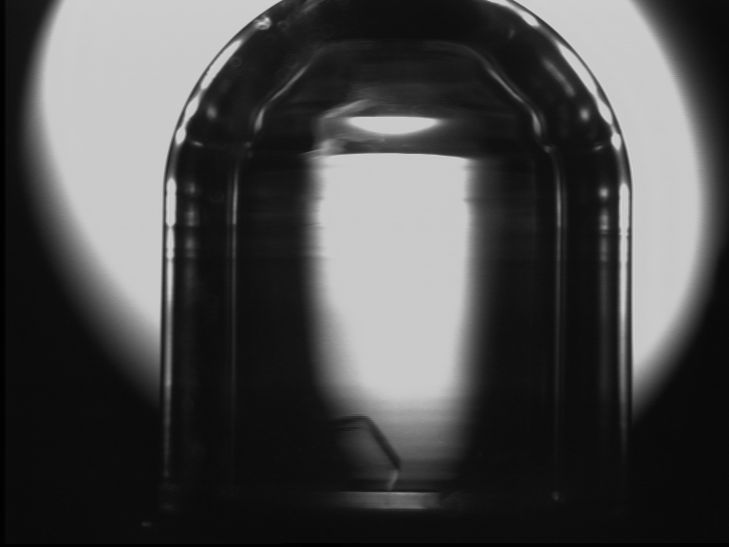
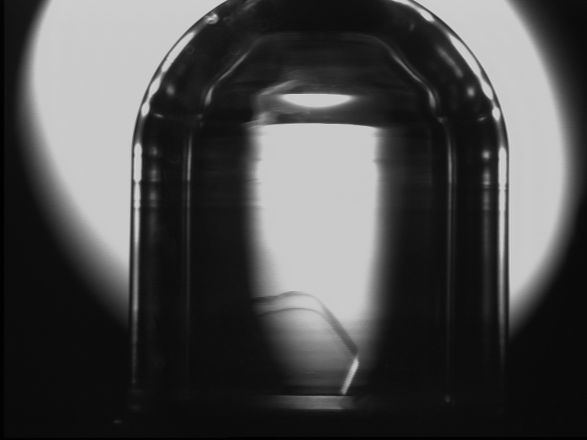
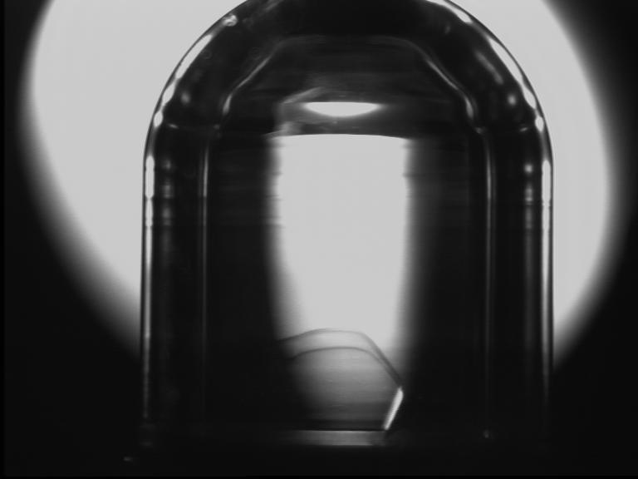
Facets of a single crystal in the minibottle
Fast growth from the superfluid at 20 mK & 25.3 bar
natural ⁴He (0.3 ppm ³He)
Notes:
Here you see on these pictures, the growth of a single crystal. The growth has been done at a relative fast from the superfluid phase in order to be able to see facets

Slide 17
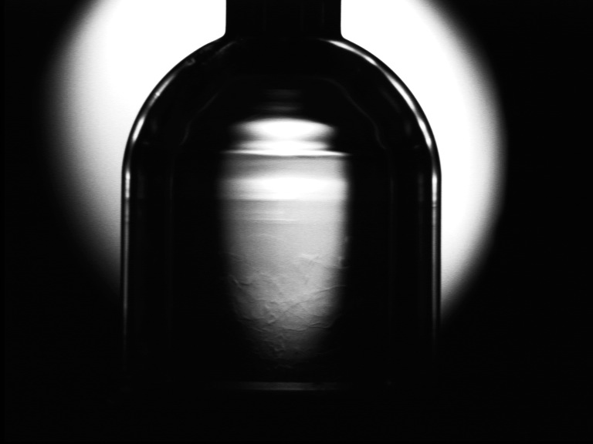
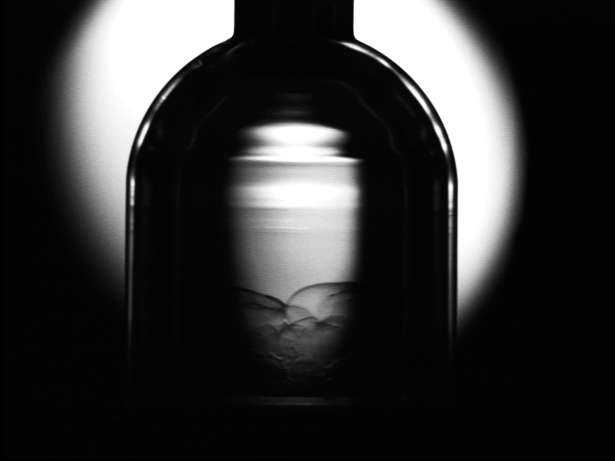
polycrystals grown at constant V from the normal liquid
liquid
polycrystal
grain boundaries are visible after lowering the pressure down to the liq-sol equilibrium

Slide 18
polycrystals
polycrystals :
the T-dependence of the resonance frequency f₀ is perfectly linear in T except for the usual hook below 50 mK which is due to the elastic anomaly of the torsion rod.
No velocity dependence. Same behavior as superfluid liquid helium in the same T range.
If it exists, the shift is < 0.2 mHz = 10⁻⁴ of the mass loading
(compatible with a change in c₄₄ less than 15%)

Slide 19
single crystals
high quality single crystals grown at 20 mK in eq. with liquid helium are unstable.
f₀ fluctuates in time and is not reproducible from one T-cycle to the next.
low quality single crystals grown at 1.4 K show a reproducible freq. shift which varies from one crystal to the next (an effect of orientation ?)
crystal #1 shift = 1 mHz = 5 10⁻⁴ mass loading
crystal #2 shift = 1.2 10⁻³ mass loading

Slide 20
the frequency shift of 2 single crystals
the polycrystal is taken as a reference and substracted here
the T-dependence is different from usually found with other TOs
(sharper shift at higher T, no apparent velocity dependence)

Slide 21
some conclusions
The rotation anomaly is larger with single crystals than with polycyrstals !
This is more compatible with an elastic anomaly (a change in stiffness)
than with supersolidity (a change in inertia)
If true, the magnitude of the change is relatively large compared to
Maris’ calculation (JLTP , 162, 12, 2011)
meaning that not only c44, perhaps c66 also, change in T .
For more details, see poster by Fefferman et al. # 11P – A029
some experiments show supersolidity
some other experiments show an elastic anomaly,
the 2 effects may add to each other …

