Slide 1






Is solid helium a quantum crystal?
Sébastien Balibar
Laboratoire de Physique Statistique and Laboratoire Pierre Aigrain,
Ecole Normale Supérieure and CNRS,
associated to the Universities Paris 6 & 7, Paris (France),
collaborations: A. Fefferman, A. Haziot, X. Rojas, F. Souris (ENS-PAris)
J. Beamish (Edmonton, Canada) M.H.W. Chan and J. West (Penn State),
H.J. Maris (Brown University),
V. Dauvois and P. Jean-Baptiste (CEA, Saclay, France)
LMU, München, May 2015

Slide 2
Outline
I - Introduction:
in hcp ⁴He crystals, quantum fluctuations are large
A paradoxical coexistence of superfluidity and solid character, i.e. supersolidity ?
II - the observed rotation anomaly is due to a giant plasticity, not to supersolidity
dislocations move freely in the very low T and very low stress limit
and in the absence of pinning by impurities
III – what is moving by quantum tunneling?
kinks on dislocations, ³He impurities are ballistic quasiparticles in the bulk crystal
IV- any evidence for 1D-superfluidity in dislocation cores?
I don't think so

Slide 3
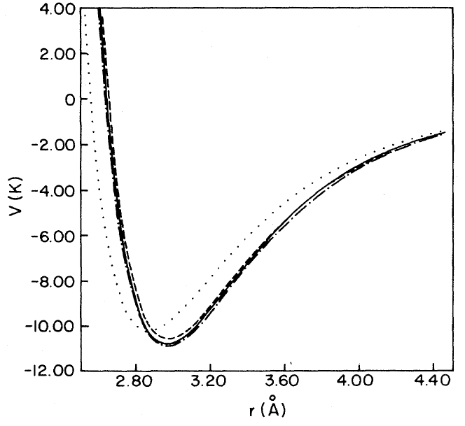
Quantum crystals: large quantum fluctuations
a particle (hard core diameter d, masse m)
localized in a box (size a)
Heisenberg principle => momentum p = ħ/(a-d)
a
d
"zero point" kinetic energy :
E_{c} = ħ²/2m(a-d)²
in the case of ⁴He crystals :
a = 0.37 nm ; d = 0.26 nm ; m = 4g/N
=> E_{k} ~ 15 K !
The interatomic potential is the sum of
a van der Waals attraction + a hard core repulsion
It has the same order of magnitude
large quantum fluctuations (Fritz London 1936)

Slide 4
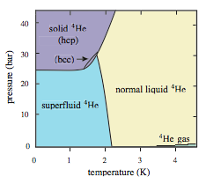
consequences at the macroscopic scale
F. Simon (1934) and F. London (1936):
a large molar volume
liquid ⁴He : 28 cm³/mole at P = 0
³He : 37 cm³/mole
⁴He
At P < 25 bar, the liquid phase is more stable
no triple point (liquid-gas-solid)
crystal growth from the liquid at low T
(negligible latent heat, high thermal conductivity)
2 liquid states: superfluid at T < 2K ; normal viscous at T > 2K

Slide 5
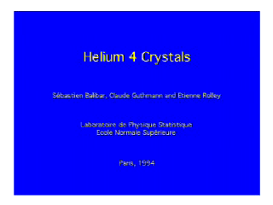
Helium 4 crystals: growth, facets

Slide 6
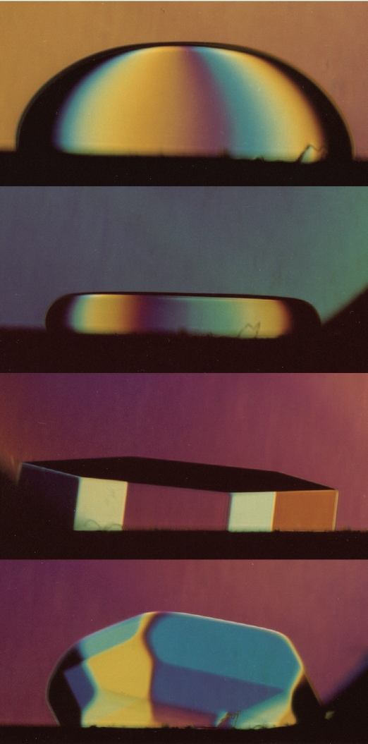
The Lindemann criterion + two questions
1.4 K
the Lindemann criterion:
at the liquid-solid equilibrium
(i.e. on the melting line)
classical systems:
the mean square displacement of atoms
R_{L} = (<u²>)^{1/2} ~ 0.10 a
(10% of the atomic spacing)
in helium 4: 26% (Burns and Isaac 1997)
atoms are weakly localized in their lattice
1 K
0.4 K
Question 1:
are facets destroyed by quantum fluctuations? NO
see Balibar, Parshin and Alles, Rev. Mod. Phys. 77, 317 (2005)
Question 2 (this talk):
any anomaly in the elastic properties ? YES
any coexistence of superfluidity and crystalline order, i.e. « supersolid » ?NO
0.1 K

Slide 7
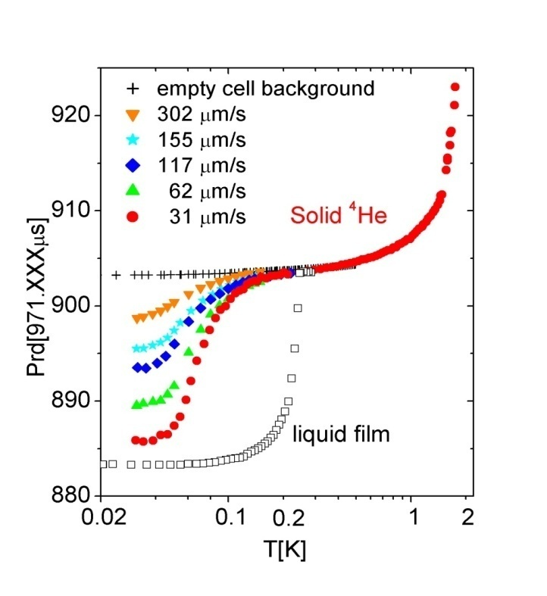
original motivation: the enigma of supersolidity
E. Kim and M. Chan (Penn. State U. 2004):
a « torsional oscillator » (~1 kHz)
a change in the resonance period below ~100 mK
a small critical velocity
1 % of the solid mass decouples : Leggett’s « NCRI »?
rigid axis
( Be-Cu)
solid He
in a box
excitation
detection
period (μs)
the resonance period
depends on the inertia momentum I and on the torsion constant K
supersolidity appears (I decreases) ?
or a change in stiffness (K increases) ?
temperature (K)

Slide 8
The 1969 historical model
Thouless 1969,
Andreev and Lifshitz 1969:
delocalized vacancies could exist at T = 0
E₀
zhν
the crystal would be « incommensurate »
BEC => superfluid flow of mass
coexistence of non-zero shear modulus and mass superflow
A.J. Leggett (1970): non-classical rotation
But hν ~1.6 K and the bottom of the vacancy band is at + 13K (Clark and Ceperley 2008)
=> no vacancies at 0.1K
P.W. Anderson (2010-11): the ground state has to be supersolid
If commensurate … not supersolid ?Prokof'ev (2007) : NO

Slide 9
Shevchenko’s scenario for supersolidity
mass flow along dislocation cores forming a connected 3D network ?
(Shevchenko 1987, Boninsegni 2007, Pollet 2008)
dislocation lines
³He
impurity
network length l_{n}
kinks
do ³He impurities promote or destroy superfluidity?
3 difficulties: a very large dislocation density (10¹² /cm² !) is needed to obtain 1% superfluid fraction and the coherence length ξ = a (T* /T ) ~ 1 nm << l_{n} at T = 100 mK
dislocation connection is poor so that l_{n} is large , of order microns, not nanometers

Slide 10
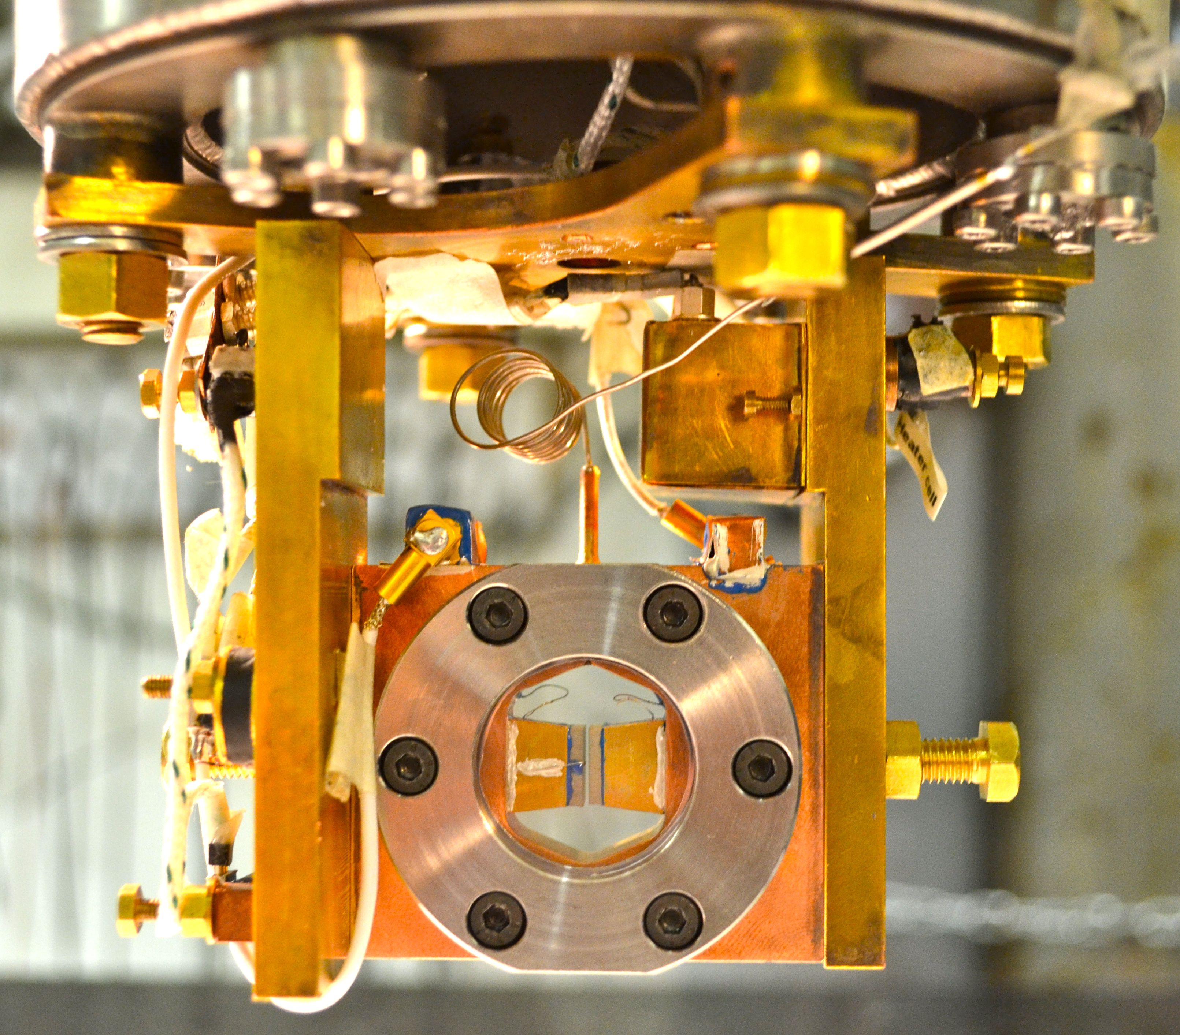
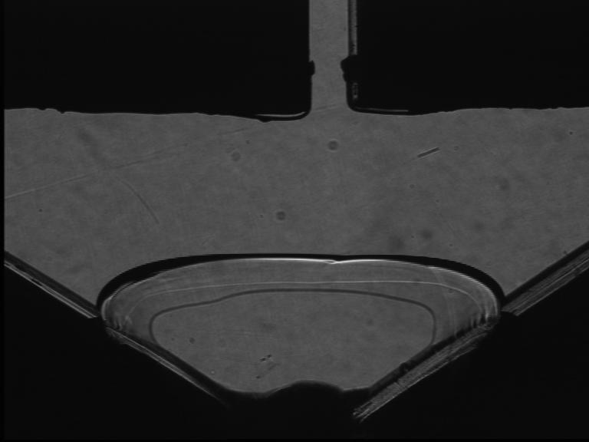
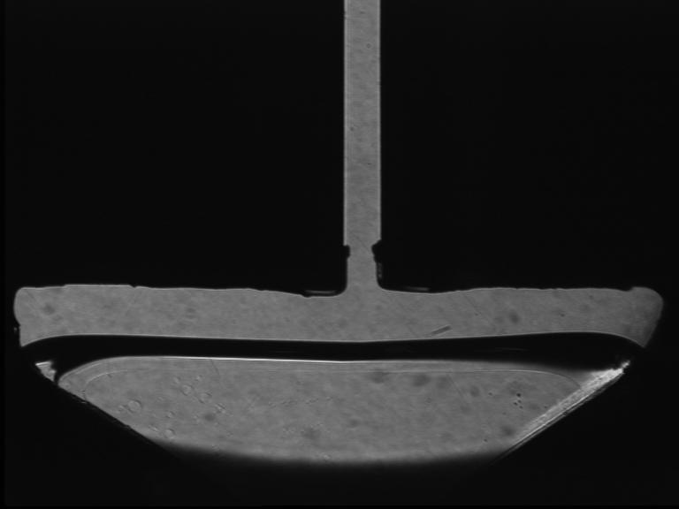
6 years after Day and Beamish 2007:
the shear modulus of oriented ⁴He
single crystals from 15 mK to 1K
Haziot et al. (PRL 110, 035301, 2013)
orientation from growth shape of a seed
growth inside the 0.7 mm gap between 2 transducers
very small AC- vertical displacement:
calibration: 0.95 AA/V at 1Hz to 20 kHz
down to 0.001 Angström ( strain ε down to 10⁻¹⁰)
vertical stress σ = με down to 10⁻⁹ bar
temperature: 15 mK to 1.5K
direct measurement of the shear modulus μ

Slide 11
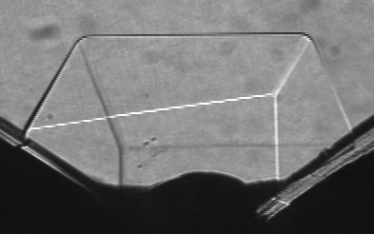
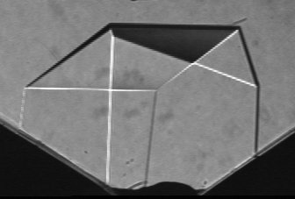
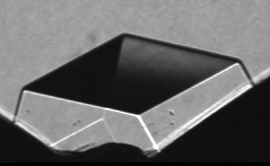
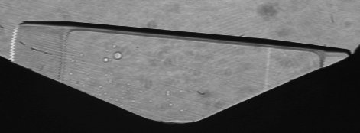
random nucleation on various sites:
many crystals with different orientations
6-fold symmetry axis c
X2
X6
X15
X3
X20
X5
X21

Slide 12
ultrapure ⁴He single crystals with only 4x10⁻¹⁰ ³He do not resist to shear in a T-domain around 0.2K
Haziot et al. submitted to Phys. Rev. Lett. (2012)
giant plasticity around 0.2K
dislocations are highly mobile in a T-domain between
- ³He impurity binding at low T
- damping from collisions with thermal phonons at higher T
=> measurements of dislocation properties:
gliding direction
density
length
binding energy to ³He impurities

Slide 13
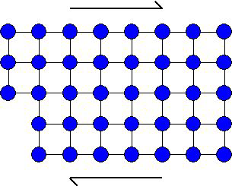
dislocation gliding is responsible for the softening of crystals
under an applied stress σ
the strain ε is the sum of
ε_{lat} due to the deformation of the lattice and
ε_{dis} due to the displacement of dislocations
a shear stress
If dislocations move enough,
ε_{dis} is large => μ_{eff} is reduced

Slide 14
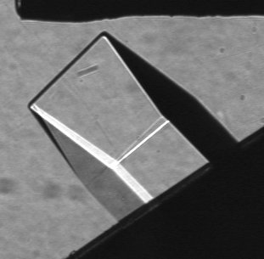
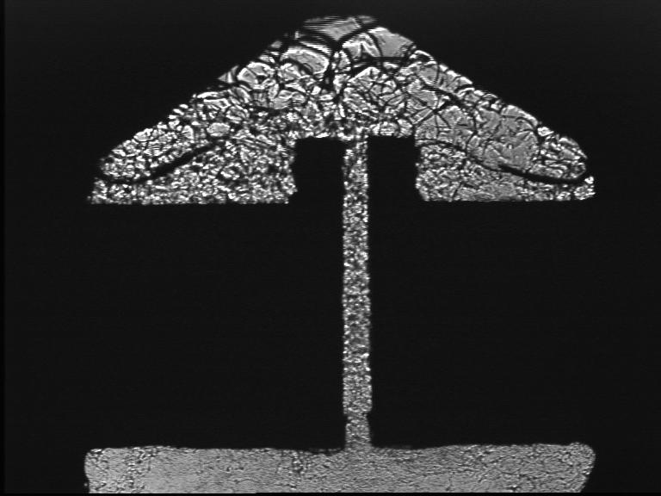
the elastic anomaly is large and anisotropic
crystal X3 at 45° :
X3
X20
polycrystal BC2:
BC2
X21
X2
X5
X2 , X21 depend mostly on c₄₄
X5 depends more on c₆₆ than c₄₄
The low T value of the stiffness is
the intrinsic value due to the lattice elasticity,
as measured by Greywall (1.2K, 10MHz)
contrary to Anderson's model of supersolidity
dislocations glide along high density planes
basal planes? reduction of c₄₄ ; prismatic planes ? c₆₆

Slide 15
dislocations glide along basal planes
X2, X5, X6 and X21 :
similar growth at 1.4K,
same purity (0.3 ppm of ³He)
=> same elastic constants?
if c66 = Cst and only c44 varies:
same reduction by 62±8% for all crystals (Souris et al. 2015: up to 90%)
the opposite hypothesis (c44 constant, c66 variable ) would lead to absurd results:
for X6, c66 should vary by 300%
more than 1000% for X21 !
hexagonal metals:
gliding along basal planes in Be, Mg, Co, Zn,
along prismatic planes in Zr, Ti
Agreement with the criterion by B. Legrand (1984) : dislocation splitting due to the low energy of stacking faults

Slide 16
with zero impurity and at T = 20mK , dislocations move freely: linear response with 80% reduction in the shear modulus c44
with impurities:
hysteretic pinning/unpinning
without impurities:
X4 cooled down to 20 mK
under larger ac-strain (10⁻⁶)
in the presence of liquid He
stable 80% reduction in c₄₄
a giant reversible plasticity
down to 10⁻¹⁰ strain
no equivalent in classical crystals
linear soft elastic behavior at 20 mK down to extremely small stresses
1 nbar = 10⁻¹¹ c₄₄ !
no Peierls barrier against kink motion?
is the kink energy E_{k} = 0 ?
crystals grown at 1.4K,
with 0.3ppm 3He
unpinning from ³He
pinning
by ³He
X4 cooled down at high drive
with liquid in the cell
X4 (zero impurity)
« resolved » = projected in the basal plane

Slide 17
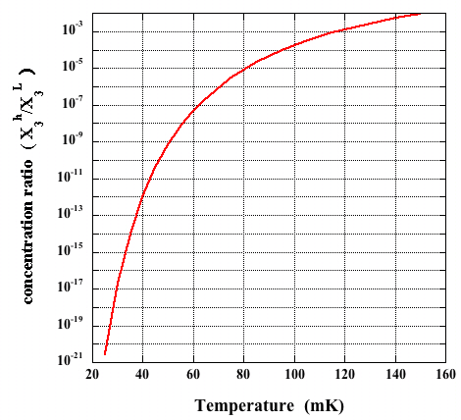
« zone melting » with ⁴He : from 0.3 ppm ³He to 0.4 ppb
… and down to zero
Slow growth proceeds very close to equilibrium at the solid-liquid interface.
The concentration ratio is
at 25 mK:
starting with X₃^{L} = 4 10⁻¹⁰
one obtains X₃^{h} = 4 10⁻³¹ !
even in the presence of dislocations,
no ³He in the crystals grown below 25 mK
concentrations equilibrate quickly
³He impurities are ballistic quasiparticles
(C.Pantalei , X. Rojas and S. Balibar, JLTP 2010
using
D.O. Edwards and S.Balibar Phys. Rev. B 1989
shaking the dislocations in the presence of some liquid expels all ³He in the liquid
=> the crystal is stable in a soft state at low T,
dislocations move like little violin strings (no measurable dissipation)

Slide 18
the quantum motion of kinks
in the classical model by Zhou, Graf, Balatsky et al., kinks only move above a rather large threshold stress.
(PRL comment on Haziot et al. 2013)
in reality, the motion is linear down to very small driving stress, actually with zero measured dissipation, an evidence for kink motion by quantum tunneling
(Haziot et al. reply, PRL 2013)
yield
stress
classical crystal
4He crystal
with
no impurities

Slide 19
damping of dislocation motion from collisions with thermal phonons
Haziot et al. submitted to Phys. Rev. Lett. (2012)
giant plasticity around 0.2K
dislocations are highly mobile in a T-domain between
- ³He impurity binding at low T
- damping from collisions with thermal phonons at higher T
=> measurements of dislocation properties:
gliding direction
density
length
binding energy to ³He impurities

Slide 20
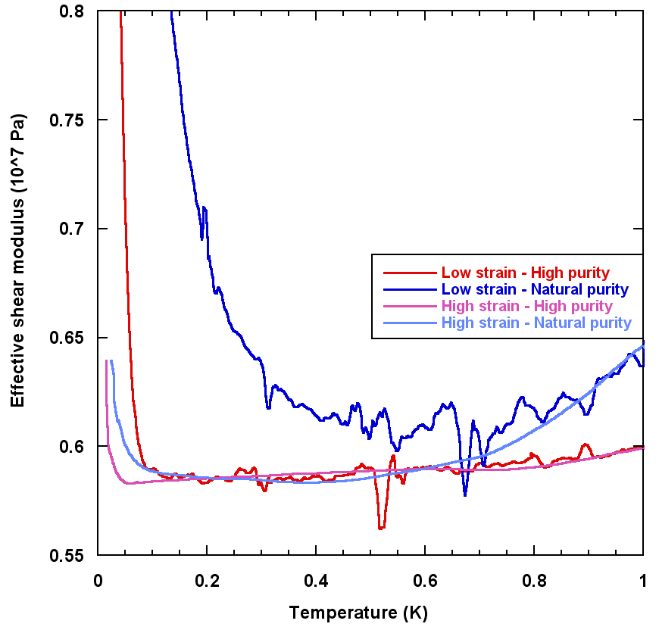
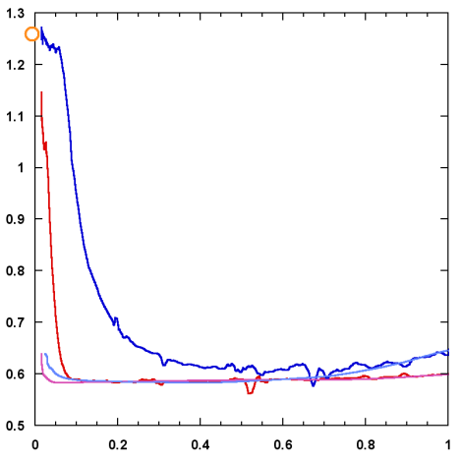
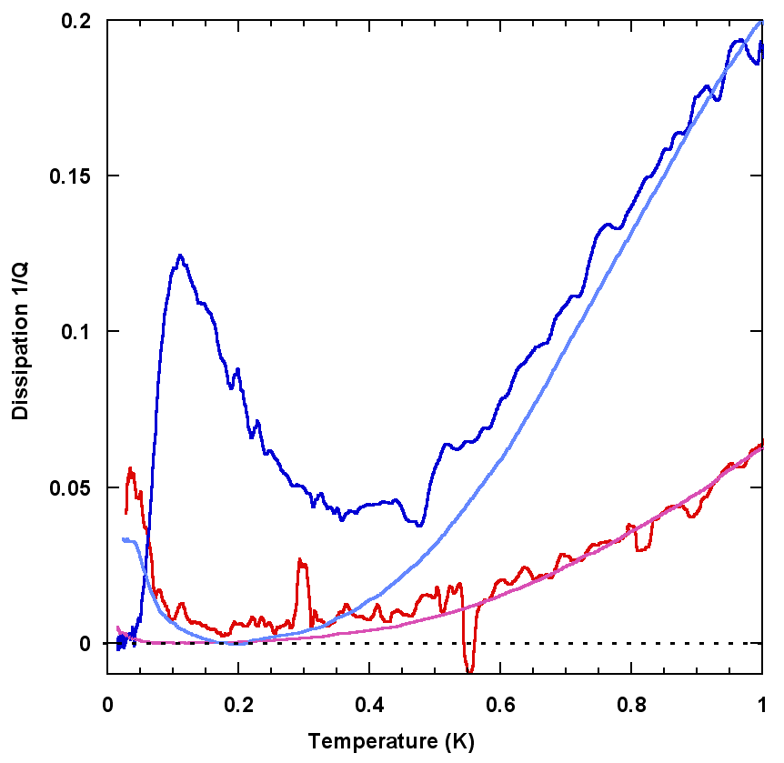
ωT³ dissipation from collisions with thermal phonons
high purity
low purity
we measure the real and imaginary parts of the response to the driving strain
the ³He binding and the reduction in c₄₄ depend on amplitude and purity
Granato and Lücke 1956 + Ninomiya 1974 stringlike vibrating dislocations
shear modulus variation
with α = 0.019 and a dissipation for phonon damping
If true, the dislocation density Λ
and the length L between network nodes
can be determined independently
low drive
high
drive
low
purity
high
purity

Slide 21
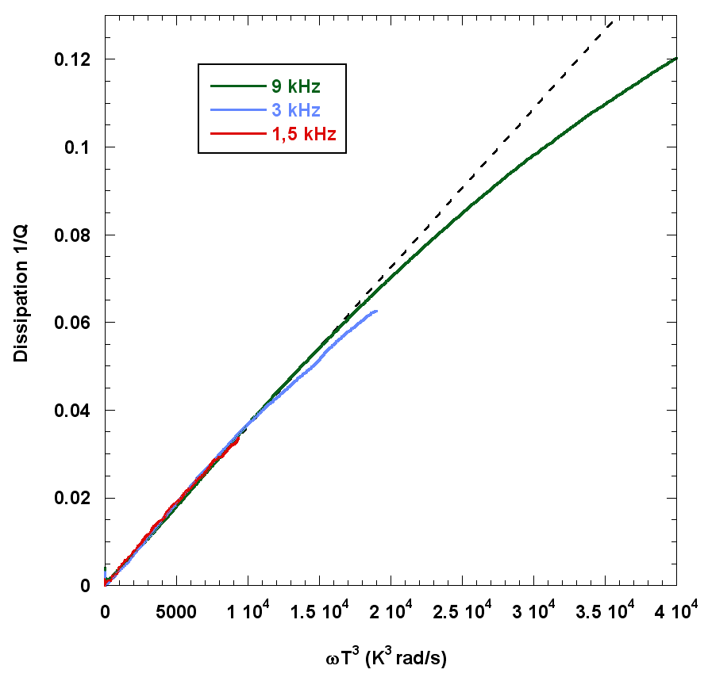
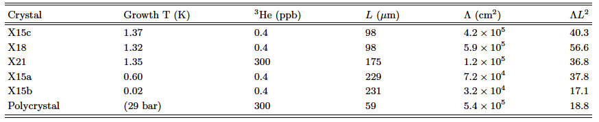
dissipation measurements => dislocation density and pinning length (Haziot et al. Phys. Rev. B87, 060509(R) 2013)
excellent agreement with 1/Q ~ ωT³
collisions with thermal phonons
densities from 3 10⁴ to 6 10⁵ cm⁻²
network lengths from 60 to 230 μm
ΛL² from 17 to 57 (F. Souris et al. 2014: up to 471)
instead of 3 for a simple 3D lattice
=> dislocations are grouped in sub-boundaries
and not well connected
dislocations cannot move at 10MHz and 1.2K
the Shevchenko theory of a network of
superfluid dislocation cores would require
10¹² disloc/cm² for a 1% NCRI
and a coherence length ξ ~ aT*/T larger than L
0.5K
no sign of superfluid transition around 0.5K, i.e.
ωT³ between 1 and 7 x 10³ (too high frequency?)

Slide 22
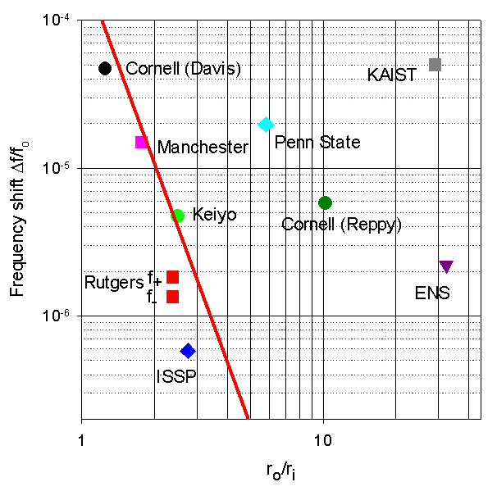
the torsion rod should not be a thin tube !
J. Beamish, A. Fefferman, A. Haziot, X. Rojas, and S. Balibar,
Phys Rev B85, 180501(R), 2012
when the « torsion rod » is a torsion tube:
r₀ : outer radius of the tube
r₁: inner radius
solid line:
maximum possible effect of the He stiffness
In at least 6 rotation experiments the observed period shift could be a consequence of a change in the He stiffness
their « critical velocity » would be the critical strain for pinning by ³He
the magnitude of their dissipation peak also agrees with the mechanical dissipation in stiffness measurements
other artifacts (thin top plate: Maris, Reppy, Chan…) need to be considered in most other experiments …
but some experiments (Kim, Kono, Shirahama…) resist to possible critics

Slide 23
a critical speed: ³He impurities move attached to dislocations below 45 μm/s
(A. Haziot et al. PRB 88, 014106, 2013)
From the dislocation density Λ = 7.6 10⁻⁵ cm⁻², and the dislocation length
L = 73 μm, we obtain the dislocation speed as a function of applied strain.
The transition occurs at
a critical speed v_{C} ≈ 45 μm/s
pinning
tentative interpretation:
a max tunneling frequency for ³He atoms on the dislocation?
in the bulk crystal ³He are quasi-particles moving by coherent quantum tunneling
bandwidth: 30 to 600 μK
average velocity:
<v>^{1/2} = 4.2 a J₃₄ ~ 0.6 to 12 mm/s
1 or 2 orders of magnitude faster
inelastic tunneling of ³He bound to dislocations up to 45 μm/s ?
tunneling along the dislocation ?
a precise model and calculation is highly desirable
damping from
bound ³He
exp(-0.67/T)
Notes:
Then, we can plot the same data but instead of the frequency, we can plot the speed as a function of 1/T.
It appears that the transition between the two regimes occurs in the same speed region suggesting the existence of a critical speed.
We measured values for this critical speed between 40 and 100 micron/s.
In order to interpret these results let’s see quickly what is the model in the classical case.

Slide 24
the damping of dressed dislocations is proportional to their ³He concentration a tentative model
the motion of the dislocation at very low T and under very small forces is made possible by the quantum tunneling of ⁴He atoms
³He atoms tunnel easily through the bulk lattice
BUT when attached to a dislocation, ³He atoms do not tunnel easily from site to site
they lag behind , distort the line, jump with transverse waves emission
³He
a preliminary calculation by H.J. Maris (Brown U.):
B ~ (4 π²/b) (ρC)^{1/2} ~ 0.027 Pa.s
our experimental value: B = 0.15 Pa.s (6 times more)
a more precise model should include non-sinosoidal motion, direct emission of phonons...
energy loss per unit jump: 0.05K even at the highest speed (45 μm/s), much less than the binding energy 0.7K

Slide 25
the length distribution of dislocations
(A. Fefferman et al. Phys. Rev. B89, 014105, 2014)
when decreasing the driving strain,
³He bind to short dislocations before long ones.
With a single dislocation length, one should see a sharp transition to the stiff state where all dislocations are pinned by impurities.
we have measured the distribution of dislocation lengths between network nodes

Slide 26
the network length distribution is wide: from 30 to 300 μm
to each driving strain amplitude ε corresponds
a max length L_{c}
below which ³He binds
L_{C} = 2F_{C} / bεμ
with F_{C} = 6.8 10⁻¹⁵ N
b = 0.36 nm (Burgers vector)
F_{C} is consistent with a potential well of width 4a

Slide 27
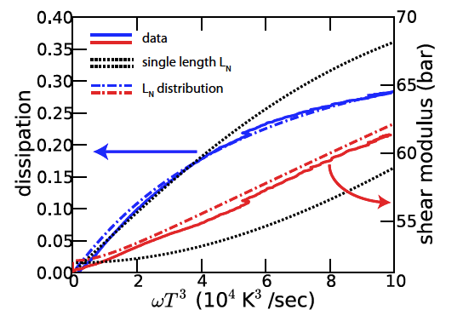
shear modulus and of dissipation far above the asymptotic regime in ωT³
Fefferman et al. PRB 89, 014105, 2014, 16 kHz
excellent fit with phonon scattering + a reasonable distribution of network lengths.
No sign of superfluid transition in grain boundaries nor dislocation cores around 0.5K as proposed by various authors
(Pollet 2007-08,
Boninsegni 2007,
Kuklov 2014,
Hallock 2007-14)
0.5K at 16 kHz

Slide 28
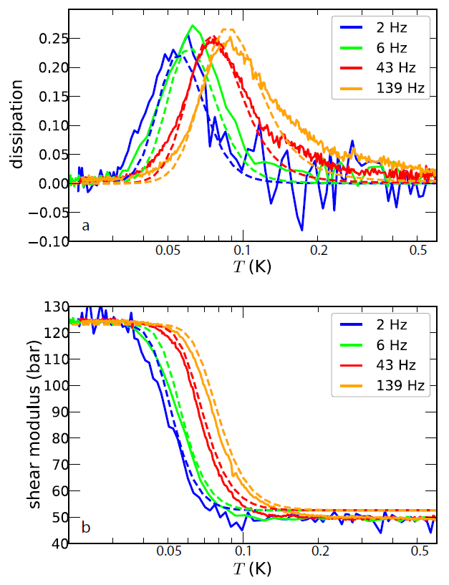
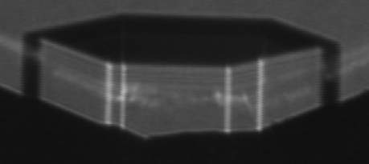
the distribution of binding energies
0.3
0.2
Crystal Z5
dissipation
0.1
0
Solid lines: Data
Dashed lines:
Calculation including distribution of network lengths.
Fit parameters:
Same length distribution as before, plus a binding energy distribution of width
0.1 K around 0.7K.
Needed:
Precise calculation of edge and screw dislocation binding energies.
0.05
0.1
0.2
0.5
temperature (K)
120
shear modulus (bar)
80
40
0.05
0.1
0.2
0.5
temperature (K)

Slide 29
more details on the motion of dressed dislocations
at sufficiently low speed (v < 45 μm/s),
dislocations move dressed with ³He impurities
the peak dissipation occurs at a temperature T_{p}, near the middle of the soft to stiff transition, where ωτ = (1 + 0.02ΛL_{N}²)^{1/2} ~ 1
ω/2π is the measurement frequency
and the relaxation time τ of the dislocations is τ = BL_{N}²/π²C
where C is the dislocation line tension
and B is the damping coefficient in the equation of motion
Ad²ξ/dt² – Bdξ/dt + Cξ = bσ
where ξ is the displacement of the dislocation line, b is the Burgers vector and σ is the driving stress.
Question:
are τ and B prop. to the concentration of ³He on the line? is B = B₀ X₃ exp(E_{b}/T) ?
where X₃ is the ³He concentration in the ⁴He cylinder

Slide 30
the relaxation time of dressed dislocations
F. Souris, A. Fefferman et al. (Phys Rev B90, 180103, 2014)
3 sets of measurements for 3 different ³He concentrations.
from 25 ppb (natural purity of ⁴He from Qatar !) to 385 ppb and to 2.32 ppm
difficulties:
- measure X₃
V. Dauvois and P. Jean-Baptiste (CEA Saclay, France)
- grow crystals without trapping ³He in the liquid
- mix gases carefully !
The scatter in the slopes is consistent with the energy distribution
0.7K ± 0.1K if
B = B₀ X₃exp(E_{b}/T)
but for a quadratic dependence, one would have
B = B₀ X₃² exp(2E_{b}/T)
so that the binding energy would be ~ 0.35K
=> extraplate to 1/T=0

Slide 31
the damping coefficient B is indeed prop. to the concentration X₃ , not to X₃²
Suppose that
B= B₀ [X₃ exp(E/T)]^{n} agreement with n = 1, not with n=2.
This result confirms that the binding energy E₃ = 0.7K,
not the values proposed by I. Iwasa in 2013 (0.2K) nor by E. Kim et al. in 2008 (0.4K)
damping coefficient B (N/m.s)
3He concentration X3

Slide 32
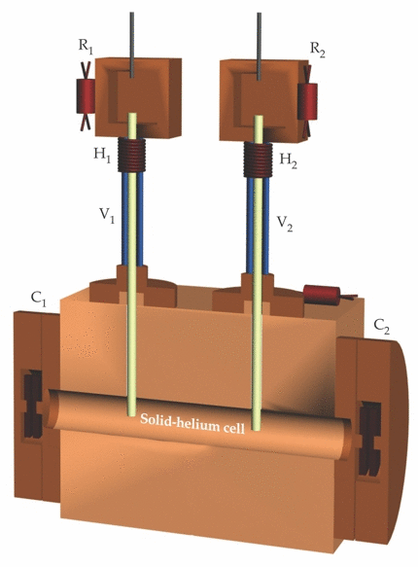
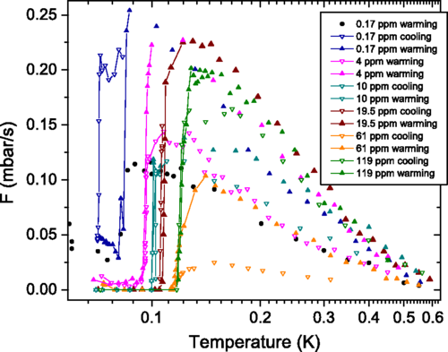
mass flow experiments though a superfluid-solid-superfluid junction
Ray, Hallock and Vekhov (Amherst 2008 – 2014)
mass flow meauserements by Vekhov, Mullin and Hallock (Amherst) PRL 113, 035302, 2014)
A possible interpretation: mass flow along superfluid dislocation cores (Luttinger liquids), blocked by 3He impurity adsorption.
May be... but not confirmed at Edmonton (PRL 2015)

Slide 33
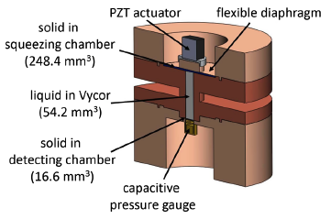
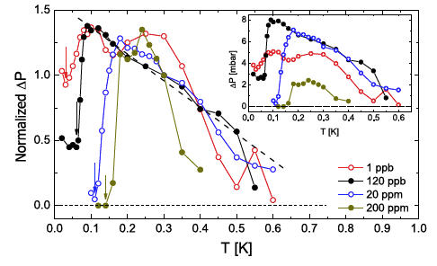
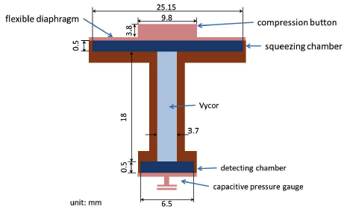
mass flow experiments through a solid-superfluid-solid junction
(Cheng et al., Edmonton Phys Rev Lett. 2015)
with no need of mass flow through the solid,
only a transmission of stress, similar T-results
3He study from 1 ppb to 200 ppm:
3He adsorb preferentially at the liquid-solid interface, not on dislocations.

Slide 34
Conclusion and further studies
No supersolidity in bulk 4He crystals
No clear evidence for superfluidity in defects of 4He crystals except from simulations
Clear evidence for quantum tunneling of kinks on dislocations, 3He impurities in bulk 4He
mass flow experiments: Amherst (Hallock et al.) vs Edmonton (Beamish et al.)
Understand the full T-dependence,
in particular the vanishing of stress transmission from 0.1 to 0.6K
could one prepare hcp ⁴He crystals with no dislocations at all?
"Search for dislocation free ⁴He crystals" by F. Souris et al. (JLTP 178, 149, 2015)
more on dislocations needs to be understood:
binding energy of ³He, splitting, kink energy, dissipation when dressed with 3He impurities...
the properties of ³He crystals:
compare Fermi to Bose crystals
in progress (Cheng and Beamish at Edmonton)

Slide 36
the (controversial ?) frequency dependence of the softening
Crystal Y3 – ε = 2.7 10⁻⁹
Temperature (K)
Day and Beamish (2007): the response time of the moving dislocation τ ~ exp(E_{b}/T) is prop. to the concentration of ³He bound to it (binding energy E_{b})
transition where ωτ ~ 1 => frequency dependence
Iwasa (2010) and Kim (2013): a T-dependent pinning length, no frequency dependence
Notes:
We measured the stiffening transition in the same crystal Y3 for a wide range of frequencies and several different excitations.
As you can see the temperature of the transition is changing with these parameters.
For each run, we measured the temperature of the dissipation peak and we place it on an Arrhenius plot.

Slide 37
two dissipation regimes (A. Haziot et al. PRB 88, 014106, July 2013)
at high frequency or strain amplitude:
no frequency dependence
real pinning as predicted by Iwasa and Kim
at low frequency or small strain:
a thermally activated dissipation regime ~ exp(-E_{b}/T)
E_{b} = 0.67K
damping of the motion of dislocations dressed with 3He impurities bound to them
the transition temperature as a function of frequency and strain amplitude
Notes:
We have discovered two different regimes.
a regime where the stiffening temperature is dependent on the frequency as described by Day and Beamish with a Debye model.
a regime where the stiffening temperature is independent of the frequency as described by Iwasa with a pinning model.

