Slide 1






The giant plasticity of a quantum crystal
S. Balibar, A. Fefferman, A. Haziot, X. Rojas
Laboratoire de Physique Statistique,
Ecole Normale Supérieure and CNRS,
associated to the Universities Paris 6 & 7, Paris (France),
and J. Beamish (Edmonton, Canada)
other collaborations: M.H.W. Chan and J. West (Penn State) ,
H.J. Maris (Brown University)
Workshop nanostructures,
P.M. Curie University , Nov. 30th , 2012

Slide 2
ultrapure ⁴He single crystals do not resist to shear around 0.2K
Haziot et al. submitted to Phys. Rev. Lett. (2012)
a hexagonal ⁴He crystal.
a direct measurement of its shear modulus
strong softening around 0.2K
dislocations are highly mobile in a T-domain between
- ³He impurity pinning at low T
- damping from collisions with thermal phonons at higher T
a giant plasticity with no equivalent in classical crystals
We have solved the « enigma of supersolidity ».

Slide 3
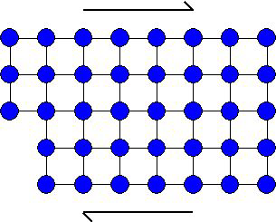
plasticity of a crystal: dislocation gliding
under small stresses: elastic deformation of the lattice determined by elastic coefficients
a shear stress
under larger stress σ
the strain ε is the sum of
ε_{lat} due to the deformation of the lattice and
ε_{dis} due to the displacement of dislocations
= μ_{eff} (ε_{lat} + ε_{dis})
an effective shear modulus μ_{eff}
If dislocations move,
μ_{eff} is reduced

Slide 4
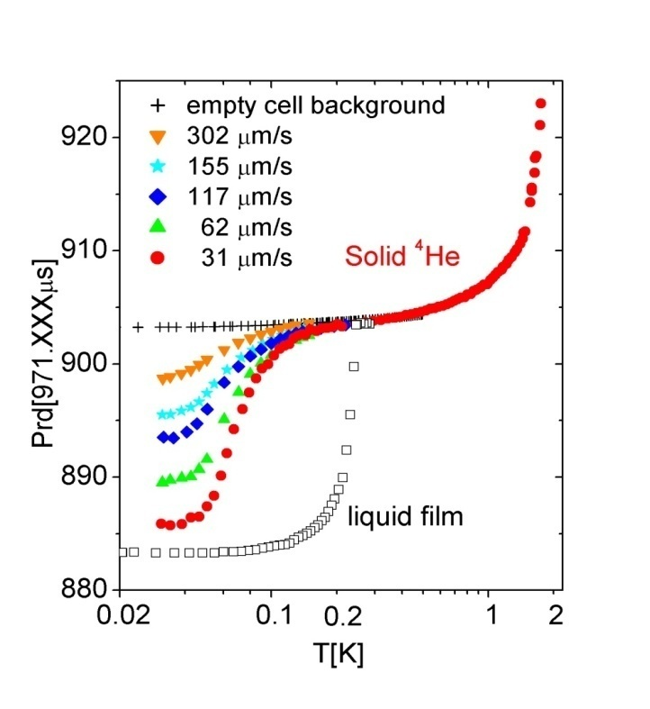
original motivation: the enigma of supersolidity
E. Kim and M. Chan (Penn. State U. 2004):
a « torsional oscillator » (~1 kHz)
a change in the resonance period below ~100 mK
a small critical velocity
1 % of the solid mass decouples : Leggett’s « NCRI »?
rigid axis
( Be-Cu)
solid He
in a box
excitation
detection
period (μs)
the resonance period
depends on the inertia momentum I and on the torsion constant K
supersolidity appears (I decreases) ?
or a change in stiffness (K increases) ?
temperature (K)

Slide 5

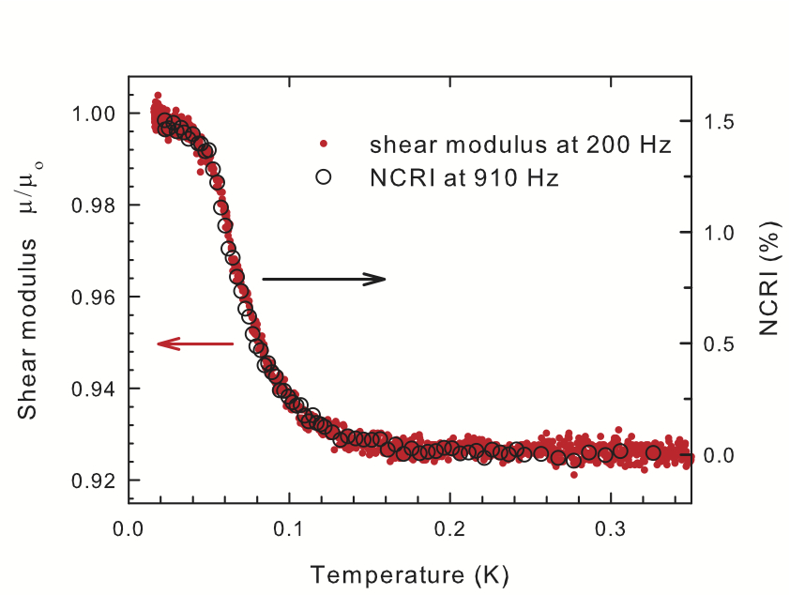
Direct shear modulus measurements: the method invented by Day and Beamish (2007):
piezoelectric shear transducers
an ac- voltage V
produces a deformation ε
and a shear stress σ
on the other transducer
inducing a current
I=ω d₁₅² μV/d
solid ⁴He
gap d ~1 mm
I
at ENS in 2012 we calibrated the measurement of μ=σ/ε on single crystals

Slide 6
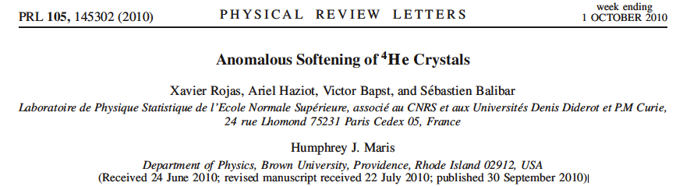
a model for the elastic anomaly:
pinning of dislocations by impurities (Beamish et al. 2008)
dislocations are pinned by ³He impurities below a temperature which depends on
the binding energy Ε_{B},
the ³He concentration X₃
the dislocation density Λ
at high T
at low T
mobile dislocations => soft cystal
pinned dislocations => stiff crystal
large plasticity if dislocations move easily
network pinning
impurity pinning
→ crossover →
Syshchenko Day and Beamish (PRL 2010) : a distribution for E_{B} 0.73 ± 0.45 K
calculation by Corboz et al. 2008 : 0.8 ± 0.1 K
Compare high quality single crystals grown at ENS
with Beamish’s polycrystals

Slide 7
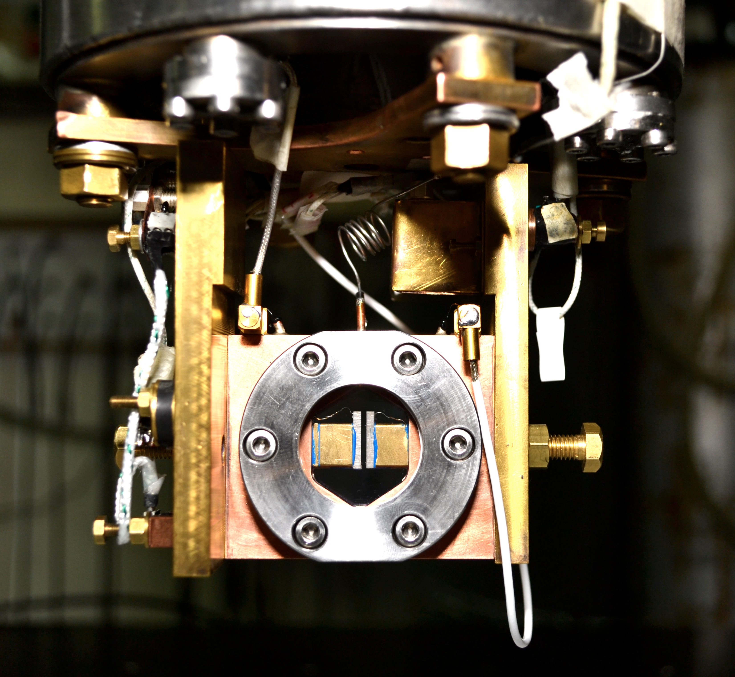
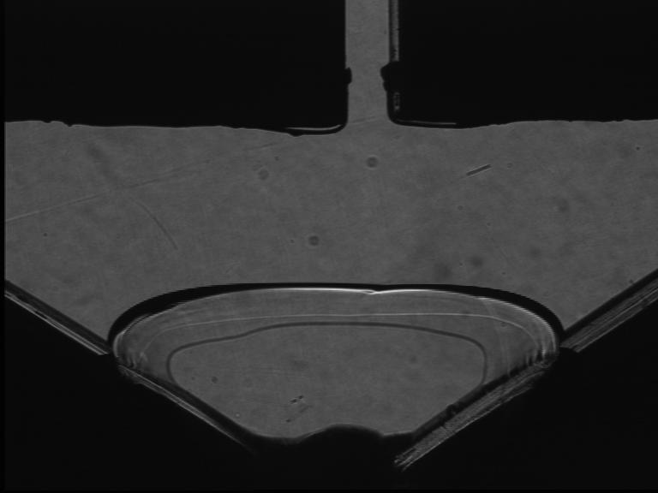
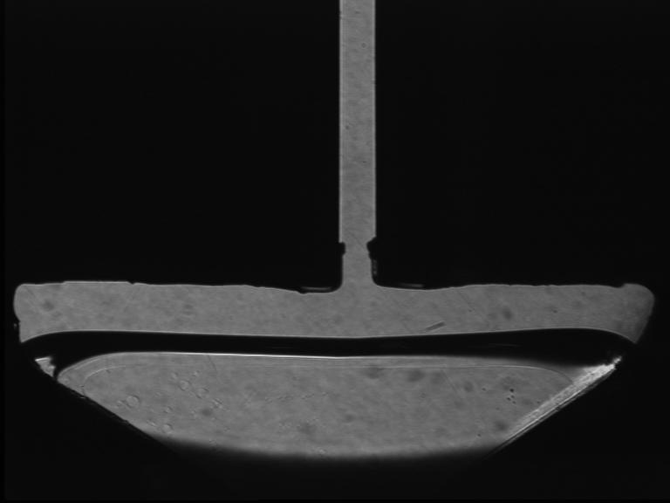
ENS Paris 2012:
direct measurements on oriented single crystals from 0.015 to 1K
orientation from growth shape of a seed
growth inside the 1.2 mm gap between 2 transducers
very small vertical displacement ~ 0.001 Angström
strain ε down to 10⁻¹⁰
0.2 Hz to 20 kHz
vertical stress component σ down to 10⁻⁹ bar

Slide 8
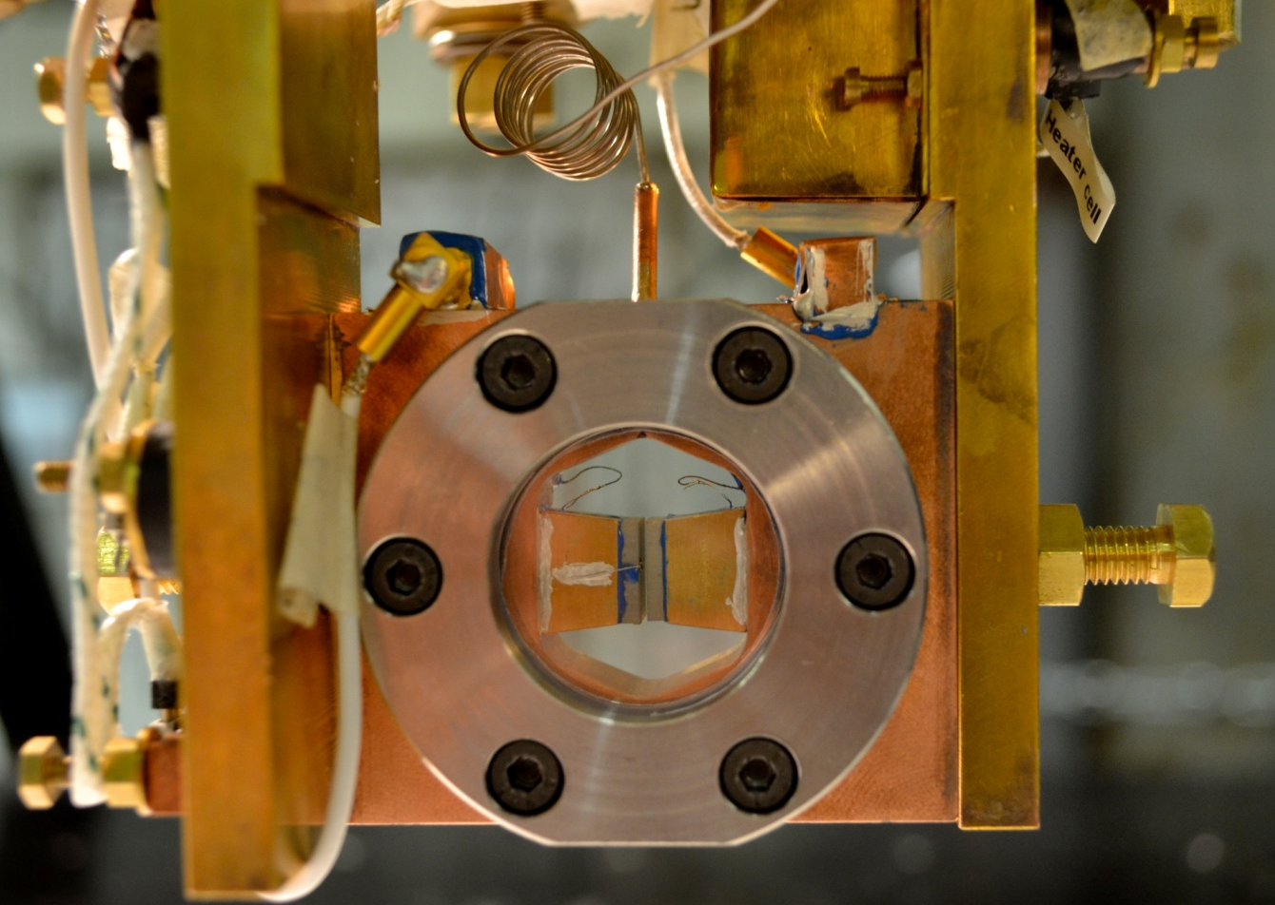
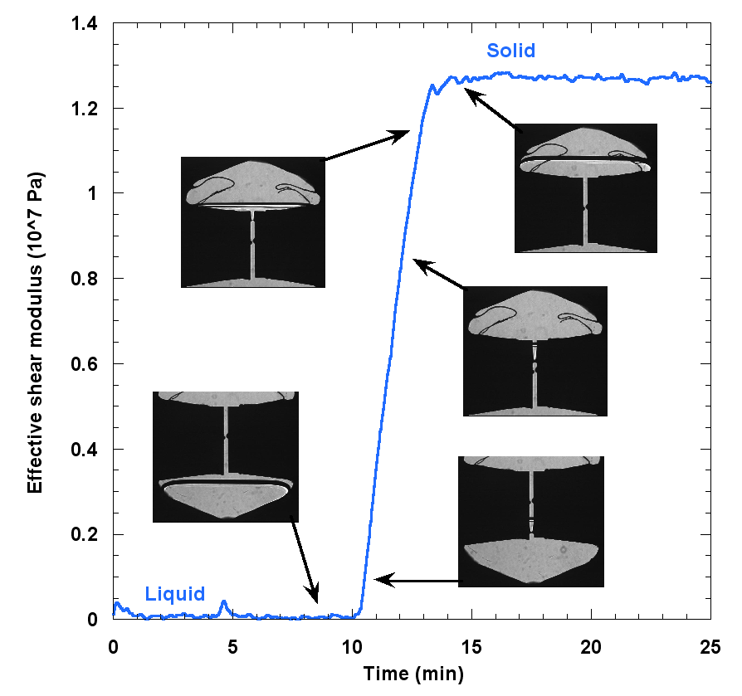
the « loading curve » in our cell #2
0.7 mm gap
the measured shear modulus increases linearly
with the level of the solid
in the 0.7 mm gap
between the 2 transducers

Slide 9
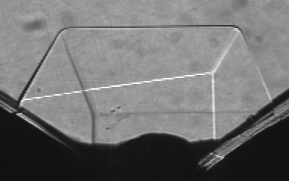
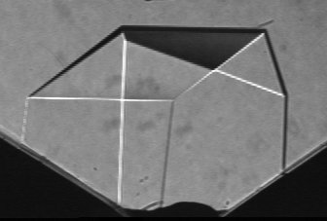
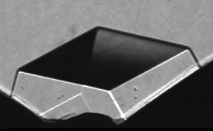
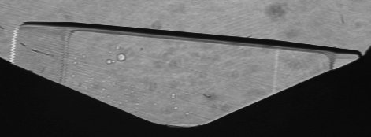
random nucleation on various sites:
many crystals with different orientations
X2
X6
X15
X3
X20
X5
X21

Slide 10
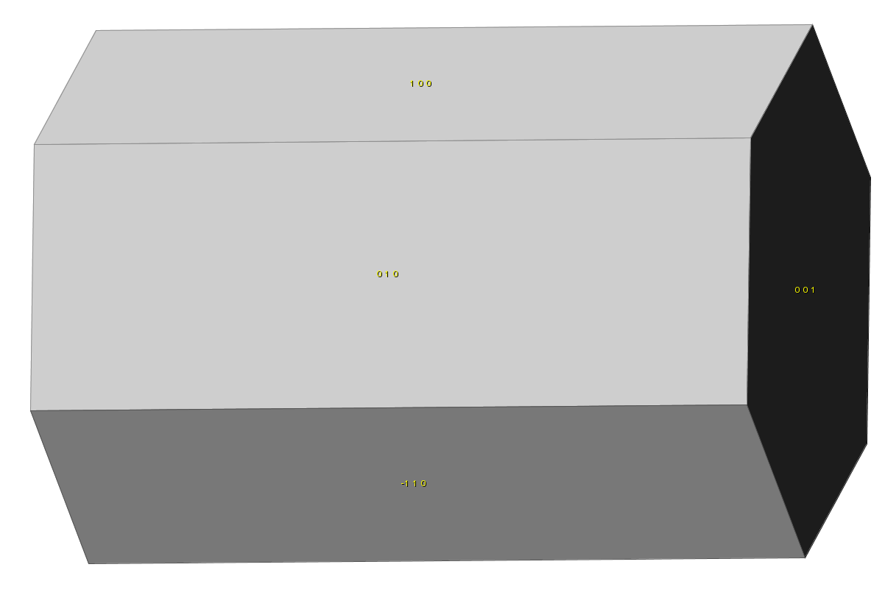
orientation X2
z
c
θ
y
x
φ
Orientation : θ=89.5° ; φ=75°
measured shear modulus:
σ = 0.0001(c₁₁-2c₁₃+c₃₃) + 0.933c₄₄ + 0.067c₆₆
depends mainly on c₄₄
c

Slide 11
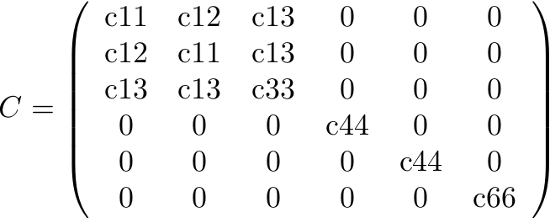
the elasticity tensor of hcp crystals
6 elastic coefficients cij
If z is parallel to the 6-fold symmetry axis c or [0001], the indices i,j from 1 to 6 mean respectively xx, yy, zz, yz, xz, and xy with
c₆₆ = (c₁₁ – c₁₂)/2
simple shear involve only c44 or c66:
the transverse sound velocity along c involves xz or yz shear and is given by
the transverse sound velocity inside the basal plane involves xy shear and is given by

Slide 12
orientation X2
z
c
θ
y
x
φ
Orientation : θ=89.5° ; φ=75°
measured shear modulus:
σ = 0.0001(c₁₁-2c₁₃+c₃₃) + 0.933c₄₄ + 0.067c₆₆
depends mainly on c₄₄
prediction from measurements by Crepeau at 1.32K and by Greywall at 1.2K where dislocations cannot move at 10 MHz:
σ_{stiff}= 122 bar
c

Slide 13
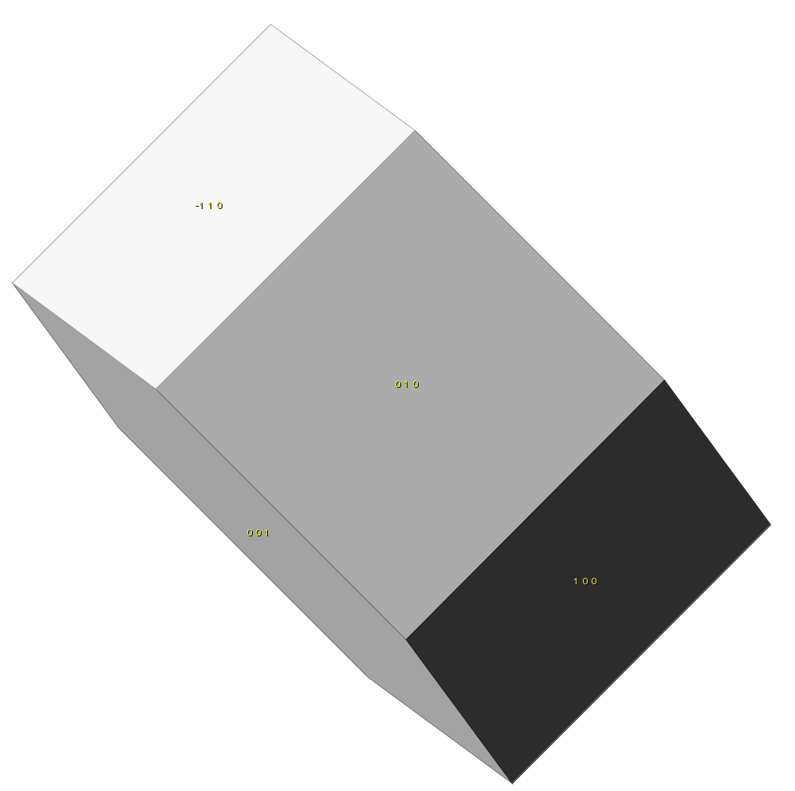
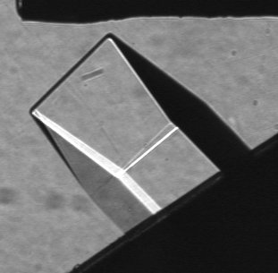
orientation X3
Orientation : θ=45° ; φ=85°
measured shear modulus: σ=0.248 (c₁₁-2.c₁₃+c₃₃) + 0.0038c₄₄ + 0.0038c₆₆
negligible dependence on c44 and c66
predicted stiff state: μ_{stiff} = 187 bar

Slide 14
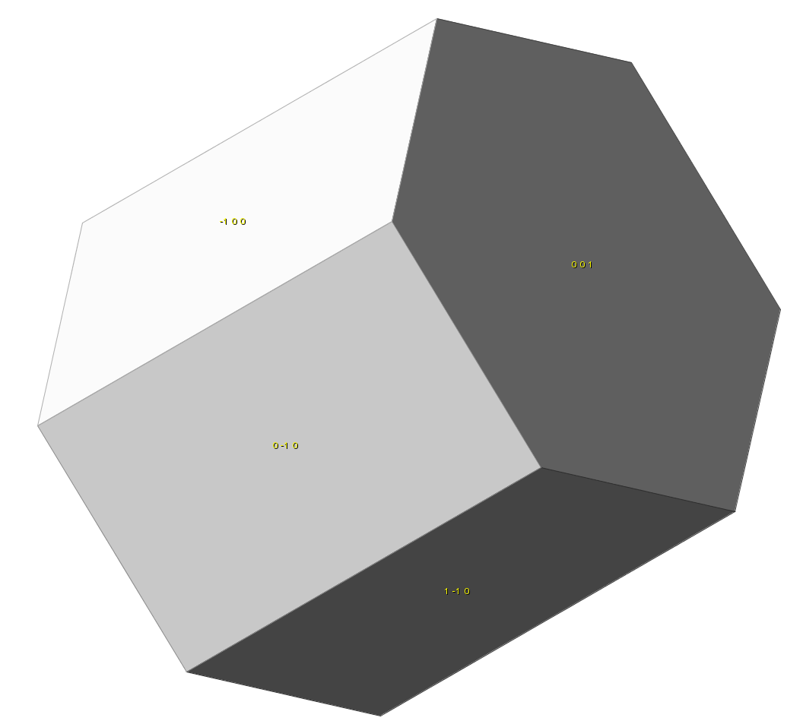
orientation X5
c
orientation : θ=60° ; φ=30°
measured shear modulus : σ=0.047 (c₃₃ + c₁₂ – 2 c₁₃ ) + 0.25 c₄₄ + 0.56 c₆₆
large dependence on c₆₆
predicted stiff state: μ_{stiff} = 1.19 10⁷ Pa = 119 bar

Slide 15
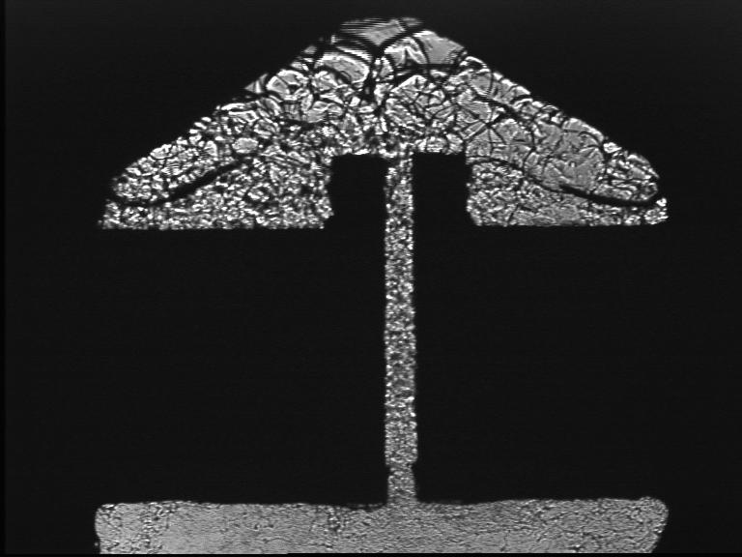
a polycrystal grown at constant V (“blocked capillary method”)
final growth pressure : 33.8 bar
predicted stiff state using HJ Maris’ averaging method: μ_{stiff} = 144 bar
melting shows grain boundaries. Small grains
ripening from the top in a few minutes

Slide 16
the softening is highly anisotropic
(A. Haziot et al. submitted to Phys Rev Lett. October 2012)
X3 is tilted by ~ 45°
no dependence on c₄₄ nor c₆₆
no T-variation μ = 187 bar
=> c11, c13 and c33 are constant
=> calibration of transducers 0.88 A/V in cell #1, 0.95 A/V in cell#2
X3
polycrystal BC1:
intermediate T-variation
BC1
X2
X5
X2 depends ~ only on c₄₄
X5 depends more on c₆₆ than c₄₄
at low T for all crystals, agreement with measurements at 10MHz and high T by Crepeau (1.32K) and Greywall (1.2K),
the « supersolid » is not stiffer than the normal solid contrary to Anderson’s prediction.

Slide 17
What is the origin of the large anisotropy of the plasticity ?
single crystal X3 c at 45° :
no dependence on c₄₄ nor c₆₆
no T-variation => calibration
X3
polycrystal BC1:
intermediate T-variation
BC1
X2
X5
X2 and X21 depend ~ only on c₄₄
X5 depends more on c₆₆ than c₄₄
The magnitude of the change in shear modulus depends on orientation
Dislocations glide along dense planes.
Basal planes ? the variation of μ should be due to c₄₄
Prismatic planes ? it should be c₆₆

Slide 18
dislocations glide only parallel to the basal planes
X2, X5, X6 and X21 :
all grown at 1.4K, natural purity should have the same elastic constants
If dislocations glide along the basal planes,
c66 = Cst and c44 varies :
62±8% reduction in c44 for all crystals
X21
Assuming the opposite (c44 contant, c66 varies ) leads to absurd results
X5 varies less than X2 with a stronger dependence on c66! c66 should vary by 300% for X6 and by > 1000% for X21 !
an expected results for hcp crystals ? may be,
but hexagonal metals show gliding either along basal planes (0001): Be, Mg, Co, Zn
or along the prismatic planes (10-10) perp to the basal planes : Zr, Ti

Slide 19
amplitude dependence at 20 mK - hysteresis
crystals grown at 1.4K,
no liquid in the cell
X6, X2 and X5:
the threshold stress
σ = 1 microbar
corresponds to the stress necessary for dislocations to break away from ³He impurities
hysteresis because the force depends on the distance between bound impurities
X4 cooled down at high drive
with liquid in the cell
X4 cooled down at high drive
with liquid in the cell
« resolved » = projected in the basal plane

Slide 20
with no impurities at all, dislocations move freely
crystals grown at 1.4K,
no liquid in the cell
X4 cooled under large strain
in the presence of liquid He
all ³He expelled into the liquid
stable soft state even when reducing the strain down to 10⁻¹⁰
80% reduction in c₄₄
a very large softening with no equivalent in classical crystals
X4 cooled down at high drive
with liquid in the cell
X4 cooled down at high drive
with liquid in the cell
« resolved » = projected in the basal plane

Slide 21
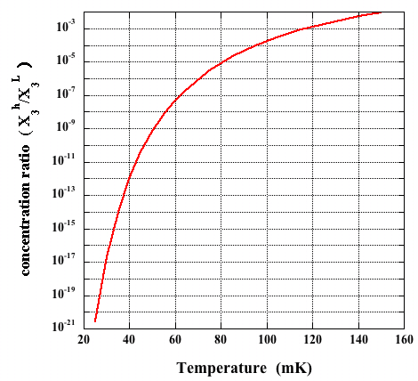
« zone melting » with ⁴He : from 0.3 ppm ³He to 0.4 ppb
… and down to zero
Slow growth proceeds very close to equilibrium at the solid-liquid interface.
The concentration ratio is
at 25 mK:
starting with X₃^{L} = 4 10⁻¹⁰
one obtains X₃^{h} = 4 10⁻³¹ !
even in the presence of dislocations, no ³He in the crystals grown below 25 mK
(C.Pantalei , X. Rojas and S. Balibar, JLTP 2010
using
D.O. Edwards and S.Balibar Phys. Rev. B 1989
shaking the dislocations in the presence of some liquid expels all ³He in the liquid
=> the crystal is stable in a soft state

Slide 22
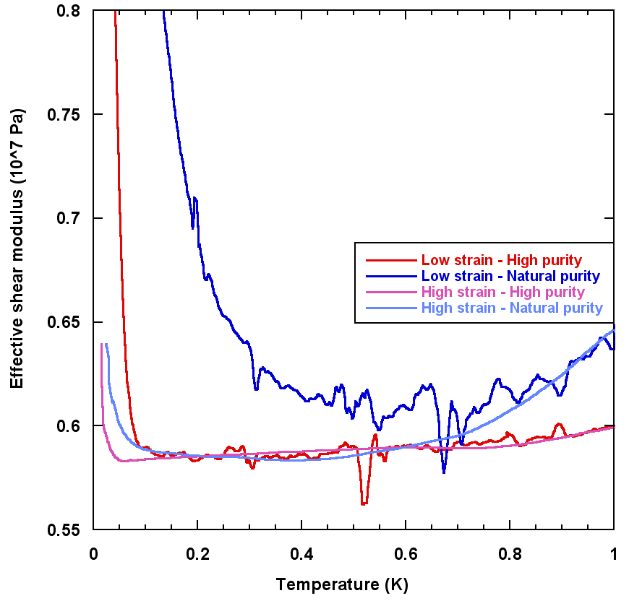
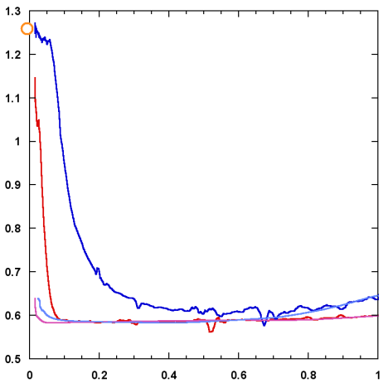
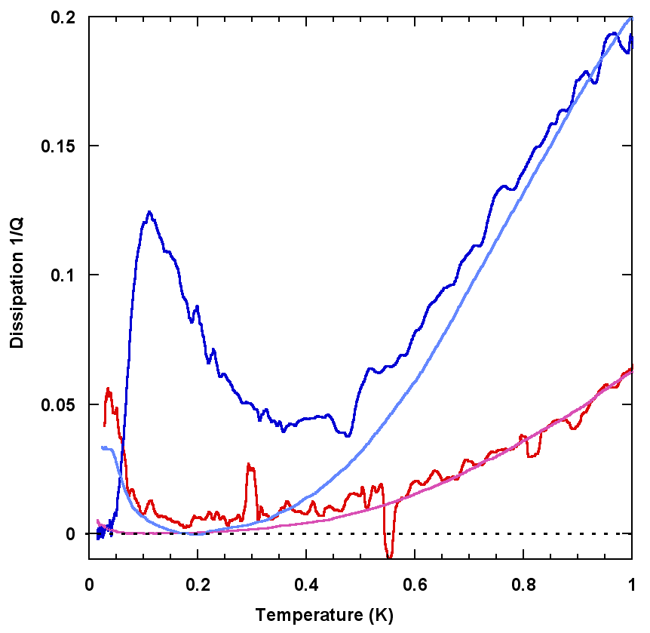
ωT³ dissipation for collisions with thermal phonons
high purity
low purity
we measure the dissipation from the phase shift of the response
the ³He binding and the reduction in c₄₄ depend on amplitude and purity
Granato and Lücke 1956 + Ninomiya 1974 predict a shear modulus variation
and a dissipation for phonon damping
If true, the dislocation density Λ
and the free length L between pinning sites
can be determined independently
low drive
high
drive
low
purity
high
purity

Slide 23
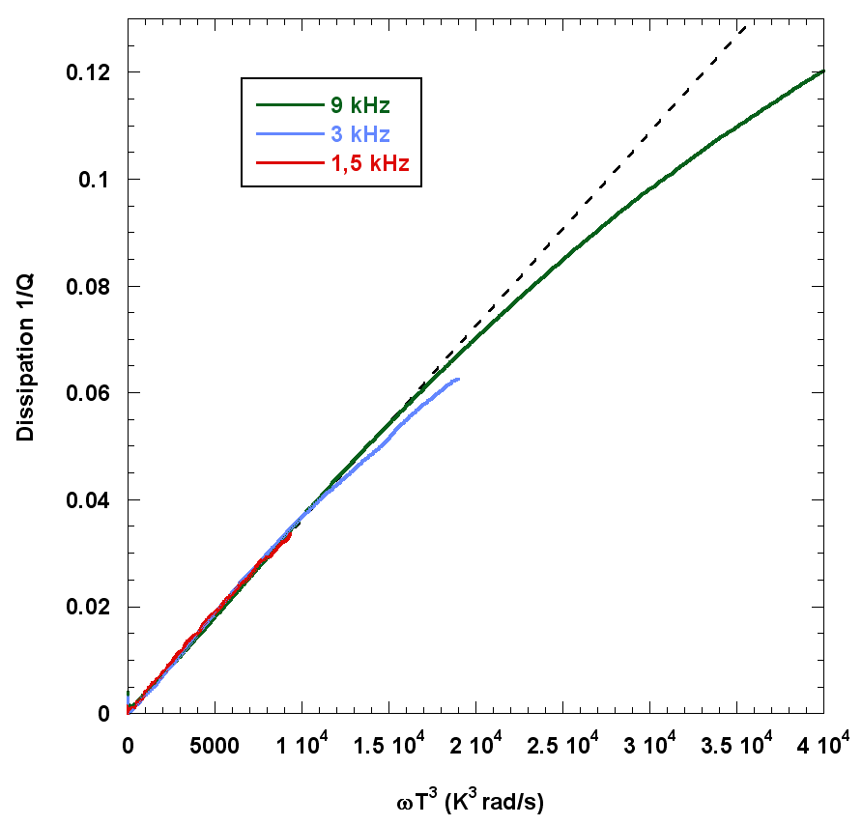
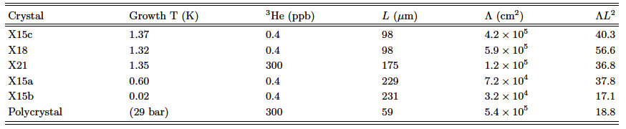
a measurement of dislocation density and pinning length for various crystals (Haziot et al. to be published)
excellent agreement with 1/Q ~ ωT³
collisions with thermal phonons
(very large damping at 10MHz and 1.2K
in Greywall’s experiment)
densities from 3 10⁴ to 6 10⁵ cm⁻²
pinning lengths from 60 to 230 μm
ΛL² from 17 to 57
instead of 3 for a simple 3D lattice
=> dislocations are grouped in sub-boundaries
The best crystals are grown at low T.
the Shevchenko theory of a network of
superfluid dislocation cores
would require 10¹² disloc/cm² for a 1% NCRI

Slide 24
dislocation motion:
comparison with a classical crystal
In Helium :
80% reduction in c₄₄ => the plastic strain ε_{d} is 4 times larger than
the elastic strain ε_{l} even for stresses 10⁻¹¹ times the shear modulus
dislocations move like little violin strings
~ 1 μm at 10 kHz under stresses σ ~ 0.6 μbar
typical velocities up to 6 cm/s
the plasticity exists at very low T,
it is giant at very low stress, reversible, linear,
fast, and anisotropic
δl
L_{n}
δl ∼ Λ b/ε_{d} with b = 3.6 Angstrom and
the dislocation density Λ ~ 10⁴ cm⁻²
In Copper (Tinder and Washburn (1964) plasticity is very much smaller even at room T:
160 times smaller under stresses 10⁵ times larger (10⁻⁶ times the shear modulus)
irreversible and slow (minutes)
An interesting question:
do dislocations move by quantum tunneling through non-zero « Peierls » barriers or
classically with zero barriers ?

Slide 25
back to supersolidity:
a possible artifact in « torsional oscillator » experiments:
J. Beamish, A. Fefferman, A. Haziot, X. Rojas, and S. Balibar, Phys Rev B 2012
when the « torsion rod » is a torsion tube:
r₀ : outer radius of the tube
r₁: inner radius
solid line: maximum possible effect of the He stiffness
In at least 4 cases the observed frequency could be a consequence of a 20 to 40% change in the He stiffness
the « critical velocity » would be the critical strain for unpinning of ³He (2 to 6 10⁻⁸ as measured by Day 2007 and by Rojas 2010)
the magnitude of the dissipation peak also agrees with the mechanical dissipation in stiffness measurements
more possible artifacts have been found in 2012 by Maris, Reppy, Chan … but some experiments (Kim, Kono, Shirahama…) resist to possible critics

Slide 26
Conclusion: giant plasticity or supersolidity or both ?
the existence of superplasticity is now well established.
Solid ⁴He is « a probe in Materials Science » (P. Nozières 1994)
to be studied:
the distribution of pinning lengths from the stress dependence
the distribution of pinning energies from the frequency dependence
quantum tunneling or negligible kink energy ?
larger strains and more defects
the limit of zero dislocation and zero impurity
the existence of supersolidity would need stronger evidence…
and support from a convincing theory

