Slide 1






Dislocations in ⁴He crystals
S. Balibar, A. Fefferman, A. Haziot, X. Rojas, F. Souris
Laboratoire de Physique Statistique et Laboratoire Pierre Aigrain,
Ecole Normale Supérieure and CNRS,
associated to the Universities Paris 6 & 7, Paris (France),
and J. Beamish (Edmonton, Canada)
other collaborations: M.H.W. Chan and J. West (Penn State),
H.J. Maris (Brown University),
V. Dauvois and P. Jean-Baptiste (CEA, Saclay, France)
QFSG, Sao Carlos, Aug. 2014

Slide 2
Outline
I - Introduction:
in hcp ⁴He crystals, where quantum fluctuations are large
dislocations move freely in the very low T and very low stress limit
and in the absence of pinning by impurities
this non-classical phenomenon produces a spectacular elastic anomaly
most of the dislocation properties are now well established and understood
II - the motion of dislocations when dressed with ³He impurities

Slide 3
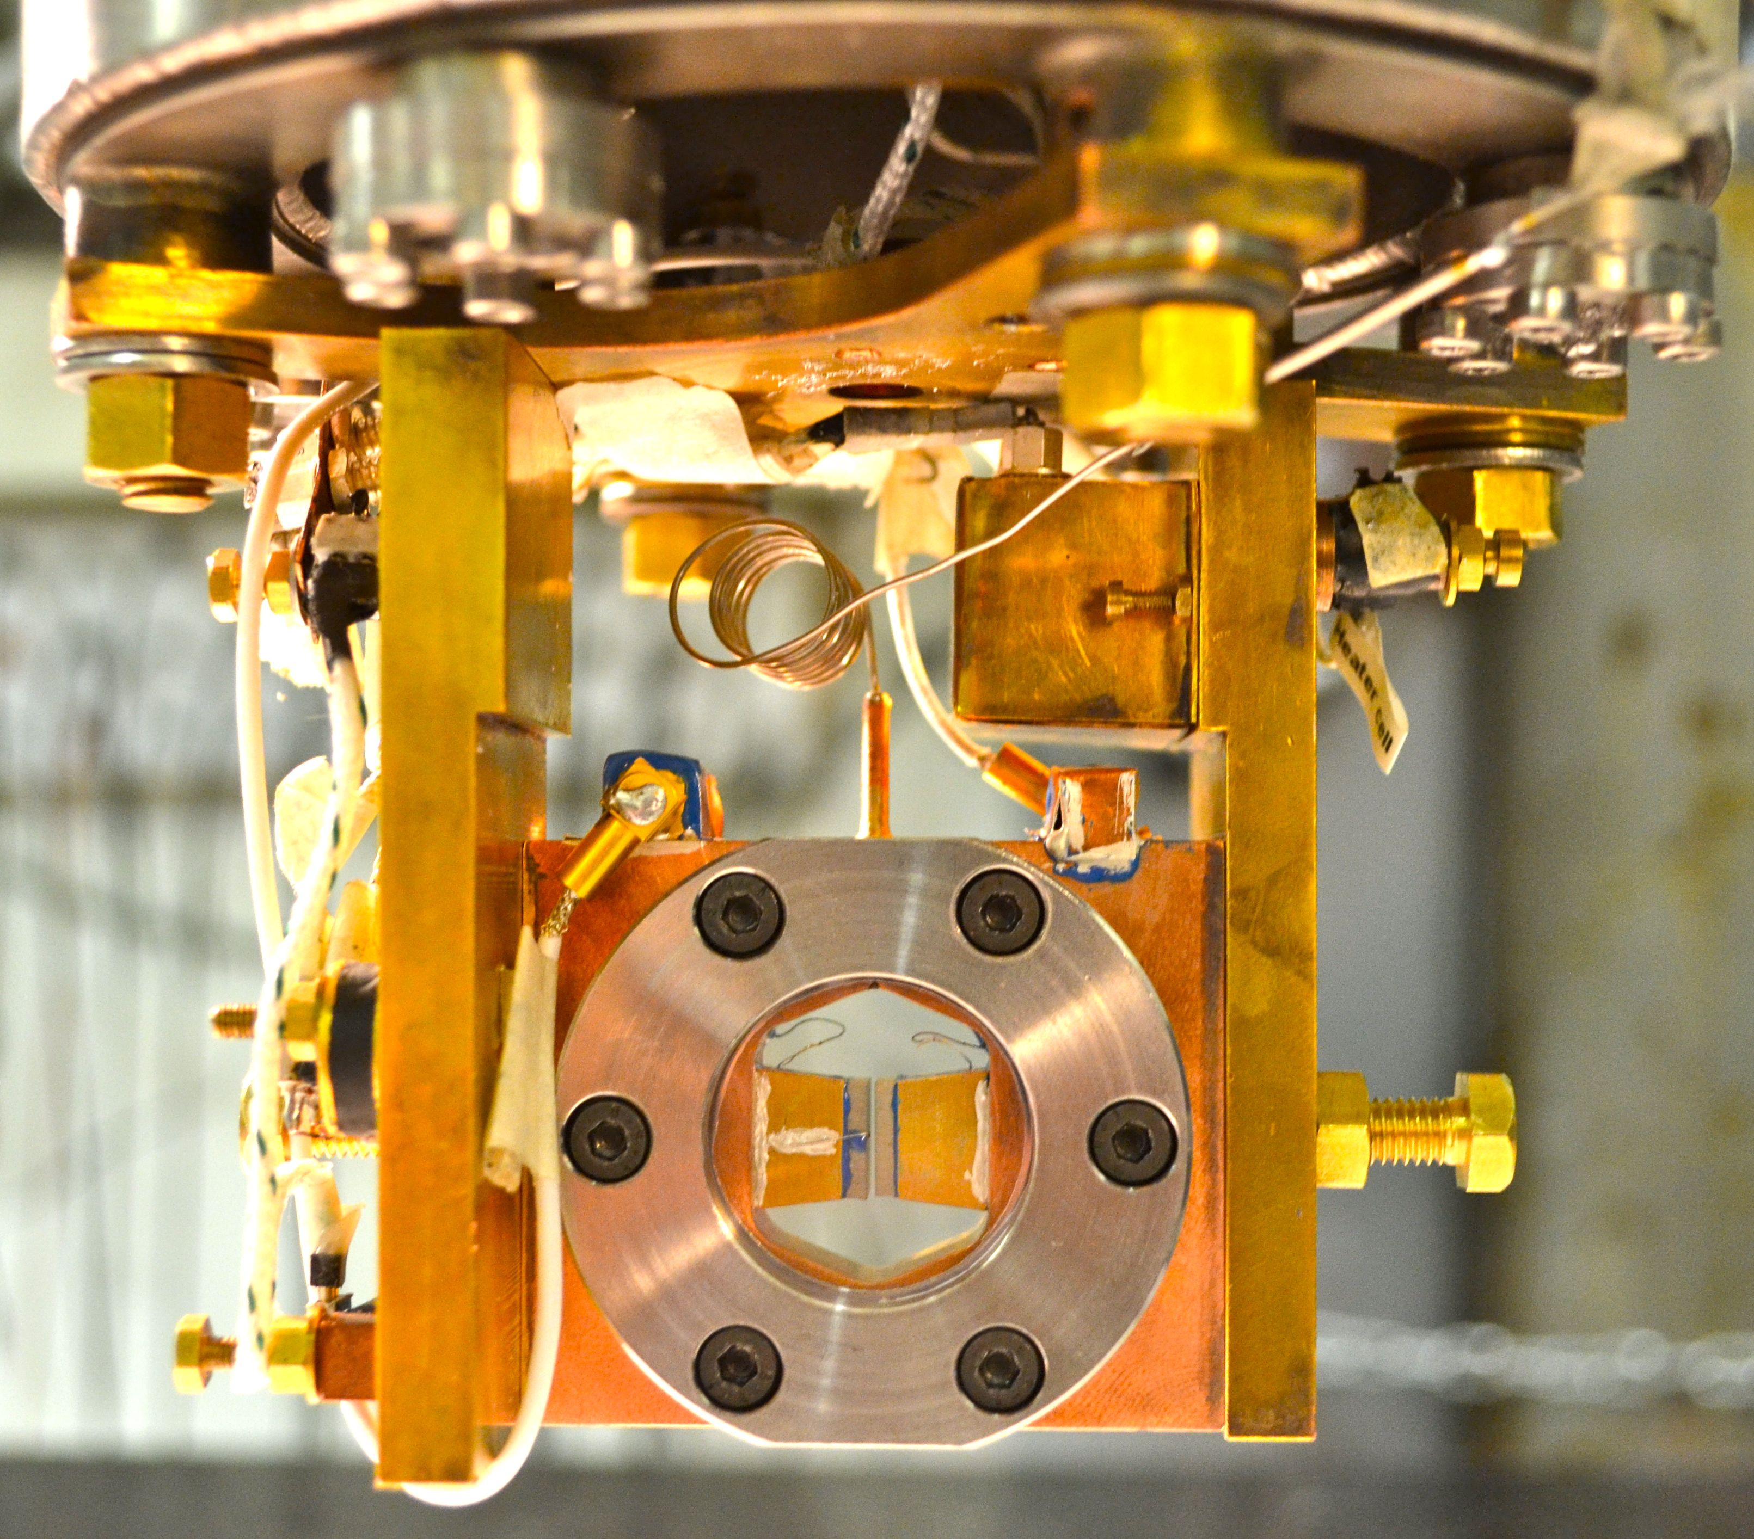
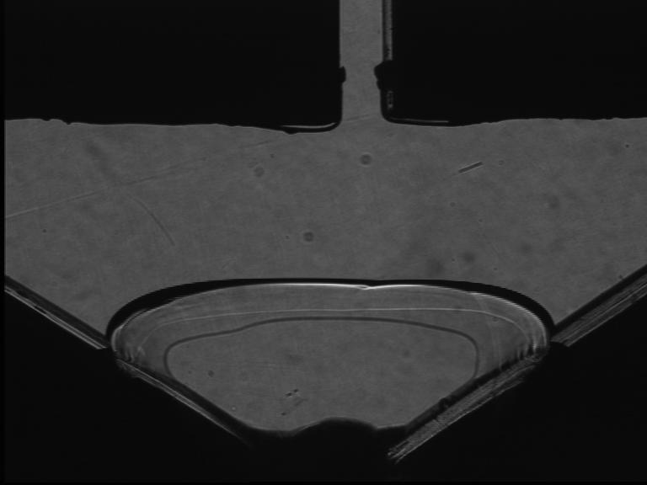
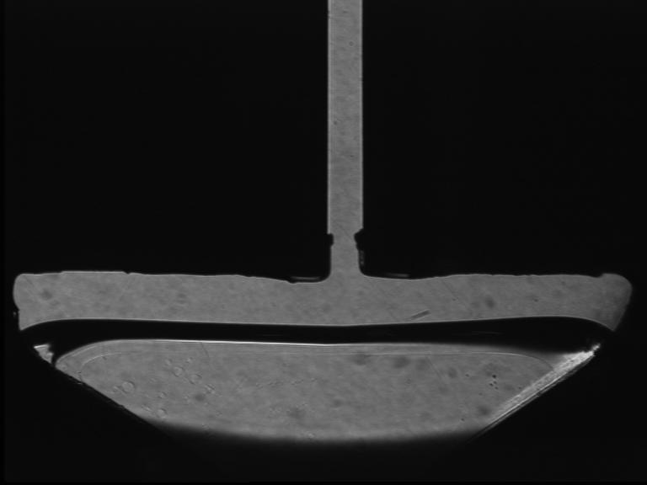
the shear modulus of oriented ⁴He
single crystals from 15 mK to 1K
Haziot et al. (PRL 110, 035301, 2013)
orientation from growth shape of a seed
growth inside the 0.7 mm gap between 2 transducers
very small AC- vertical displacement:
calibration: 0.95 AA/V at 1Hz to 20 kHz
down to 0.001 Angström ( strain ε down to 10⁻¹⁰)
vertical stress σ = με down to 10⁻⁹ bar
temperature: 15 mK to 1.5K
direct measurement of the shear modulus μ

Slide 4
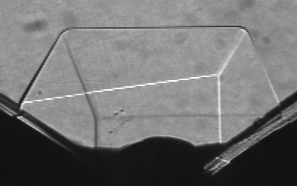
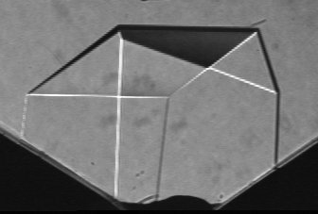
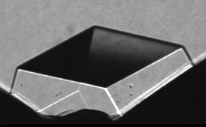
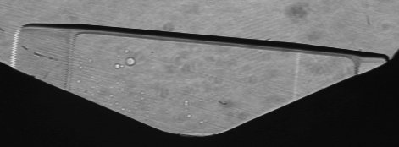
random nucleation on various sites:
many crystals with different orientations
X2
X6
X15
X3
X20
X5
X21

Slide 5
ultrapure ⁴He single crystals with only 4x10⁻¹⁰ ³He do not resist to shear in a T-domain around 0.2K
Haziot et al. submitted to Phys. Rev. Lett. (2012)
giant plasticity around 0.2K
dislocations are highly mobile in a T-domain between
- ³He impurity binding at low T
- damping from collisions with thermal phonons at higher T
=> measurements of dislocation properties:
gliding direction
density
length
binding energy to ³He impurities

Slide 6
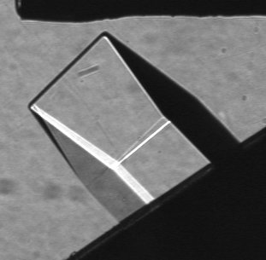
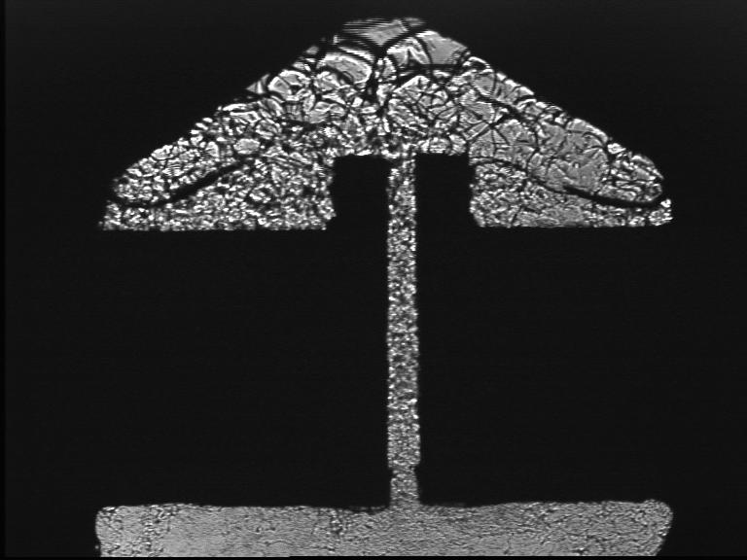
the elastic anomaly is large and anisotropic
crystal X3 at 45° :
X3
X20
polycrystal BC2:
BC2
X21
X2
X5
X2 , X21 depend mostly on c₄₄
X5 depends more on c₆₆ than c₄₄
The low T value of the stiffness is
the intrinsic value due to the lattice elasticity,
as measured by Greywall (1.2K, 10MHz)
contrary to Anderson's model of supersolidity
dislocations glide along high density planes
basal planes? reduction of c₄₄ ; prismatic planes ? c₆₆

Slide 7
dislocations glide along basal planes
X2, X5, X6 and X21 :
similar growth at 1.4K,
same purity (0.3 ppm of ³He)
=> same elastic constants?
if c66 = Cst and only c44 varies:
same reduction by 62±8% for all crystals
the opposite hypothesis (c44 constant, c66 variable ) would lead to absurd results:
for X6, c66 should vary by 300%
more than 1000% for X21 !
hexagonal metals:
gliding along basal planes in Be, Mg, Co, Zn,
along prismatic planes in Zr, Ti
Agreement with the criterion by B. Legrand (1984) : dislocation splitting due to the low energy of stacking faults

Slide 8
with zero impurity and at T = 20mK , dislocations move freely: linear response with 80% reduction in the shear modulus c44
with impurities:
hysteretic pinning/unpinning
without impurities:
X4 cooled down to 20 mK
under larger strain (10⁻⁶)
in the presence of liquid He
stable 80% reduction in c₄₄
a giant reversible plasticity
down to 10⁻¹⁰ strain
no equivalent in classical crystals
linear soft elastic behavior at 20 mK down to extremely small stresses
1 nbar = 10⁻¹¹ c₄₄ !
no Peierls barrier due to large quantum fluctuations ?
is the kink energy E_{k} = 0 ?
crystals grown at 1.4K,
with 0.3ppm 3He
unpinning from ³He
pinning
by ³He
X4 cooled down at high drive
with liquid in the cell
X4 (zero impurity)
« resolved » = projected in the basal plane

Slide 9
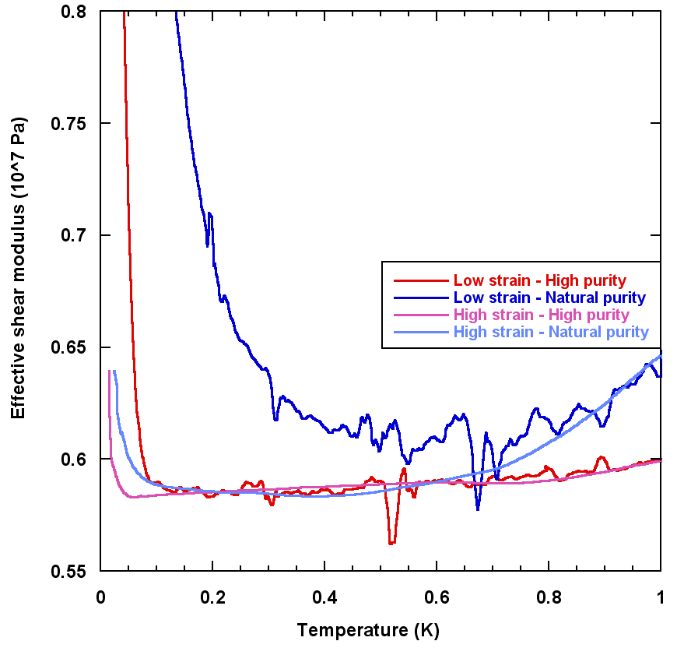
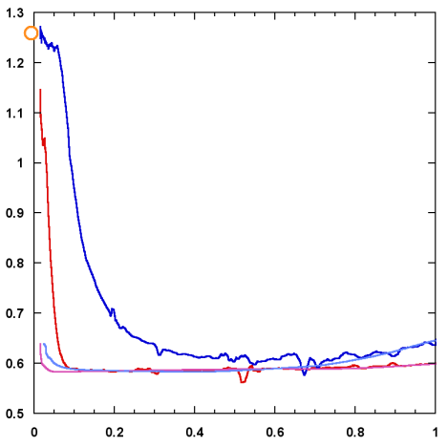
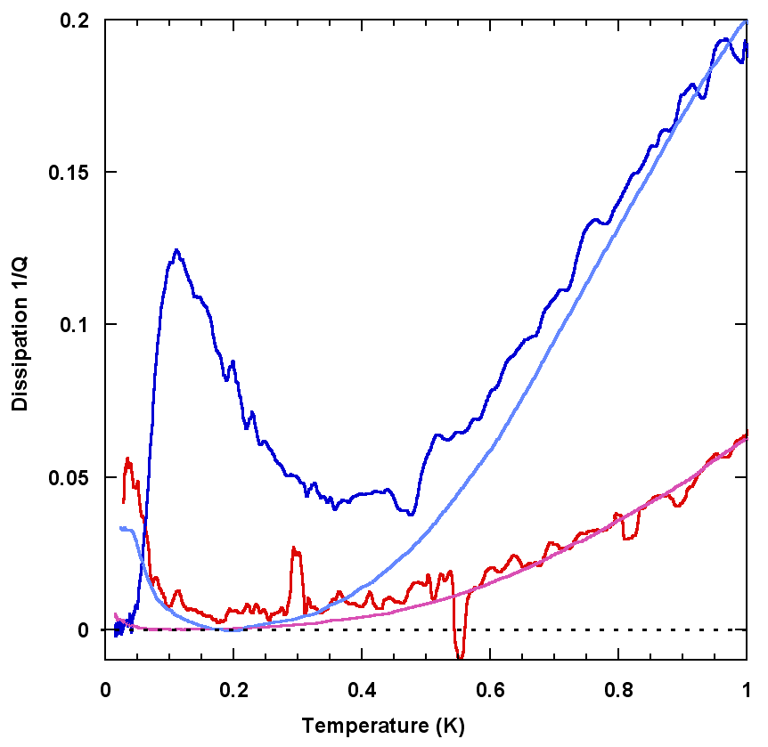
ωT³ dissipation from collisions with thermal phonons
high purity
low purity
we measure the real and imaginary parts of the response to the driving strain
the ³He binding and the reduction in c₄₄ depend on amplitude and purity
Granato and Lücke 1956 + Ninomiya 1974 predict a shear modulus variation
with α = 0.019 and a dissipation for phonon damping
If true, the dislocation density Λ
and the length L between network nodes
can be determined independently
low drive
high
drive
low
purity
high
purity

Slide 10
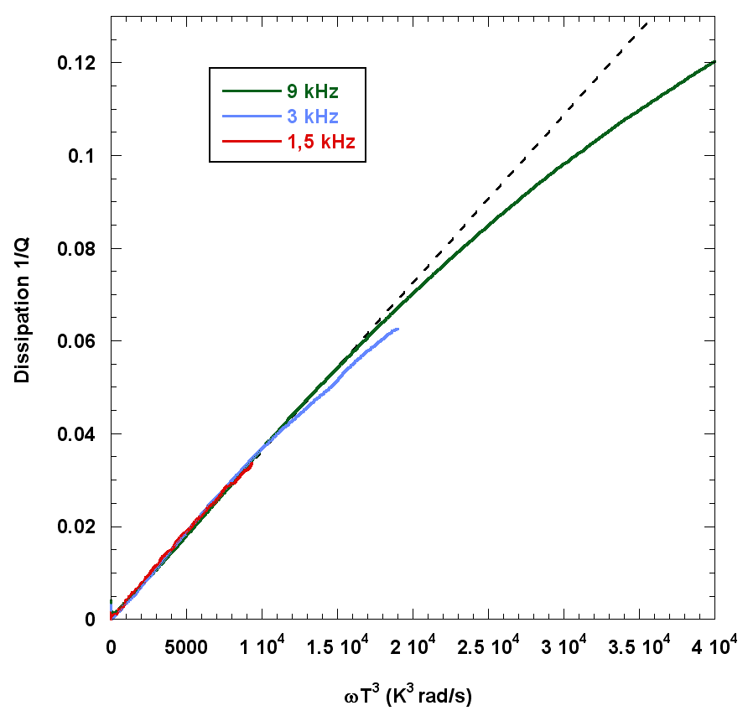
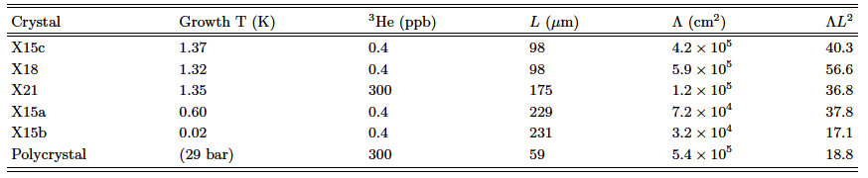
a measurement of dislocation density and pinning length for various crystals (Haziot et al. Phys. Rev. B87, 060509(R) 2013)
excellent agreement with 1/Q ~ ωT³
collisions with thermal phonons
densities from 3 10⁴ to 6 10⁵ cm⁻²
network lengths from 60 to 230 μm
ΛL² from 17 to 57 (F. Souris et al. 2014: up to 150)
instead of 3 for a simple 3D lattice
=> dislocations are grouped in sub-boundaries
and not well connected
dislocations cannot move at 10MHz and 1.2K
the Shevchenko theory of a network of
superfluid dislocation cores would require
10¹² disloc/cm² for a 1% NCRI
and a coherence length ξ ~ aT*/T larger than L

Slide 11
the (controversial ?) frequency dependence of the softening
Crystal Y3 – ε = 2.7 10⁻⁹
Temperature (K)
Day and Beamish (2007): the response time of the moving dislocation τ ~ exp(E_{b}/T) is prop. to the concentration of ³He bound to it (binding energy E_{b})
transition where ωτ ~ 1 => frequency dependence
Iwasa (2010) and Kim (2013): a T-dependent pinning length, no frequency dependence
Notes:
We measured the stiffening transition in the same crystal Y3 for a wide range of frequencies and several different excitations.
As you can see the temperature of the transition is changing with these parameters.
For each run, we measured the temperature of the dissipation peak and we place it on an Arrhenius plot.

Slide 12
two dissipation regimes (A. Haziot et al. PRB 88, 014106, July 2013)
at high frequency or strain amplitude:
no frequency dependence
real pinning as predicted by Iwasa and Kim
at low frequency or small strain:
a thermally activated dissipation regime ~ exp(-E_{b}/T)
E_{b} = 0.67K
damping of the motion of dislocations dressed with 3He impurities bound to them
the transition temperature as a function of frequency and strain amplitude
Notes:
We have discovered two different regimes.
a regime where the stiffening temperature is dependent on the frequency as described by Day and Beamish with a Debye model.
a regime where the stiffening temperature is independent of the frequency as described by Iwasa with a pinning model.

Slide 13
a critical speed: ³He impurities move attached to dislocations below 45 μm/s
(A. Haziot et al. PRB 88, 014106, July 2013)
From the dislocation density Λ = 7.6 10⁻⁵ cm⁻², and the dislocation length
L = 73 μm, we obtain the dislocation speed as a function of applied strain.
The transition occurs at
a critical speed v_{C} ≈ 45 μm/s
pinning
tentative interpretation:
a max tunneling frequency for ³He atoms on the dislocation?
in the bulk crystal ³He are quasi-particles moving by coherent quantum tunneling
bandwidth: 30 to 600 μK
average velocity:
<v>^{1/2} = 4.2 a J₃₄ ~ 0.6 to 12 mm/s
1 or 2 orders of magnitude faster
inelastic tunneling of ³He bound to dislocations up to 45 μm/s ?
tunneling along the dislocation ?
a precise model and calculation is highly desirable
damping from
bound ³He
exp(-0.67/T)
Notes:
Then, we can plot the same data but instead of the frequency, we can plot the speed as a function of 1/T.
It appears that the transition between the two regimes occurs in the same speed region suggesting the existence of a critical speed.
We measured values for this critical speed between 40 and 100 micron/s.
In order to interpret these results let’s see quickly what is the model in the classical case.

Slide 14
the length distribution of dislocations (A. Fefferman et al. Phys. Rev. B89, 014105, 2014)
when decreasing the driving strain,
³He bind to short dislocations before long ones.
With a single dislocation length, one should see a sharp transition to the stiff state where all dislocations are pinned by impurities.
we have measured the distribution of dislocation lengths between network nodes

Slide 15
the network length distribution is wide: from 30 to 300 μm
to each driving strain amplitude ε corresponds
a max length L_{c}
below which ³He binds
L_{C} = 2F_{C} / bεμ
with F_{C} = 6.8 10⁻¹⁵ N
b = 0.36 nm (Burgers vector)
F_{C} is consistent with a potential well of width 4a

Slide 16
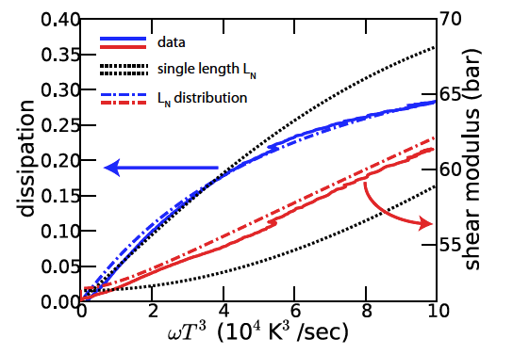
A good fit of the dissipation due to thermal phonons up to 1K, far above the asymptotic regime in ωT³

Slide 17
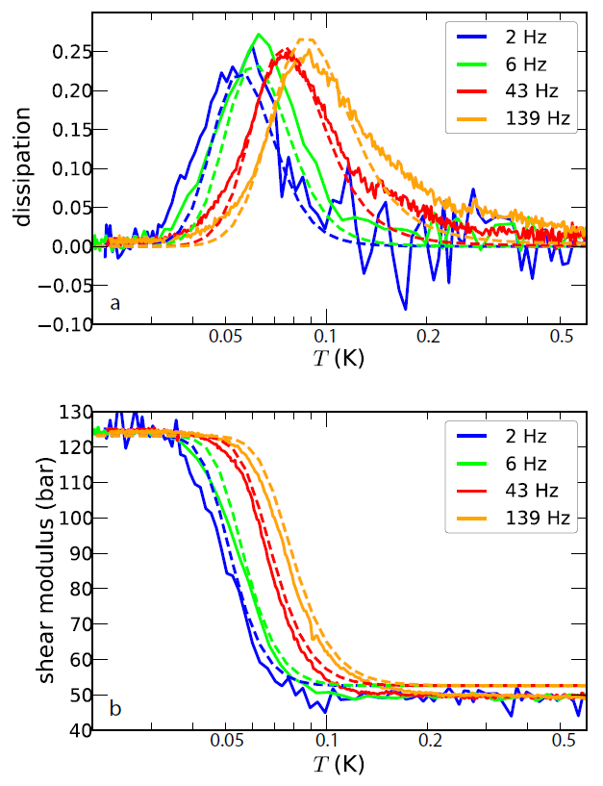
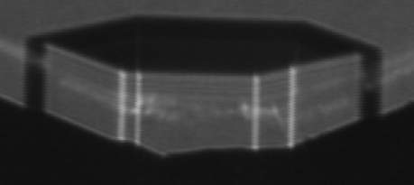
the distribution of binding energies
0.3
0.2
Crystal Z5
dissipation
0.1
0
Solid lines: Data
Dashed lines:
Calculation including distribution of network lengths.
Fit parameters:
Same length distribution as before, plus a binding energy distribution of width
0.1 K around 0.7K.
Needed:
Precise calculation of edge and screw dislocation binding energies.
0.05
0.1
0.2
0.5
temperature (K)
120
shear modulus (bar)
80
40
0.05
0.1
0.2
0.5
temperature (K)

Slide 18
more details on the motion of dressed dislocations
at sufficiently low speed (v < 45 μm/s),
dislocations move dressed with ³He impurities
the peak dissipation occurs at a temperature T_{p}, near the middle of the soft to stiff transition, where ωτ = (1 + 0.02ΛL_{N}²)^{1/2} ~ 1
ω/2π is the measurement frequency
and the relaxation time τ of the dislocations is
τ = BL_{N}²/π²C where C is the dislocation line tension and B is the damping coefficient in the equation of motion
Ad²ξ/dt² – Bdξ/dt + Cξ = bσ
where ξ is the displacement of the dislocation line, b is the Burgers vector and σ is the driving stress.
Question:
are τ and B prop. to the concentration of ³He on the line? is B = B₀ X₃ exp(E_{b}/T) ?
where X₃ is the ³He concentration in the ⁴He cylinder

Slide 19
the relaxation time of dressed dislocations F. Souris, A. Fefferman et al. April-July 2014 to be submitted
3 sets of measurements for 3 different ³He concentrations.
from 25 ppb (natural purity of ⁴He from Qatar !) to 385 ppb and to 2.32 ppm
difficulties:
- measure X₃
V. Dauvois and P. Jean-Baptiste (CEA Saclay, France)
- grow crystals without trapping ³He in the liquid
- mix gases carefully !
The scatter in the slopes is consistent with the energy distribution
0.7K ± 0.1K if
B = B₀ X₃exp(E_{b}/T)
but for a quadratic dependence, one would have
B = B₀ X₃² exp(2E_{b}/T)
so that the binding energy would be ~ 0.35K
=> extraplate to 1/T=0

Slide 20
the damping coefficient B is indeed prop. to the concentration X₃ , not to X₃²
Suppose that
B= B₀ [X₃ exp(E/T)]^{n} agreement with n = 1, not with n=2.
This result confirms that the binding energy E₃ = 0.7K,
not the values proposed by I. Iwasa in 2013 (0.2K) nor by E. Kim et al. in 2008 (0.4K)
damping coefficient B (N/m.s)
3He concentration X3

Slide 21
the damping of dressed dislocations is proportional to their ³He concentration a tentative model
the motion of the dislocation at very low T and under very small forces is made possible by the quantum tunneling of ⁴He atoms
³He atoms do not tunnel easily from site to site
they lag behind and distort the line
successive jumps
emission of transverse waves
³He
a preliminary calculation by H.J. Maris (Brown U.):
B ~ (4 π²/b) (ρC)^{1/2} ~10⁻³ Pa.s
our experimental value: B = 0.15 Pa.s (hundred times more...)

Slide 22
other problems to be studied
mass flow experiments: Amherst (Hallock et al.) vs Edmonton (Beamish et al.)
could one prepare hcp ⁴He crystals with no dislocations at all?
an attempt by F. Souris et al. (to be submitted in September 2014)
the properties of hcp ³He crystals: compare Fermi to Bose crystals

