Slide 1




Quantum crystals: from quantum plasticity to supersolidity
S. Balibar , V. Bapst, A. Haziot, X. Rojas
Laboratoire de Physique Statistique,
Ecole Normale Supérieure and CNRS,
associated to the Universities Paris 6 & 7, Paris (France)
Collaborations: H.J. Maris (Brown Univ. USA)
M.H.W. Chan and J.West (Penn. State Univ. USA)
Facets of quantum physics at ENS
Paris, Nov. 2010

Slide 2
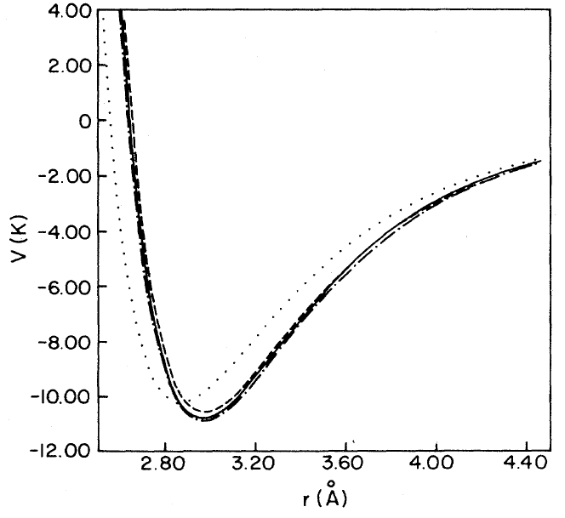
Quantum crystals: large quantum fluctuations
a particle (hard core diameter d, masse m)
localized in a box (dimension a)
Heisenberg principle => a momentum p = ħ/(a-d)
a
d
and a "zero point" kinetic energy :
E_{c} = ħ²/2m(a-d)²
in the case of ⁴He crystals :
a = 0.37 nm ; d = 0.26 nm ; m = 4g/N
=> E_{k} ~ 15 K !
The interatomic potential is the sum of
a van der Waals attraction + a hard core repulsion
It has the same order of magnitude

Slide 3
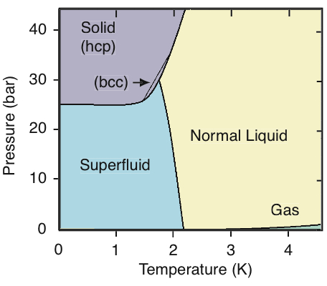
consequences at the macroscopic scale
the liquid state is more stable than the solid state below 25 bar
a transition to a superfluid state below 2K
solid 4He exists only above 25 bar
no triple point
the liquid-solid transition is nearly independent of T below 1K
the Lindemann criterion is violated:
(<Δx²>)^{1/2} = 0.27 a in ⁴He
on the melting line
instead of 0.10 a in classical crystals

Slide 4
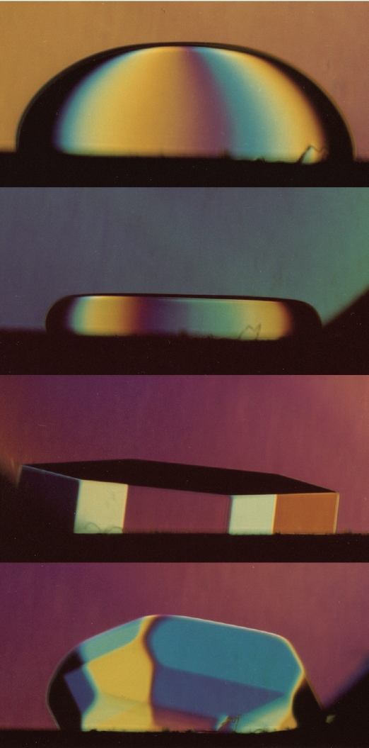
Facets of quantum physics ...
Question 1: are facets on quantum crystals destroyed by large quantum fluctuations ?
NO
(see S. Balibar et al. Rev. Mod. Phys. 77, 317, 2005)
Question 2:
Could ⁴He crystals be superfluid ?
YES
a solid has a non-zero shear modulus
if part of the mass is superfluid it is called "supersolid"
Supersolidity has been discovered in 2004
its existence confirmed despite many objections
no consensus yet on its physical mechanism
relation with cold atoms in an optical lattice ?
long range interactions, spontaneous symmetry breaking

Slide 5
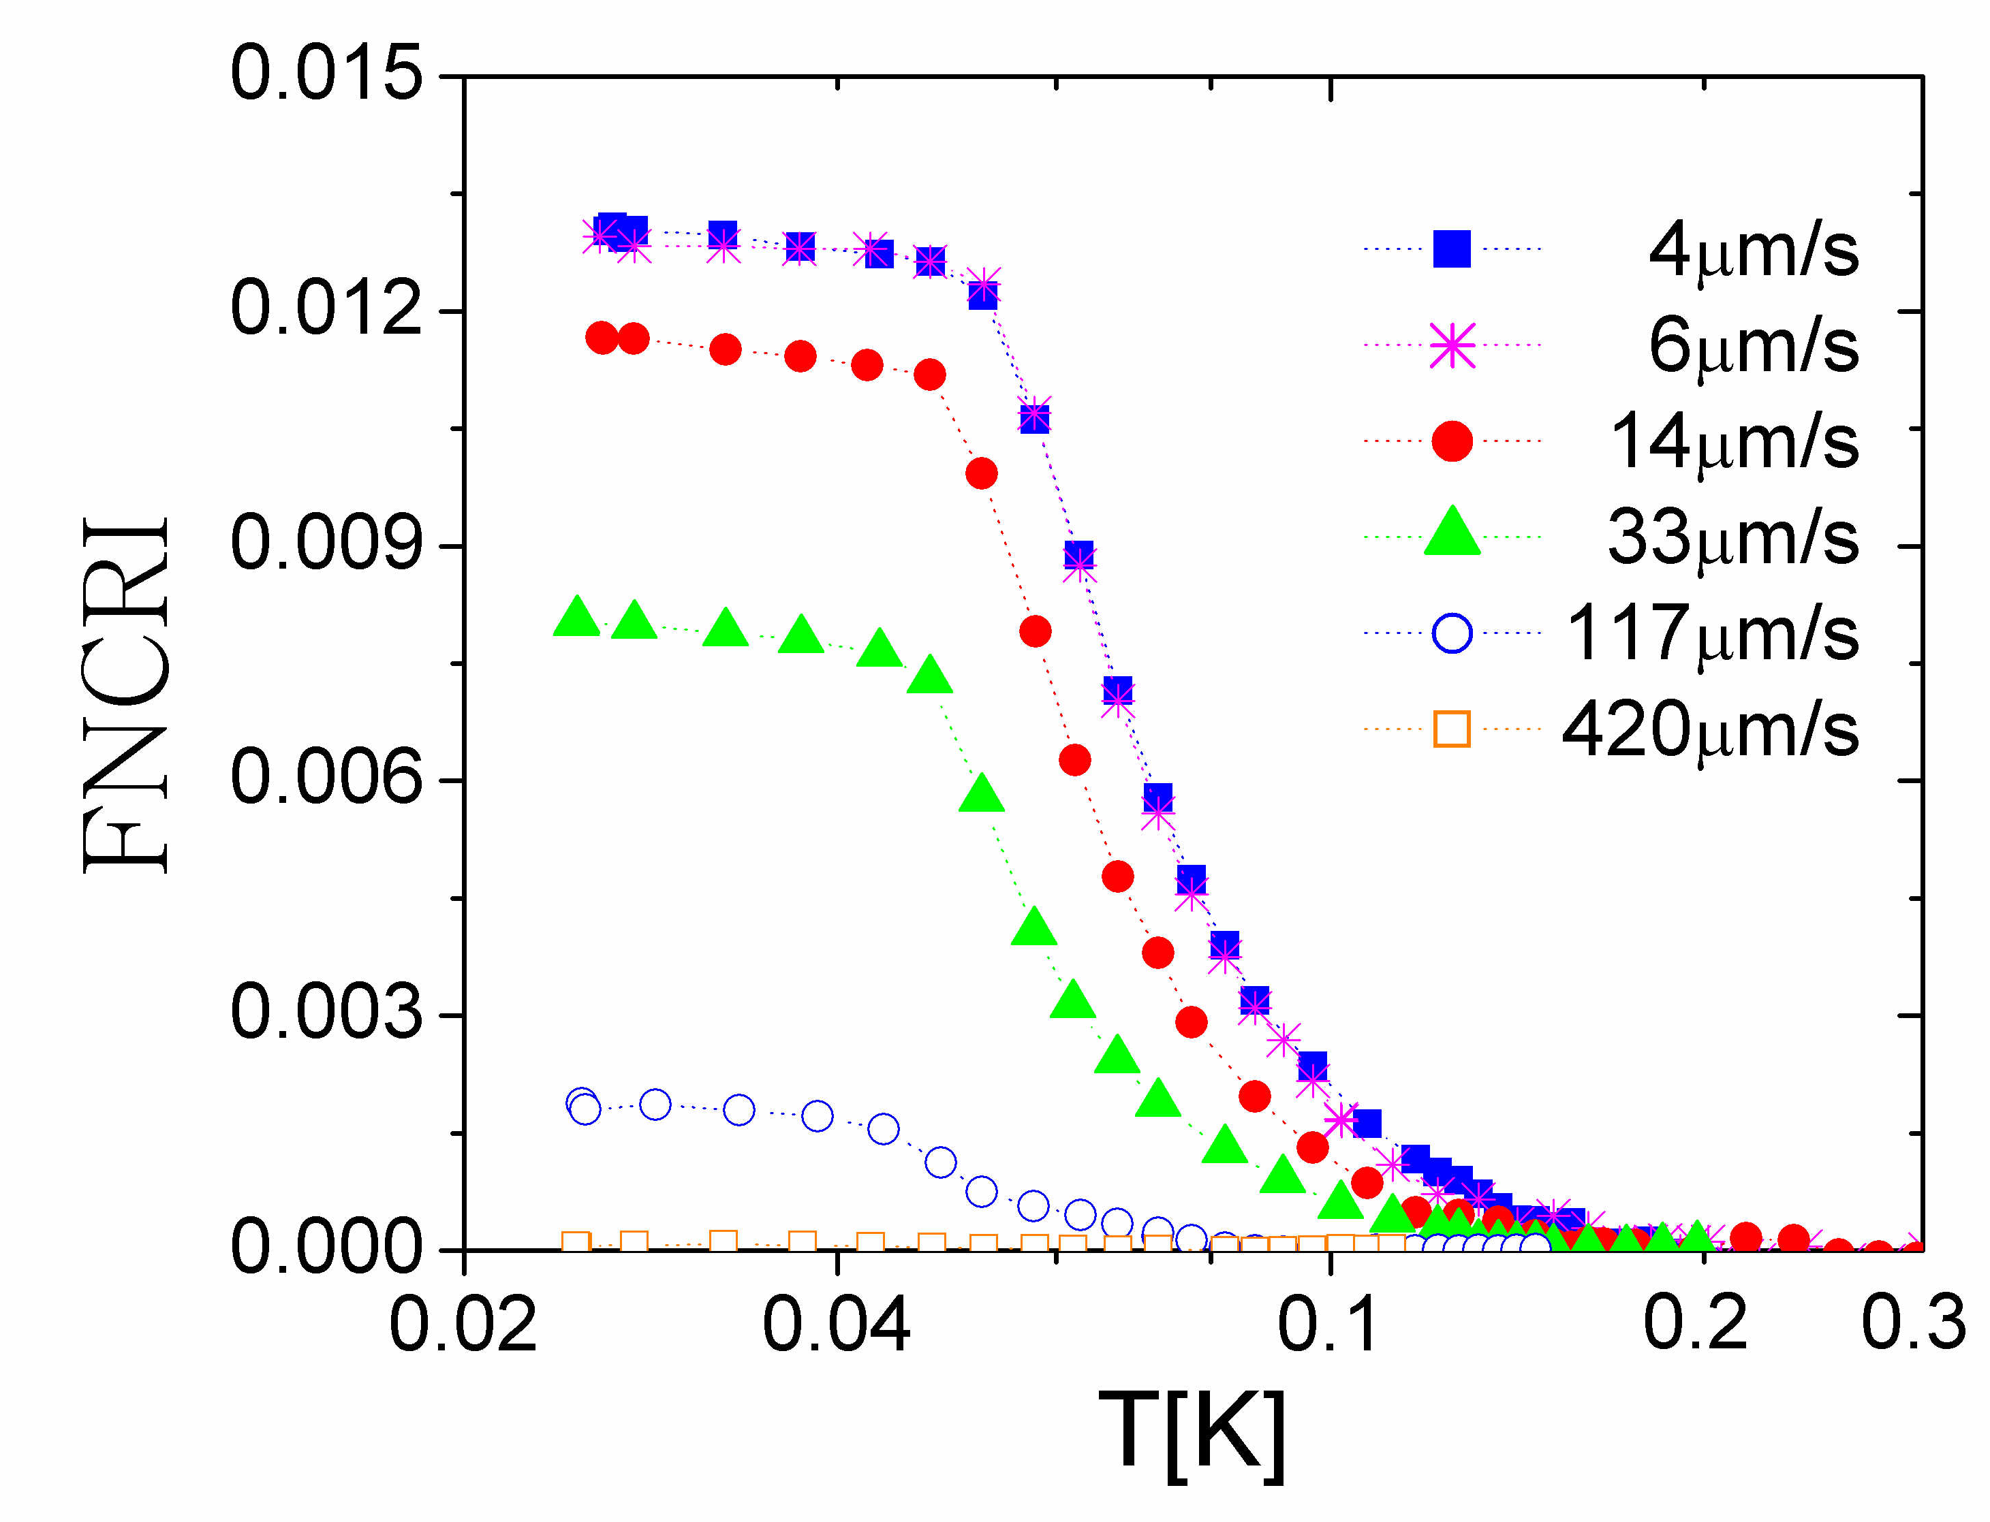
could solid helium 4 flow like a superfluid ?
E. Kim and M. Chan (Penn. State U. 2004):
a « torsional oscillator » (~1 kHz)
a change in the resonance period below ~100 mK
1 % of the solid mass decouples from the oscillating walls ?
no effect in helium 3 (fermions)
rigid axis
( Be-Cu)
solid He
in a box
excitation
detection
superfluid fraction (NCRIF)
Temperature (K)

Slide 6
a historical model
Thouless 1969,
Andreev and Lifshitz 1969:
delocalized vacancies could exist at T = 0
E₀
zhν
( the crystal would be « incommensurate »)
BEC => superfluid flow of mass
coexistence of non-zero shear modulus and mass superflow
A.J. Leggett (1970): non-classical rotation + bounds for the superfluid fraction
But hν ~1.6 K and the bottom of the vacancy band is at + 13K (Clark and Ceperley 2008)
This model looks irrelevant to me despite several articles by P.W. Anderson

Slide 7
Day and Beamish (2007) : supersolid helium 4 is stiffer than normal solid helium 4
the shear modulus increases by ~ 10 % below ~ 100 mK
the temperature variation is the same as for the rotational inertia
West, Chan, Day and Beamish, Nature Physics 5, 598 (2009):
it is not a coincidence
hcp ⁴He shows stiffening and supersolidity
hcp ³He shows stiffening but no supersolidity
the period change of the oscialltor is not due to an increase of the quantity K in τ = 2π √I/K
the rotation anomaly and the elastic anomaly are the 2 consequences of a single phenomenon . Which phenomenon ?

Slide 8
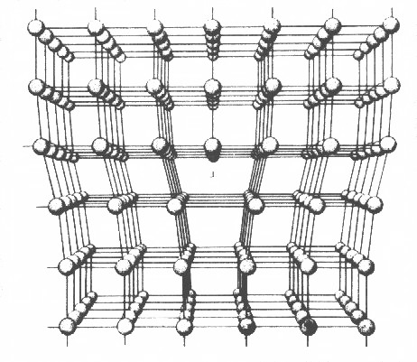
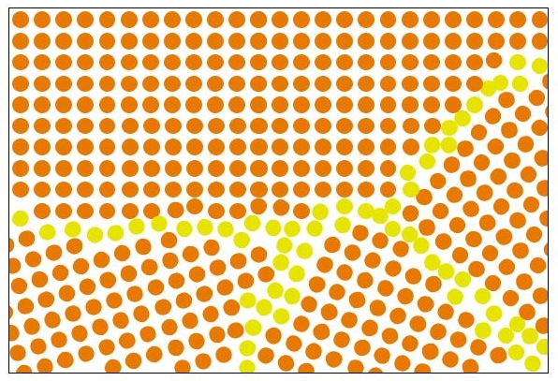
disorder
there are defects in real solid samples
dislocations in single crystals grain boundaries in polycrystals
perhaps glassy regions in quench frozen samples?
where atoms are loosely packed and exchange is easier
=> supersolidity could exist inside defects
(Pollet, Boninsegni, Svistunov, Prokofev, Kuklov, Troyer et al. 2007-2008)
impurities ( ³He) could bind to defects and change their properties
(Kuklov 2009)
the observed anomalies appear highly sensitive to
- the amount of disorder (rarely characterized...)
- the ³He concentration (even below 10⁻⁹!)
see Kim et al., Rittner and Reppy, Day and Beamish, Rojas et al.( ENS 2009)...

Slide 9
a model for the elastic anomaly
Following previous work by Iwasa and Suzuki (1980) and by Paalanen (1981),
Day and Beamish propose in 2007:
³He bind to dislocations
below a temperature which depends
on their binding energy ε_{B}
and on their concentration X₃
T > ε_{B}
T << ε_{B}
A crystal with mobile dislocations is softer than if they are pinned by impurities
Syshchenko Day and Beamish (Phys. Rev. Lett. 2010) :
measurements as a function of frequency and of the concentration X₃
precise agreement if ε_{B} = 0.73 ± 0.45 K
measurements made on polycrystals...

Slide 10
a possible model for supersolidity superfluid flow only if dislocations do not fluctuate (pinning)
dislocation lines
³He
impurity
kinks
transverse fluctuations of the dislocation lines could induce local mass currents, consequently phase fluctuations which destroy the quantum coherence
Inversely, if the line is superfluid, the phase is blocked and the line should be fixed
difficulties: a very large dislocation density is needed in order to obtain phase coherence at Tc ~100 mK and ~1% supersolid fraction

Slide 11
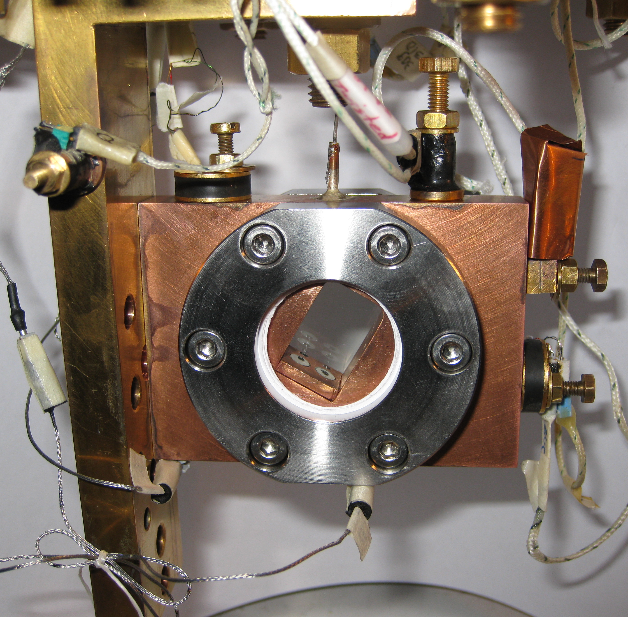
acoustic measurements in oriented single crystals
a retangular hole
18 x 12 x 11 mm³
in a copper plate
+ 2 sapphire windows,
In rings and
stainless steel clamps
fill line (0.1 mm ID) at the top
(the cell is tilted)
optical control of the crystal growth
2 piezo-electric transducers for the excitation and detection of acoustic resonances in the helium sample

Slide 12
consequences at the macroscopic scale
polycrystal at Cst V
low quality single
crystal at Cst T and P
high quality single
crystal at Cst T and P
Ruutu et al. (1997): 0 to 100 dislocations / cm² if grown slowly near 20mK

Slide 13
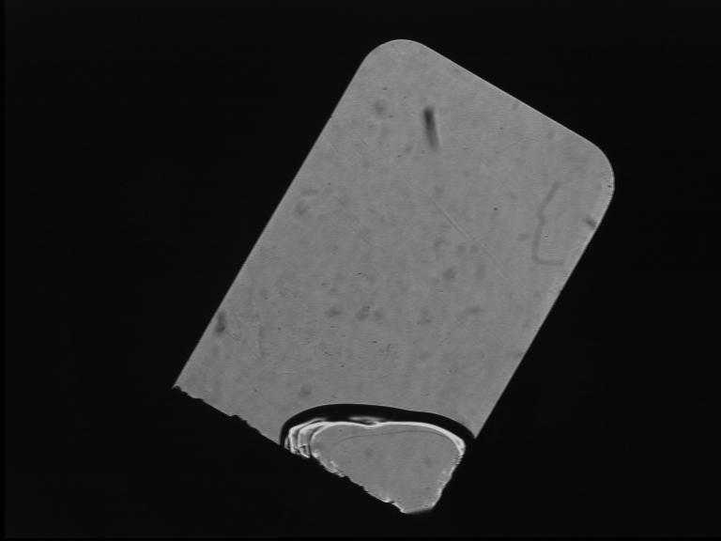
growth of a low quality crystal
X4a at 1.4 K
when cooled down along the melting curve, P decreases by ~1 bar
large stresses produce a large disorder (see M.Thiel et al. 1992)

Slide 14
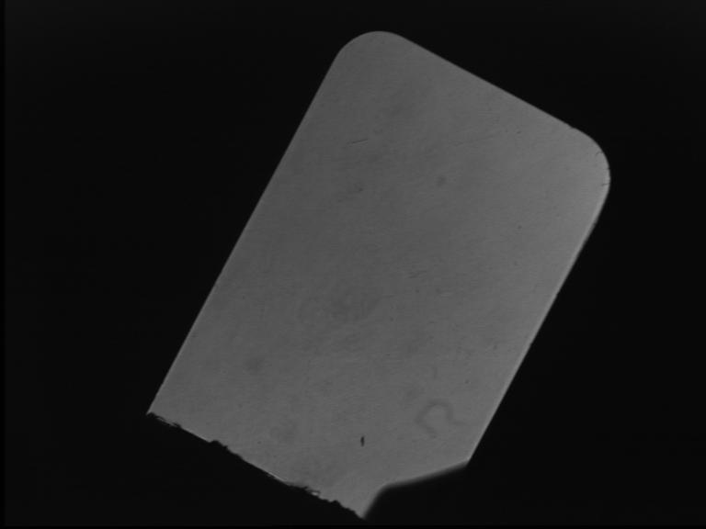
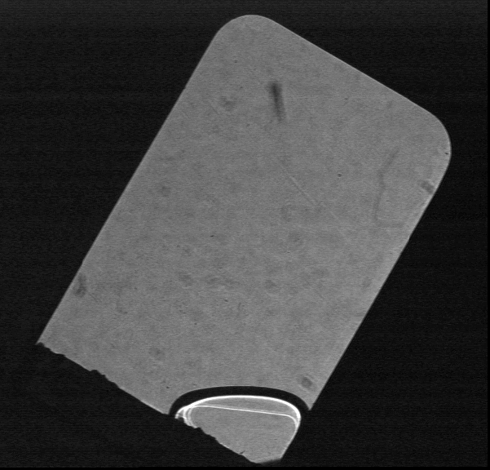
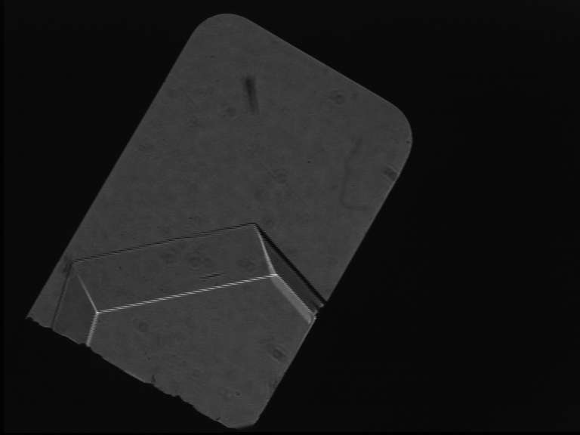
high quality ultrapure crystals (0.4 ppb ³He)
fast growth
in ~ 30 sec
slow growth
at 25 mK
in ~12 hrs
It is possible to melt and regrow crystals with the same orientation and variable disorder
The orientation is measured from the fast growth shape
liquid
a
c

Slide 15
acoustic measurements
L=12mm
2 longitudinal transducers (PZT)
we measure the resonance frequency of the fundamental mode in the cell
It depends on all elastic coefficients c11, c13, c33, c44 and c66
Comparison with a numerical calculation by
HJ Maris
excitation
detection
a very low level of excitation: 4 mV correspond to 3.2 10⁻³ Angström displacement
maximum strain at resonance: ε = 0.8 10⁻⁸ , less than the threshold for non linear behavior measured by Day and Beamish (3 10⁻⁸)
Note: the crystals are studied at the liq-solid equilibrium P_{m}(T)
some slits in the cell remain liquid

Slide 16
temperature dependence
liquid
a
c
crystal
X5c
the resonance frequency decreases
( the crystal softens)
as T increases from 24 to 100 mK

Slide 17
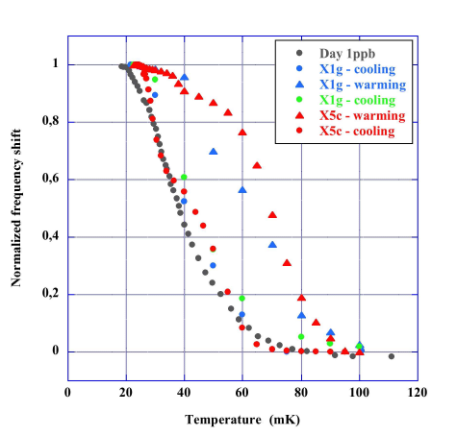
low quality single crystals and polycrystals
a comparison with polycrystals
of similar purity (< 1 ppb ³He)
studied by Day and Beamish (2007) :
during cooling single crystals
show a similar stiffening
consistent with the accepted model
(Iwasa 1980, Paalanen 1981, Day 2007)
T-dependent pinning of dislocations
a crossover from network pinning
to impurity pinning
the grains do not slip
grain boundaries are not liquid

Slide 18
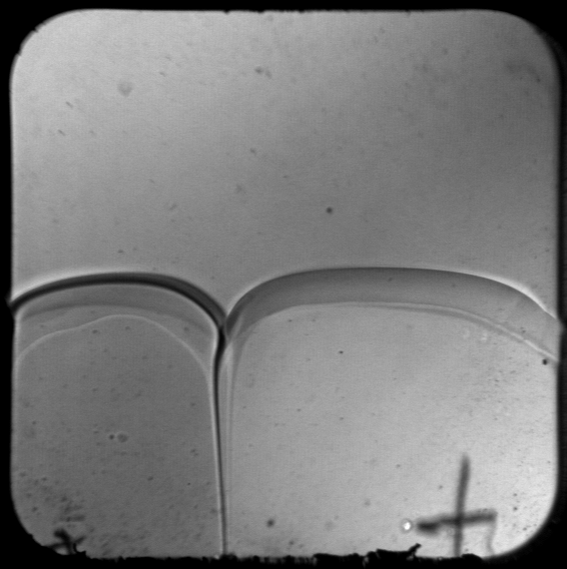
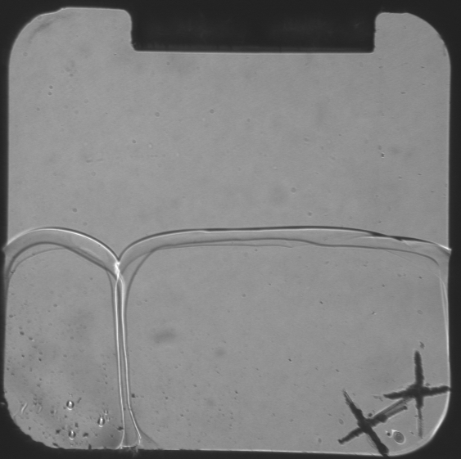
2 crystals + 1 grain boundary
cell thickness 10 mm
cell thickness 3 mm
angle 2θ
the groove angle is non-zero => the grain boundary energy σ_{GB} is strictly < 2 σ_{LS}
=> microscopic thickness , in agreement with Pollet et al. (2007) and with general arguments (long range forces).
A complete wetting would imply σ_{GB} = 2 σ_{LS} (2 liq-sol interfaces with liquid in between)
see Sasaki et al. PRL 2007 and JLTP 2008

Slide 19
low quality single crystals and polycrystals
a comparison with polycrystals
of similar purity (<1 ppb ³He)
studied by Day and Beamish (2007) :
during cooling single crystals
show a similar stiffening
consistent with the accepted model
(Iwasa 1980, Paalanen 1981, Day 2007)
T-dependent pinning of dislocations
a crossover from
network pinning to impurity pinning
the grains do not slip
grain boundaries are not liquid
hysteresis:
- depends on warming rate,
not observed in polycrystals):
- dislocations exert a force on impurities
which depends on the pinning length

Slide 20
high quality single crystals
X5a
freshly grown X5a is soft
17.6 instead of 19.2 +/- 0.2 kHz
its sound velocity is typically
10% lower than it should ,
according to measurements of
the elastic coefficients by
Greywall at 1.2K where
the motion of dislocations
is damped by thermal fluctuations
fresh from growth, this crystal
contains NO impurity

Slide 21
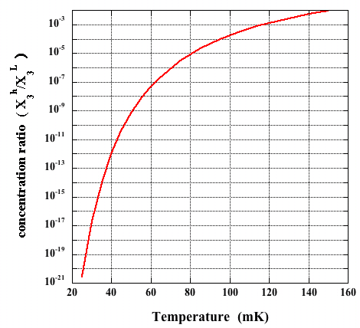
No ³He impurities in perfect crystals...
During slow growth ( 12 hrs),
quasi-equilibrium
at the solid-liquid interface.
The concentration ratio is
(Pantalei et al. JLTP 2010
Edwards and Balibar PRB 1989)
at 25 mK:
starting with X₃^{L} = 4 10⁻¹⁰ one obtains X₃^{h} = 4 10⁻³¹.

Slide 22
high quality single crystals
freshly grown X5a is soft
17.6 instead of 19.2 +/- 0.2 kHz
1st warm up:
the stiffness increases
a variation opposite to all previous observations
- some ³He come out of the liquid and strongly bind to dislocations
- slanted dislocations may also fall in Peierls potential valleys (Kuklov et al. 2010)
1st cool down:
with ³He inside the crystal, dislocations get pinned
the stiffness increases again
successive T cycles:
the res. freq. varies between 18 and 19.4 kHz
the amount of ³He in the crystal should depend on
the highest T reached

Slide 23
the stiff state at low T is not stable
at 20 mK, ³He do not stay bound on dislocations
the stiff state relaxes to the soft state with a time constant of order 100 hrs
probably because ³He atoms escape from dislocations with a probability ~ exp(-E_{B}/T) and finally reach the liquid
much faster in the presence of mechanical vibrations

Slide 24
a high quality crystal annealed at 950 mK : X5b
after annealing at 0.95K
the resonance freqency is now reduced to 15.9 kHz at high T
According to Maris'calculations,
this corresponds to c₄₄ being reduced to 14% of its normal value.
a mosaic structure improved by the annealing
The T-dependence varies as a function of
- cooling rate
- vibration level (1K pot)
regrowth at 1.21K produces disorder (P_{m}(T) now varies)
- weaker softening

Slide 25
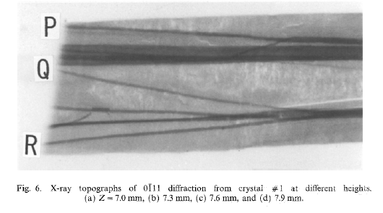
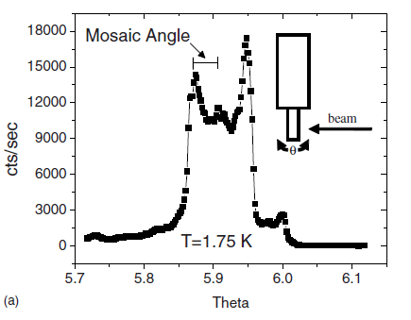
a mosaic structure
According to J. Friedel (see "Dislocations", Pergamon Press 1964)
a network of single dislocation lines would only allow ~ 5% change in the shear modulus c44
The change may increase up to 100% and c44 vanish in the case of a mosaic structure where dislocations group together in low angle grain boundaries
d
dislocations form low angle grain boundary
Iwasa et al. JLTP 1995
Burns et al. Phys Rev. B 2008

Slide 26
astonishing quantum plasticity in high quality ⁴He crystals
86% reduction in c₄₄ means that the strain is dominated by the motion of dislocations
σ = c₄₄ (ε_{l} + ε_{d}) where there is a lattice contribution and a dislocation contribution
a large dislocation motion leads to a large strain ε_{d} and consequently to
a small effective shear modulus, as observed in the experiment
A
how large ?
with ε = 10⁻⁸ and (ε_{l} + ε_{d}) ~ ε_{d} = (Λ A b)/ L_{n}
Λ : dislocation density ~ 100 cm⁻²
A: area scanned by the moving dislocation
b : Burgers vector
one finds that , under the applied acoustic field,
the dislocations move 80 μm at 16 kHz, meaning at typical velocities of 8 m/s
motion by tunneling of their kinks
δl
L_{n}

Slide 27
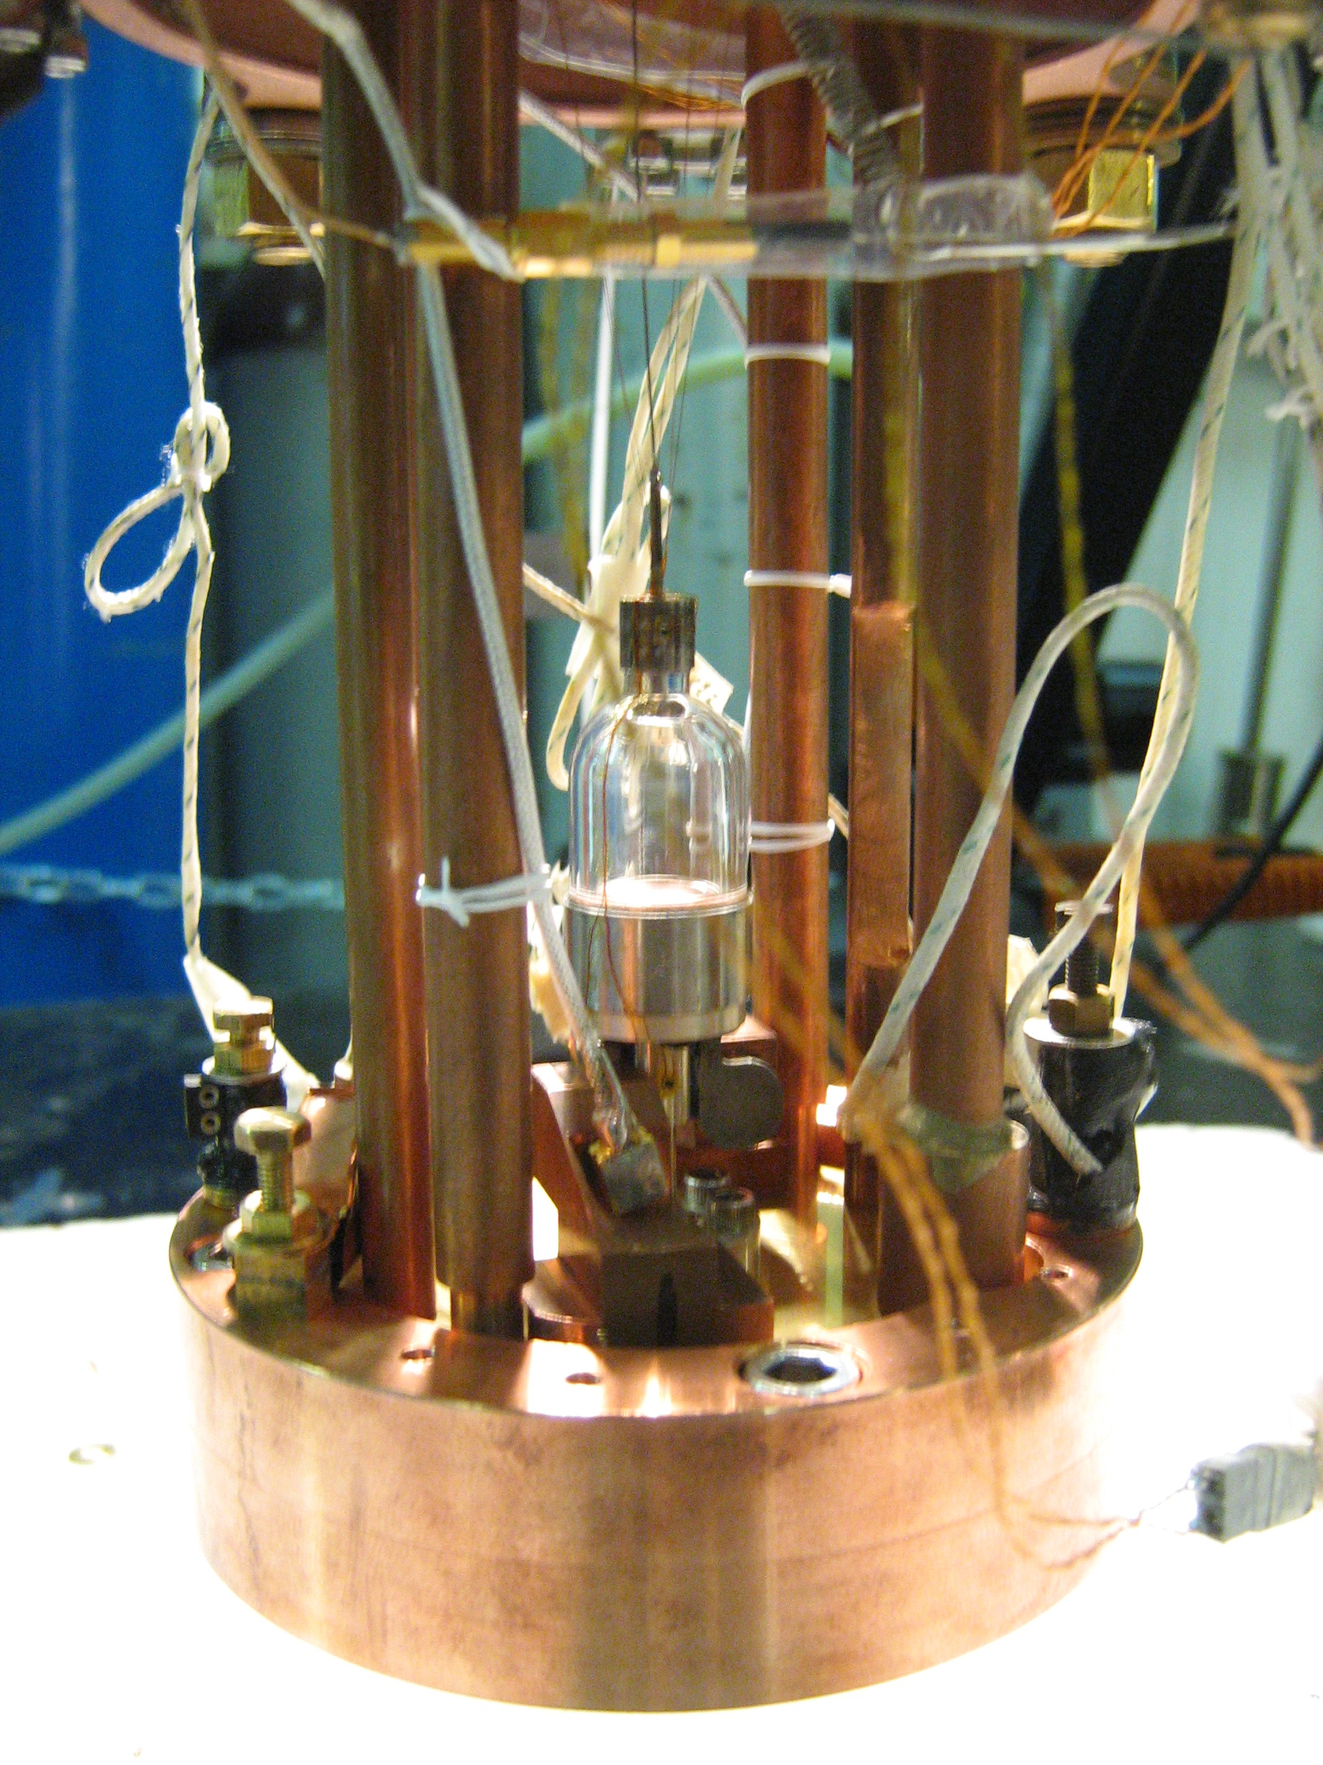
Conclusion:
quantum plasticity vs supersolidity
Quantum plasticity of ⁴He crystals
if their dislocations are mobile:
- no ³He impurities
- T > Tc ~ 100mK where ³He impurities unbind but T < 1K ( thermal damping)
apparently, the shear modulus c₄₄ nearly vanishes
What about the other elastic coefficients ?
measure more resonance modes in a better cell
should quatum plasticity disappear
for supersolidity to appear ?
to be checked by studying the rotational properties
of crystals similar to those presented in this talk
a transparent torsional oscillator built
in collaboration with J. West and M. Chan (Penn. State)

Slide 28
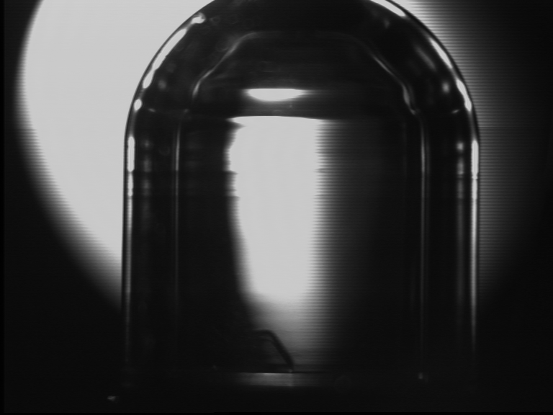
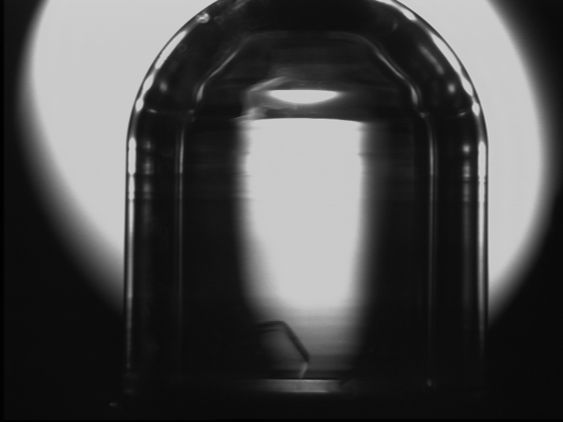
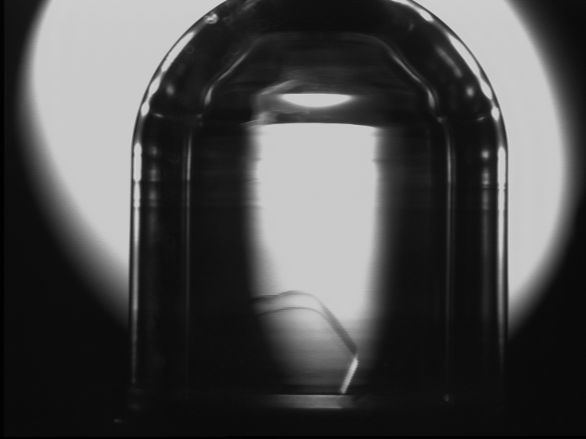
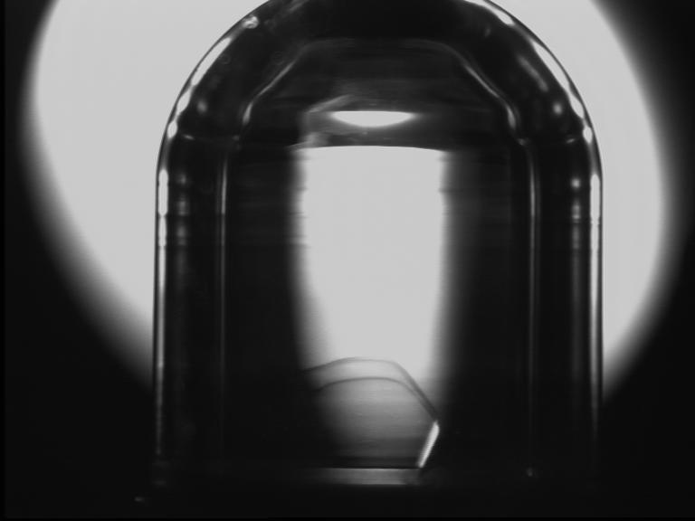
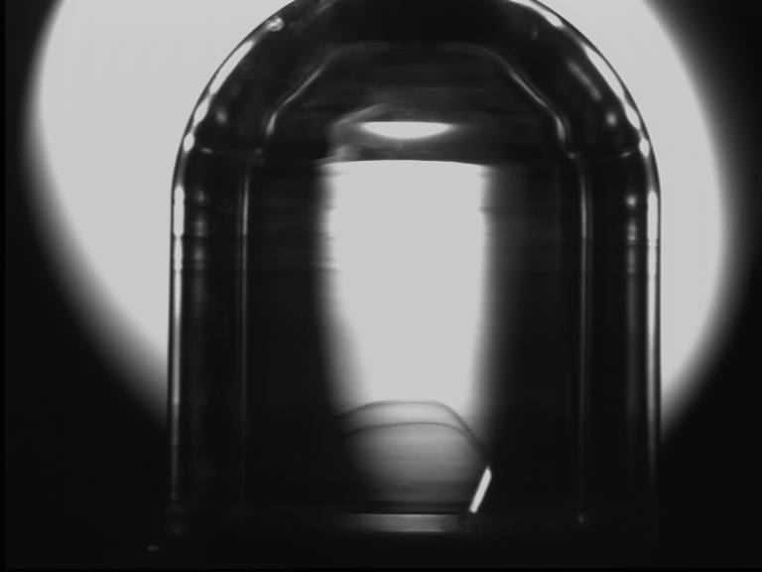
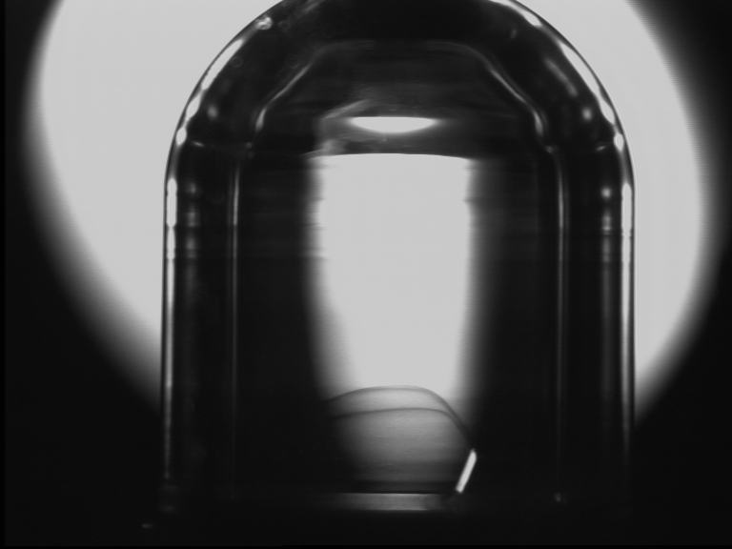
Facets of a single crystal in the minibottle
Fast growth at low T
Notes:
We did single crystals, we see facets on these photos during fast growth

Slide 29
future experiments
make simultaneous measurements of
the elastic and the rotation properties
vary and measure the density of dislocations Λ
the rotation anomaly should increase with Λ
the elastic anomaly should decrease with L

Slide 31
... nor in the presence of some dislocations
on dislocations,
the binding energy of ³He is
E_{B} = 0.73 ± 0.45 K
(Syshchenko et al. PRL 2010)
Even the lowest energy states are higher than in the liquid
the concentration of ³He on dislocations
X₃^{d} < X₃^{L} = 4 10⁻¹⁰
the maximum distance between ³He on dislocations is
L_{i} = a/X₃^{d} > 100 cm
while the cell width is 1 cm
=> with a dislocation density of order 100 cm⁻², there is
at most one ³He atom on the whole dislocation network
bulk solid
0.73 K
1.359 K
dislocations
liquid
L_{i}
a
³He
³He

Slide 32
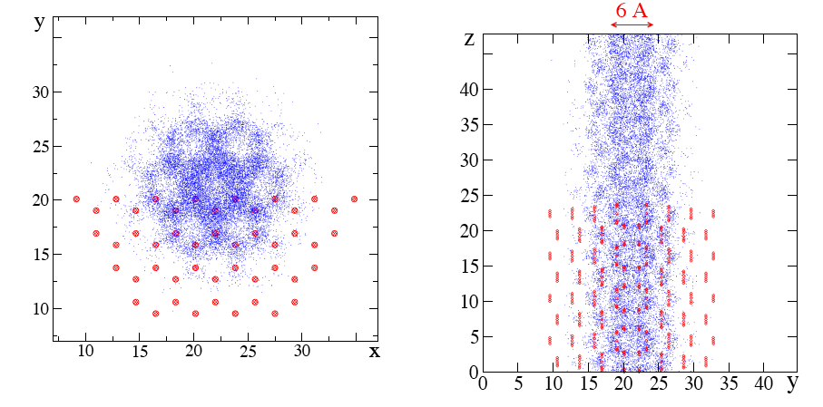
a superfluid network of dislocations ?
Boninsegni et al. PRL 2007
along a 1D - dislocation, the coherence length ξ ~ a (T*/T)
quantum coherence should percolate dans un réseau through the 3D network of
dislocation lines (Shevchenko 1987)
difficulties: a very large dislocation density is needed in order to reach
Tc ~100 mK and ~1% supersolid fraction

Slide 33
comment vérifier ?
mesurer à la fois les propriétés de rotation et les propriétés élastiques dans des cristaux où l'on fait varier:
- la densité de dislocations (de 0 à 10¹² disloc/cm² à mesurer par atténuation ultrasonore)
- la concentration en impuretés ³He (entre 10⁻³⁰ à 10⁻⁶ )
cellule acoustique (X. Rojas, A. Haziot et al.
Phys. Rev. Lett. 131, 147503, 2010)
un oscillateur de torsion transparent
construit avec J. West et M. Chan (Penn State)

