Slide 1
Anomalous softening of ⁴He crystals
S. Balibar , V. Bapst, A. Haziot, X. Rojas
Laboratoire de Physique Statistique,
Ecole Normale Supérieure et CNRS,
associated to the Universities Paris 6 & 7, Paris (France)
and H.J. Maris (Brown University, USA)
QFS, Grenoble
August 2010

Slide 2
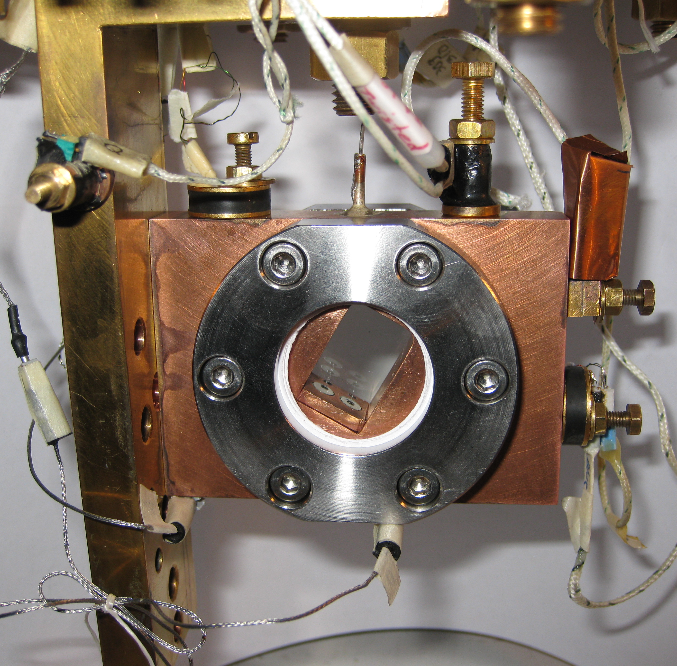
a transparent cell for acoustic measurements
a retangular hole
18 x 12 x 11 mm³
in a copper plate
+ 2 sapphire windows,
In rings and
stainless steel clamps
fill line (0.1 mm ID) at the top
(the cell is tilted)
optical control of the crystal growth
2 piezo-electric transducers for the excitation and detection of acoustic resonances in the helium sample

Slide 3
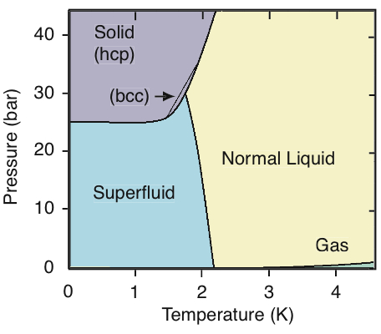
different growth conditions => different quality crystals
polycrystal at Cst V
low quality single
crystal at Cst T and P
high quality single
crystal at Cst T and P
Ruutu et al. (1997): 0 to 100 dislocations / cm² if grown slowly near 20mK

Slide 4
growth of a low quality crystal
X4a at 1.4 K
when cooled cown along the melting curve, P decreases by ~1 bar
large stresses produce a large disorder (see M.Thiel et al. 1992)

Slide 5
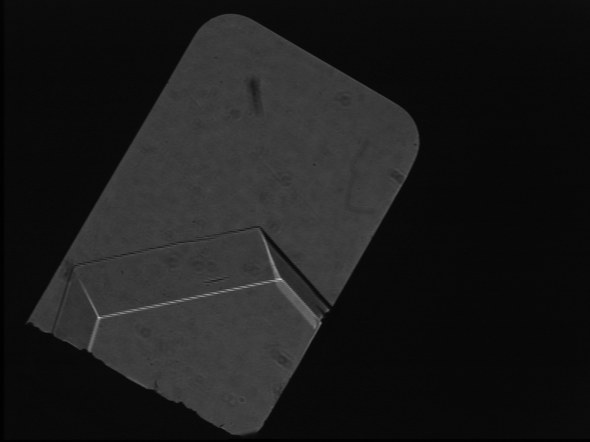
high quality ultrapure (0.4 ppb ³He) crystals
fast growth
in ~ 30 sec
slow growth
at 25 mK
in ~12 hrs
It is possible to melt and regrow crystals with the same orientation and variable disorder
The orientation is measured from the fast growth shape
liquid
a
c

Slide 6
acoustic measurements
L=12mm
2 longitudinal transducers (PZT)
we measure the resonance frequency of the fundamental mode in the cell
It depends on all elastic coefficients c11, c13, c33, c44 and c66
Comparison with a numerical calculation by
HJ Maris
excitation
detection
a very low level of excitation: 4 mV correspond to 3.2 10⁻³ Angström displacement
maximum strain at resonance: ε = 0.8 10⁻⁸ , less than the threshold for non linear behavior measured by Day and Beamish (3 10⁻⁸)
Note: the crystals are studied at the liq-solid equilibrium P_{m}(T)
some slits in the cell remain liquid

Slide 7
temperature dependence
liquid
a
c
crystal
X5c
the resonance frequency decreases
( the crystal softens)
as T increases from 24 to 100 mK

Slide 8
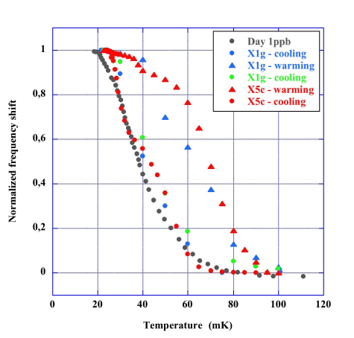
low quality single crystals and polycrystals
a comparison with polycrystals
of similar purity (< 1 ppb ³He)
studied by Day and Beamish (2007) :
during cooling single crystals
show a similar stiffening
consistent with the accepted model
(Iwasa 1980, Paalanen 1981, Day 2007)
T-dependent pinning of dislocations
a crossover from network pinning
to impurity pinning
the grains do not slip
grain boundaries are not liquid

Slide 9
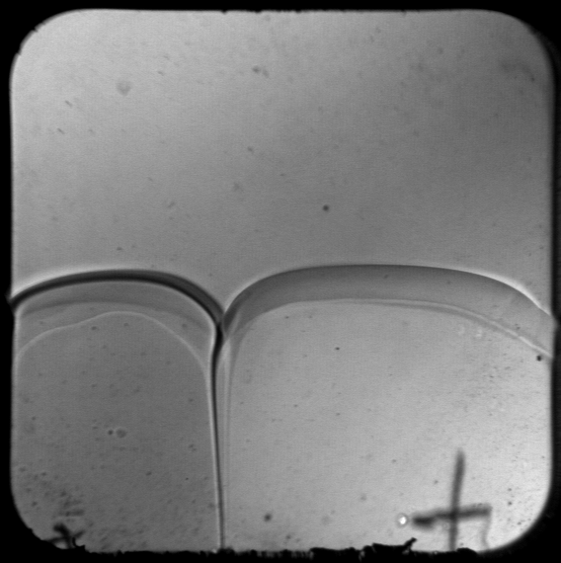
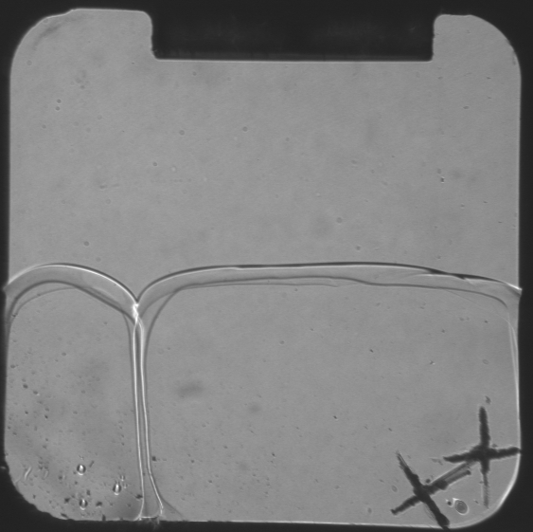
2 crystals + 1 grain boundary
cell thickness 10 mm
cell thickness 3 mm
angle 2θ
the groove angle is non-zero => the grain boundary energy σ_{GB} is strictly < 2 σ_{LS}
=> microscopic thickness , in agreement with Pollet et al. (2007) and with general arguments (long range forces).
A complete wetting would imply σ_{GB} = 2 σ_{LS} (2 liq-sol interfaces with liquid in between)
see Sasaki et al. PRL 2007 and JLTP 2008

Slide 10
low quality single crystals and polycrystals
a comparison with polycrystals
of similar purity (<1 ppb ³He)
studied by Day and Beamish (2007) :
during cooling single crystals
show a similar stiffening
consistent with the accepted model
(Iwasa 1980, Paalanen 1981, Day 2007)
T-dependent pinning of dislocations
a crossover from
network pinning to impurity pinning
the grains do not slip
grain boundaries are not liquid
hysteresis:
- depends on warming rate,
not observed in polycrystals):
- dislocations exert a force on impurities
which depends on the pinning length

Slide 11
high quality single crystals
freshly grown X5a is soft
17.6 instead of 19.2 +/- 0.2 kHz
its sound velocity is typically
10% lower than it should ,
according to measurements of
the elastic coefficients by
Greywall at 1.2K
fresh from growth, this crystal
contains NO impurity

Slide 12
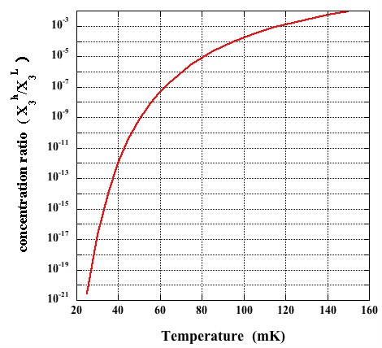
No ³He impurities in perfect crystals...
During slow growth ( 12 hrs),
quasi-equilibrium
at the solid-liquid interface.
The concentration ratio is
(Pantalei et al. JLTP 2010
Edwards and Balibar PRB 1989)
at 25 mK:
starting with X₃^{L} = 4 10⁻¹⁰ one obtains X₃^{h} = 4 10⁻³¹.

Slide 13
... nor in the presence of some dislocations
on dislocations,
the binding energy of ³He is
E_{B} = 0.73 ± 0.45 K
(Syshchenko et al. PRL 2010)
Even the lowest energy states are higher than in the liquid
the concentration of ³He on dislocations
X₃^{d} < X₃^{L} = 4 10⁻¹⁰
the maximum distance between ³He on dislocations is
L_{i} = a/X₃^{d} > 100 cm
while the cell width is 1 cm
=> with a dislocation density of order 100 cm⁻², there is
at most one ³He atom on the whole dislocation network
bulk solid
0.73 K
1.359 K
dislocations
liquid
L_{i}
a
³He
³He

Slide 14
high quality single crystals
freshly grown X5a is soft
17.6 instead of 19.2 +/- 0.2 kHz
1st warm up:
the stiffness increases
a variation opposite to all previous observations
- some ³He come out of the liquid and strongly bind to dislocations
- slanted dislocations may also fall in Peierls potential valleys (Kuklov et al. 2010)
1st cool down:
with ³He inside the crystal, dislocations get pinned
the stiffness increases again
successive T cycles:
the res. freq. varies between 18 and 19.4 kHz
the amount of ³He in the crystal should depend on
the highest T reached

Slide 15
the stiff state at low T is not stable
at 20 mK, ³He do not stay bound on dislocations
the stiff state relaxes to the soft state with a time constant of order 100 hrs
probably because ³He atoms escape from dislocations with a probability ~ exp(-E_{B}/T) and finally reach the liquid
much faster in the presence of mechanical vibrations

Slide 16
a high quality crystal annealed at 950 mK : X5b
after annealing at 0.95K
the resonance freqency is now reduced to 15.9 kHz at high T
According to Maris'calculations,
this corresponds to c₄₄ being reduced to 14% of its normal value. a mosaic structure improved by the annealing
The T-dependence varies as a function of
- cooling rate
- vibration level (1K pot)
regrowth at 1.21K produces disorder (P_{m}(T) now varies)
- weaker softening

Slide 17
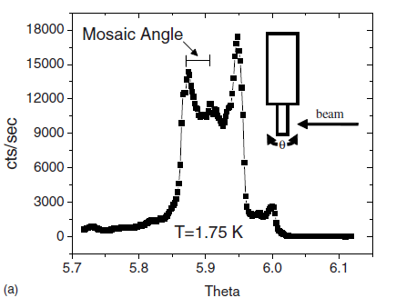
a mosaic structure
According to J. Friedel
(see "Dislocations", Oxford U. Press)
a network of single dislocation lines would only allow ~ 5% change in the shear modulus c44
The change may increase up to 100% and c44 vanish in the case of a mosaic structure where dislocations group together in low angle grain boundaries
d
where is the density of
dislocations in the low angle grain boundary
Iwasa et al. JLTP 1995
Burns et al. Phys Rev. B 2008

Slide 18
astonishing quantum plasticity in high quality ⁴He crystals
86% reduction in c₄₄ means that the strain is dominated by the motion of dislocations
σ = c₄₄ (ε_{l} + ε_{d}) where there is a lattice contribution and a dislocation contribution
a large dislocation motion leads to a large strain ε_{d} and consequently to
a small effective shear modulus, as observed in the experiment
A
how large ?
with ε = 10⁻⁸ and (ε_{l} + ε_{d}) ~ ε_{d} = Λ A b
Λ : dislocation density ~ 100 cm⁻²
A area scanned by the moving dislocation
b : Burgers vector
one finds that , under the applied acoustic field,
the dislocations move 80 μm at 16 kHz, meaning at typical velocities of 8 m/s
motion by tunneling of their kinks
δl
Ln

Slide 19
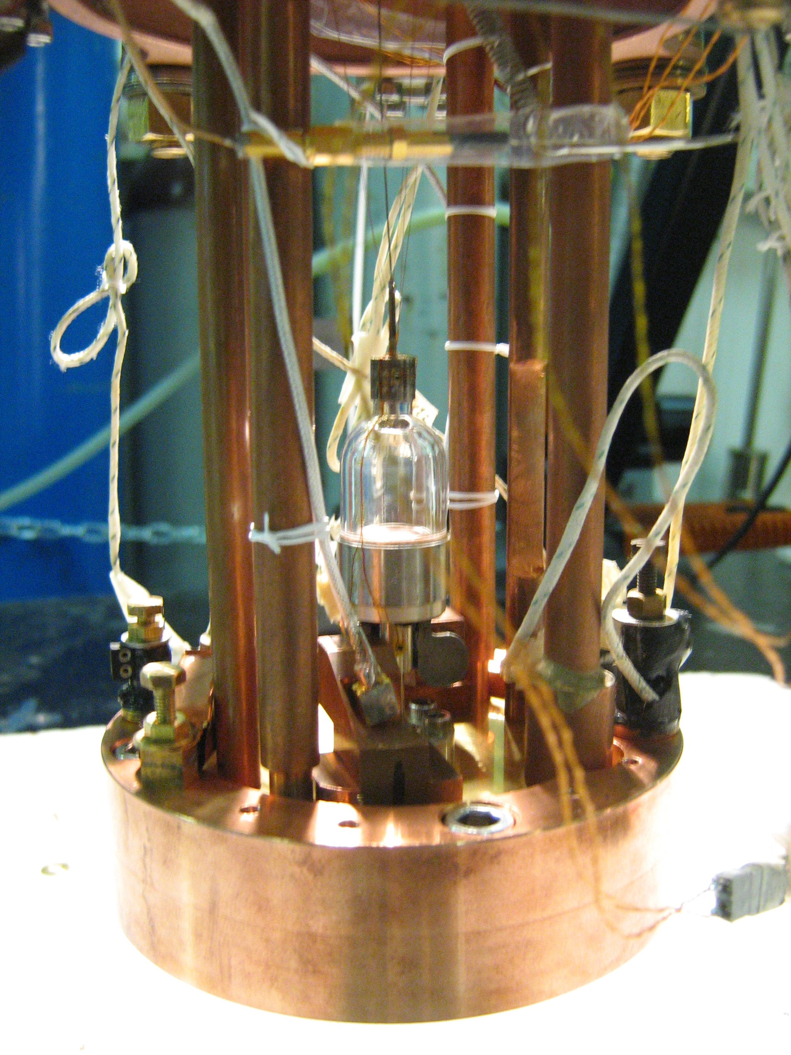
conclusion
⁴He crystals are anomalously soft if their dislocations are mobile:
- no ³He impurities
- T > Tc ~ 100mK where ³He impurities unbind but T < 1K ( thermal damping)
high quality ⁴He crystals show a very large softening (up to 86% reduction in c₄₄),
a consequence of the mosaic structure + a very large mobility of dislocations at low T
relation with supersolidity ?
it is possible that mobile dislocations fluctuate
and consequently do not allow the phase coherence
necessary for the superfluidity of their cores
to be checked by studying the rotational properties
of crystals similar to those presented in this talk

Slide 20
growth of a low quality crystal

